Slide 1
MELT Class 1 Driver Training
Cargo securement and security
Notes:
Instructor notes:

Slide 2
Lesson overview
Cargo regulations
Handling cargo
Cargo loading and inspection
Types of cargo
Securement requirements
Weight distribution and load limits
Driver responsibilities
Cargo theft and security
Personal safety
Notes:
Instructor notes:

Slide 3
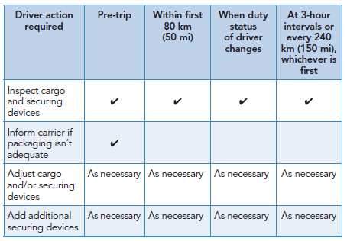
Drivers must inspect cargo at these points
Notes:
Instructor notes:
Review NSC requirements in the student guide.

Slide 4
Securement regulations
Regulations require you to secure the following equipment:
Tailgates
Tailboards
Doors
Tarps
Spare tires
Documentation is important.
Cargo must be loaded onto a vehicle so that it does not:
Obscure your vision
Interfere with your control of the vehicle
Block access to emergency equipment
Make it difficult for you or a passenger to get out of the vehicle
Your vision and vehicle access must not be blocked
Notes:
Instructor notes:
The cargo securement regulations use terms such as “immobilize”, “contain” and “restrain” to define how cargo might be secured on or within a vehicle. These terms really describe different ways of making cargo secure.
Immobilize means “not moving” or “incapable of being moved”.
Discuss the basic reasons for covering cargo—to protect cargo and prevent spills/loose cargo.
Discuss the types of coverings and decide which materials are best for what job. Also point out when certain types should not be used.
Discuss the importance of cargo documentation and why it must be left in an obvious place in the cab.
Discuss why it is important to verify that the cargo they’ll be transporting matches the paperwork and is properly secured

Slide 5
Securement systems
A cargo securement system combines the use of one or combination of the following components:
Vehicle structure
Securing devices
Blocking and bracing equipment
Dunnage
Load locking bars
Tarps
Notes:
Instructor notes:
Explain
You must be able to make any kind of maneuver with your vehicle, including a swerve, a sudden lane change or a panic stop, without worrying about the security of your load.
If you aren’t certain your load will be secure during such an event, or if you are afraid of what would happen to your load if you had to make an emergency stop, you better take a good look at the way the load is secured.

Slide 6
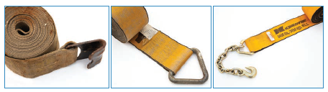
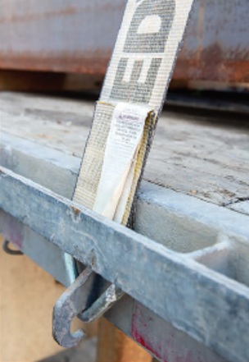
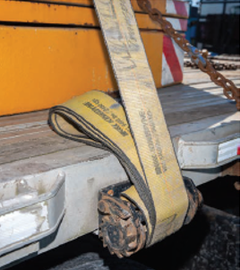
Securement systems - tiedowns
You may use tiedowns to produce only downward force, to provide restraint in a single direction or to provide restraint in several directions at the same time.
Notes:
Instructor notes:
Cargo tiedowns many be any of the following, or they may be assemblies that include more than one of these elements:
Chain
Web straps or synthetic webbing
Rope, natural or synthetic
Wire rope or cable
Steel strapping
A tiedown must be designed, constructed and maintained in a way that the driver can tighten it. To function properly, tiedowns must not:
Have knots or obvious damage
Be in distress
Have any weakened part or weakened section
Some tiedowns are passed over or through the cargo. When they are properly used, a downward force is created to increase the friction between the cargo and the vehicle’s deck. The friction created restrains the cargo.

Slide 7
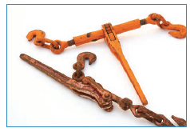
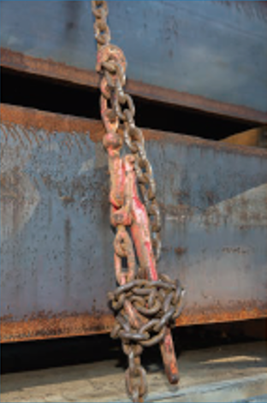
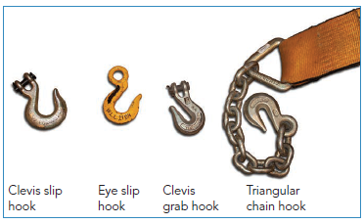
Securement devices - tiedowns
Notes:
Instructor notes:
No unmarked tie downs allowed - must be marked by the manufacturer with the Working Load Limit (WLL).
Securement devices must be strong enough to properly secure a load. Manufacturers test these devices to determine how much force can be applied to them before they will break.
The WLL of a securement device refers to the maximum load that may be applied to that device during normal service.
Tie downs must not come loose, unfastened, opened or released while the vehicle is moving.
All tie downs/securement systems must be located inside any rub rails whenever practical. Use edge protection where a tie down is subject to wear or cutting at the point where it touches an article of cargo. Edge protection must resist wear, cutting and crushing.

Slide 8
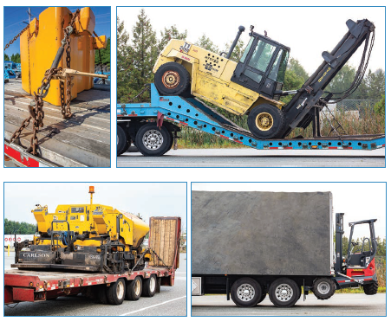
Chaining down an item
Notes:
Instructor notes:

Slide 9
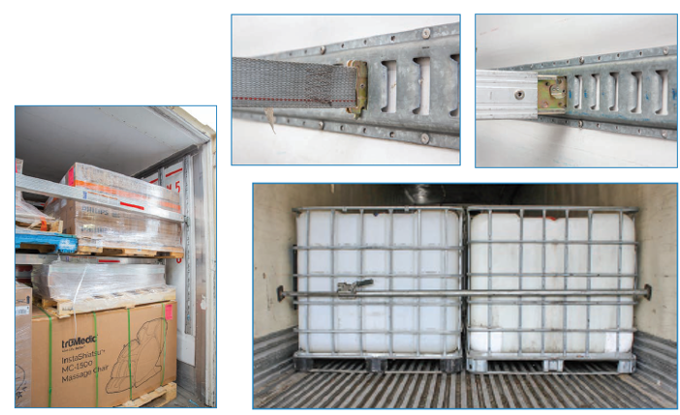
Securing freight in vans
E Track
Dunnage
Friction mats
Jack bars
Notes:
Instructor notes:

Slide 10
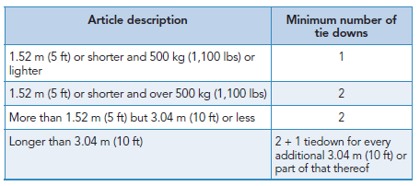
Securement devices - tiedowns
Notes:
Instructor notes:
Review the points in the lesson plan and chart information.
The table shows the minimum number of tie downs required if an article of cargo on or in a vehicle isn’t prevented from moving forward by a front end structure, tie down, other cargo or a device like the drop on a step deck trailer.
As a rough guide, use two tie downs for the first 3.04 metres (10 feet) of a load and one tie down for every 3.04 m (10 ft) after that.
Machinery or fabricated structural items that need special securement because of their size, design, shape or weight are exempted from these requirements.
NOTE: Before a securement system is selected, the driver must ensure that it is appropriate for the cargo size, shape, strength, and characteristics.

Slide 11
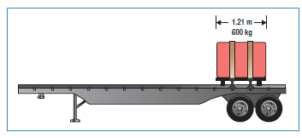
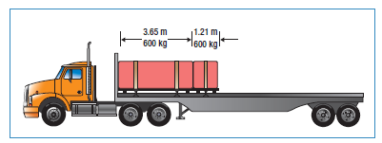
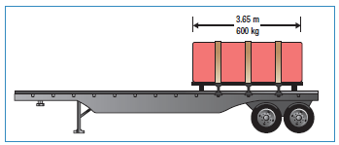
Working load limit (WLL)
The total working load limit of any cargo securement system must be at least half of the weight of the load being secured.
Notes:
Instructor notes:

Slide 12
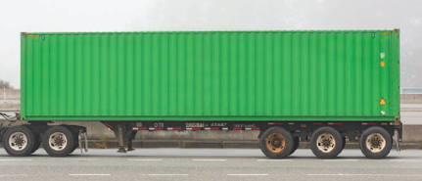
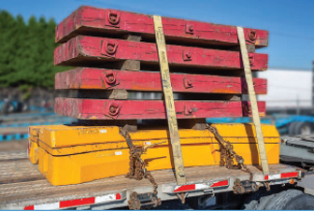
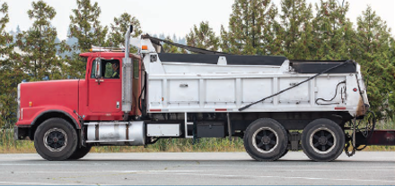
Securement systems - three ways to secure cargo on or within a vehicle
Immobilize Restrain Contain
Notes:
Instructor notes:
Articles of cargo that are likely to shift, tip or roll must be restrained by chocks, wedges, or a cradle to prevent movement. These restraints must stay fastened or secured while the vehicle is moving.
The proper securement of cargo is important not only for the protection of the cargo itself, but also for ensuring the safety of a driver and the motoring public. Cargo that shifts or tips may cause a vehicle to tip or operate in an unsafe manner.

Slide 13
Weight distribution
On every trip, you need to know:
the legal weight of the tractor-trailer,
the overall length of the vehicle,
the weight allowed per axle, and
all federal, provincial and municipal laws and restrictions.
Notes:
Instructor notes:
Discuss (see student guide for more information)
For easy handling of the truck, it is important that the cargo weight is properly distributed.
Fines imposed on drivers hauling loads that exceed weight limits can be very costly—to both carriers and drivers.
Weight limits and size limits. How weights are checked.
The importance of drivers being familiar with size and weight limits as they drive across the country.
How distributing weight correctly can prevent a truck from being classed as overweight.
Hazards of loads being hauled with weight improperly distributed.
More detail on this is covered in the documents and regulatory requirements – height and weight lesson.

Slide 14
Specific commodities securement
The next set of slides covers:
Logs
Dressed lumber
Metal coils
Paper rolls
Concrete pipe
Intermodal containers
Large boulders
Dry bulk and liquid tanks
Vehicles (small, large, crushed)
Crushed vehicles
Roll-on/roll-off or hook lift container
Covering cargo
Notes:
Instructor notes:
Use the following slides or images in the student guide to give a brief overview of methods of loading and securing different types of cargo. Students should receive training from the employer on the details.

Slide 15
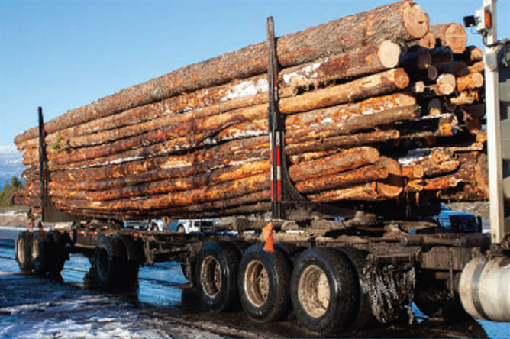
Logs
Notes:
Instructor notes:

Slide 16
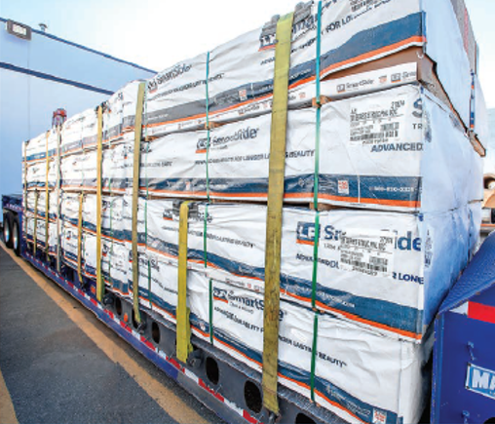
Dressed lumber
Notes:
Instructor notes:

Slide 17
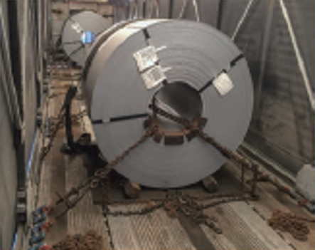
Metal coils
Notes:
Instructor notes:

Slide 18
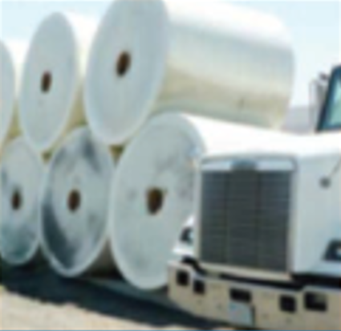
Paper rolls
Notes:
Instructor notes:

Slide 19
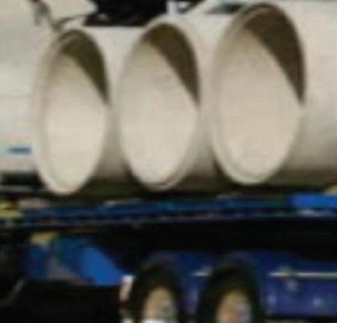
Concrete pipe
Notes:
Instructor notes:

Slide 20
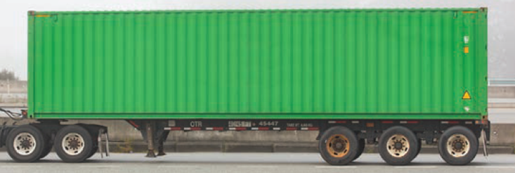
Intermodal container
Notes:
Instructor notes:

Slide 21
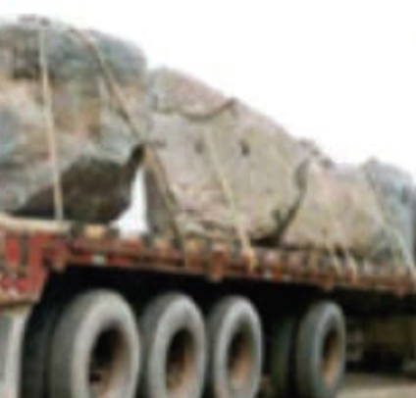
Boulders
Notes:
Instructor notes:

Slide 22
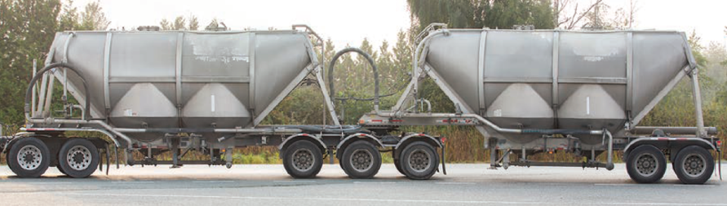
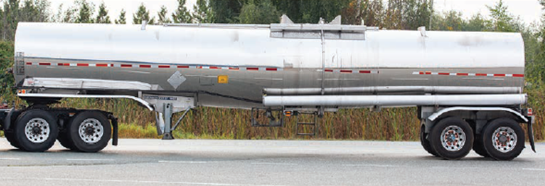
Dry bulk and liquid tanks
Notes:
Instructor notes:

Slide 23
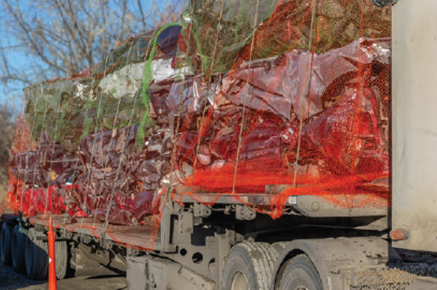
Vehicles
Notes:
Instructor notes:

Slide 24
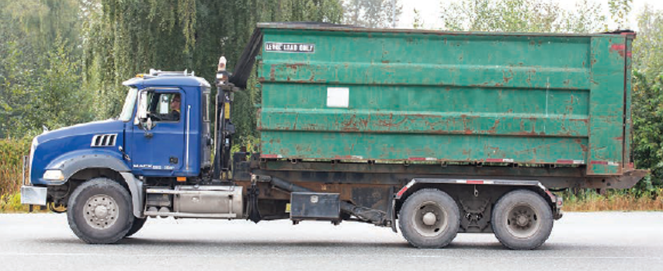
Roll-on/off and hook lift containers
Notes:
Instructor notes:

Slide 25
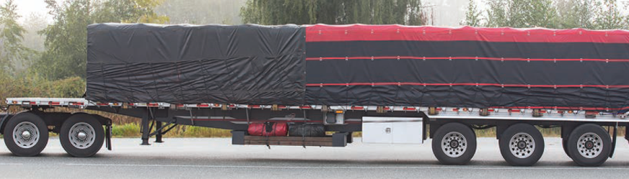
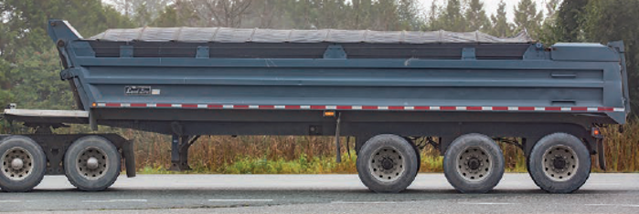
Covering cargo
Notes:
Instructor notes:

Slide 26
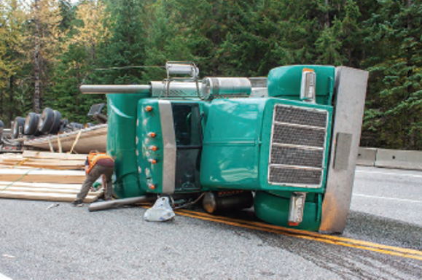
Load securement incident scenarios
In your groups, read your assigned scenario and discuss the questions in your workbook. Come back prepared to present your scenario and findings.
Notes:
Instructor notes:
Handout the scenarios and discuss either in groups with report back or as a whole class.

Slide 27
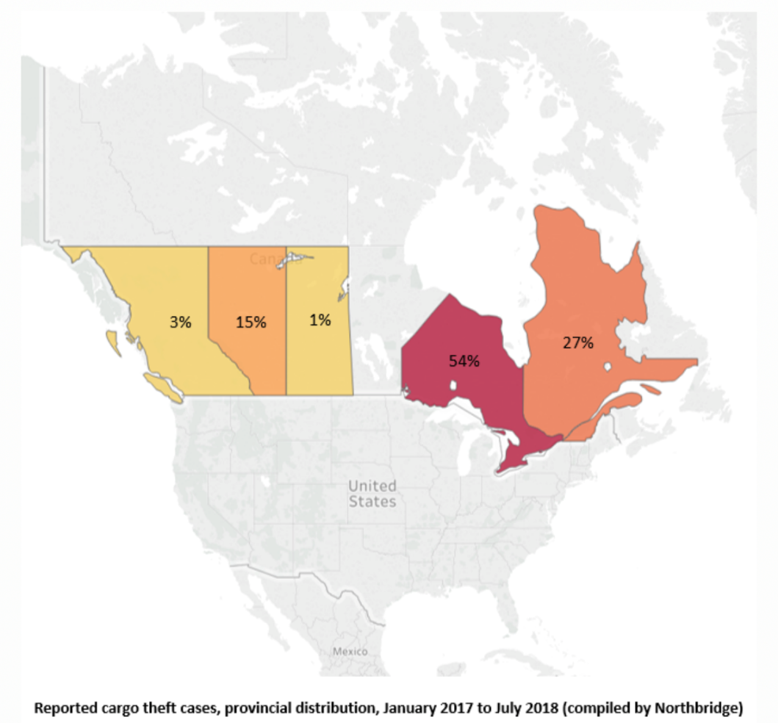
Cargo theft and security
Cargo security is a major part of a professional driver’s job. Every year, millions of dollars in cargo and equipment are stolen.
Notes:
Instructor notes:
Discuss the prevalence of cargo theft.
The map indicates the distribution of reported cargo theft in Canada. So, while cargo is stolen across the nation, the highest concentration of reported cargo theft is in Ontario – with 54% of reported thefts.
According to the Insurance Bureau of Canada (IBC), there's estimated to be approximately $5 billion worth of cargo theft in Canada every year. Only a fraction of the stolen goods, which range from lobsters, to steaks, to shoes, are ever recovered.
Discuss cargo security and how to be mindful of security for yourself, your rig and your cargo when on the road.

Slide 28
Cargo security continued
CBC News – Radio
Merchandise on wheels: why thieves are stealing cargo trucks (7:16)
https://www.cbc.ca/news/canada/hamilton/cargo-truck-thefts-1.5278924
Notes:
Instructor notes:
Listen to this CBC New Radio podcast. Time: 7:16
$471,000 worth of Blundstone footwear were stolen in July in Woodstock, Ontario.

Slide 29
Tips to prevent cargo theft
Understand how cargo theft happens.
Make sure your employer provides training and education.
Pay attention to your surroundings.
Keep your freight moving.
Do some research and plan.
Use technology and other safety measures.
Tips to prevent cargo theft on the road
https://www.youtube.com/watch?v=HXuSm0AgEwc
Notes:
Instructor notes:
Review the detail in the student guide.
Review these statistics. Cargo thieves are opportunists. Locations for theft include
Truck stops and highway rest areas are the most targeted locations at more than one-third (39%) of all incidents
Modal yards (managed by trucking companies, railroads or ocean carriers) at 27%
Unsecured locations (drop lots, motel, restaurant and mall parking lots) at 25%
Other cargo thefts and disappearances include warehouse burglaries (6%) and hijackings (3%).
Source – industry week
https://www.industryweek.com/leadership/companies-executives/article/21956198/7-steps-to-prevent-cargo-theft

Slide 30
Recognize it and report it
Help IBC fight cargo theft across Canada.
To report stolen cargo:
Make an anonymous phone call to 1-877-IBC-TIPS (422-8477), which operates day and night.
Complete and submit an anonymous Cargo Theft Incident Report Form
Contact an IBC Consumer Information Officer
Notes:
Instructor notes:
Discuss how to report cargo theft.
If cargo theft goes unreported, property recovery and prosecution becomes a challenge. Cargo theft cheats consumers, retailers, insurers and the trucking community, and wastes law enforcement resources.

