Slide 1
MELT Class 1 Driver Training
Vehicle Inspection and Maintenance
Notes:
Instructor notes:

Slide 2
Unit overview
Importance of inspections.
Consequences of non-compliance and vehicle failures.
A systematic approach to inspections.
Completing inspection reports.
Driver responsibilities.
Major and minor defects.
Notes:
Instructor notes:

Slide 3

Why conduct vehicle inspections?
Early detection of problems or defects reduces breakdowns and incidents.
Legal requirement and part of written maintenance program.
Will pass roadside inspections saving time/expense.
Reports are the communication between drivers and maintenance department.
Notes:
Instructor notes:
Daily vehicle inspection is important in ensuring that problems and defects are detected early before the vehicle is operated on the highway. Inspections prevent the operation of a vehicle with conditions that are likely to cause or contribute to the severity of a collision.
The trip inspection process is part of a carrier’s legal requirement to have and implement a written maintenance program. It also ensures there is clear communication within the company about the vehicle’s day-to-day safety. Time spent performing vehicle inspection is part of the on-duty time and should reported in the daily log book as on-duty not driving
Inspection reports serve as communication between drivers, the carrier and the carrier’s maintenance department. Reports are used to verify inspections, record defects, report defects and may be used to verify repairs.
Legal Requirements – passing roadside inspections demonstrates a sincere respect for the rules and regulations of the transportation system.
Safety comes first – meeting operational safety standards reduces the frequency of breakdowns and accident/incidents.
Professional attitude – accepting responsibility as an operator, focusing on efficiency and establishing a standard of safety.

Slide 4
Regulations and requirements
 | NSC Standard 11 Maintenance | NSC Standard 11 CVIP | NSC Standard 12 CVSA | NSC Standard 13 Trip Inspections
Frequency | Regular (weekly, monthly, quarterly, semi-annually) | Annual | Random | Daily
Inspection conducted by | Motor carrier mechanic | Government approved and certified mechanics | Inspection and enforcement officers (government/police) | Driver/carrier service technician
# of vehicle systems and parts inspected | Variable – depends on system implemented by motor carrier and trip inspection reports provided by driver | 10 vehicle systems and 90 components with 1,100 inspection and rejection criteria | 12 critical vehicle safety systems and driver paperwork items | 23 critical vehicle safety systems
Compliance verification | On-road and audit of motor carrier facility | On-road and audit | On-road (weigh scales or vehicle stop) | On-road and audit
Notes:
The Canadian trip inspection rules require professional drivers to complete more thorough and complete daily trip inspections than is required in the US.
Commercial Vehicle Safety Alliance (CVSA) on-road inspections performed by enforcement officers are identical in both countries.

Slide 5
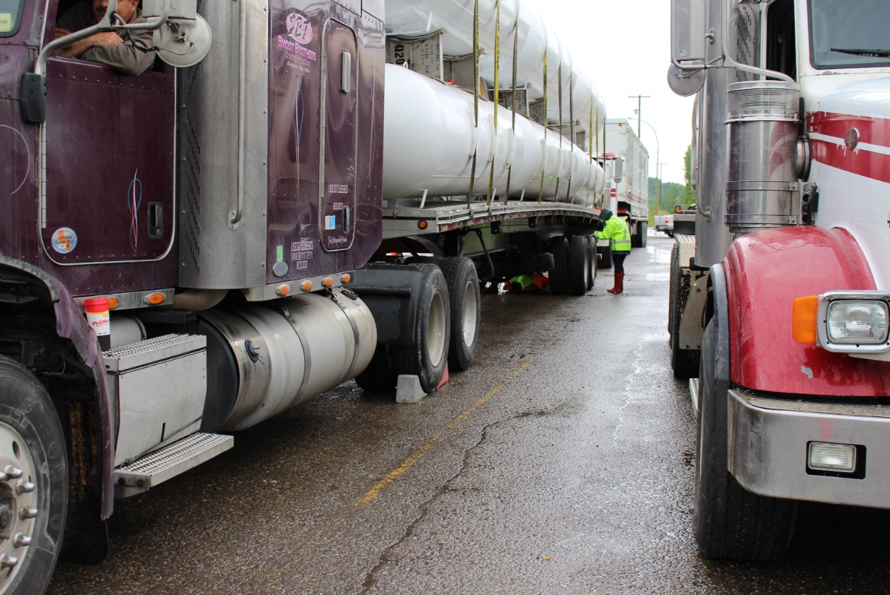
Maintenance standard
Carrier has the primary responsibility to ensure all vehicles under its control are systematically inspected, maintained and repaired to B.C. requirements.
Frequency and what is checked will vary with carrier system and reports provided by the driver.

Slide 6
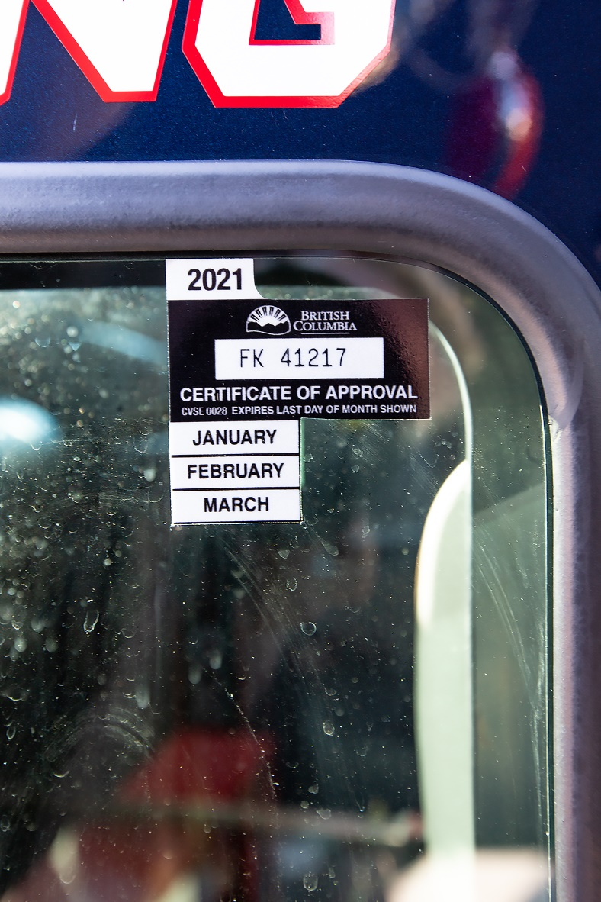
CVIP annual inspection
All commercial vehicles to be inspected at least once a year.
B.C. regulations are more stringent - requires inspection every six months unless the inspection is carried out under an approved Preventative Maintenance Plan (PMP) in which case the annually inspection requirement applies.
Must be conducted by an authorized inspector in a government certified inspection facility.

Slide 7
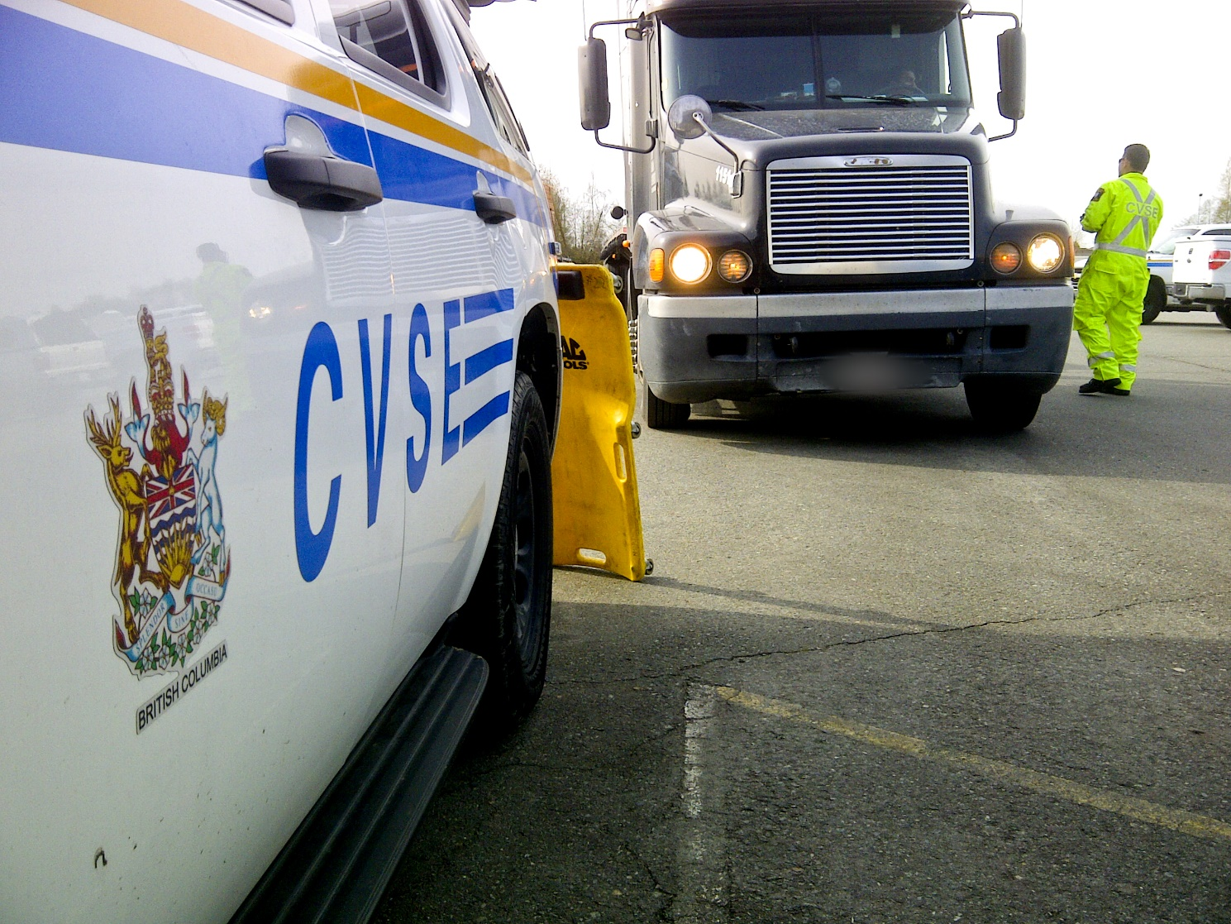
CVSA/CVSE inspections
Notes:
Instructor notes:
CVSE officers conduct more than 30,000 vehicle inspections each year, issuing violation tickets and removing unsafe vehicles from the provincial roadways on a daily basis.
During a sweep in May 2019 in Delta police and safety inspectors took 160 unsafe vehicles off the road.
During a sweep in August 2019, 48 per cent of the commercial vehicles failed in at least one area.
In 2017, more than half of the commercial vehicles checked during a road-safety blitz were immediately ordered off the road.
75 trucks were checked and 40 had to be taken out of service while drivers of the remaining 35 rigs were ticketed for at least one infraction.
Mechanical deficiencies, load security, bald tires, brakes, windshields, suspension, and steering components were a few of the problem areas.

Slide 8
Driver’s daily responsibilities
Before and after each trip, the driver, or a person specified by the carrier, must ensure that the vehicle is in a safe operating condition.
Inspection is performed daily before the first trip of the day.
If the trip lasts more than one day, the inspection is carried out on the second and every subsequent day of the trip no later than the first rest stop of the day.
A copy of the trip inspection is carried in the vehicle for the day in which it was done.

Slide 9
Vehicle inspection report
Licence plate or unit number.
Name of the motor carrier.
Date and time that the inspection was completed.
A declaration that the vehicle identified on the report has been inspected as required.
Minor, major or no defects.
Name and signature of the person who conducted the inspection.
Name and signature of the driver if other than the person who conducted the inspection.
Odometer reading.
Notes:
Instructor notes:
Review a sample inspection report and discuss information recorded.
Report is valid for 24 hours.

Slide 10
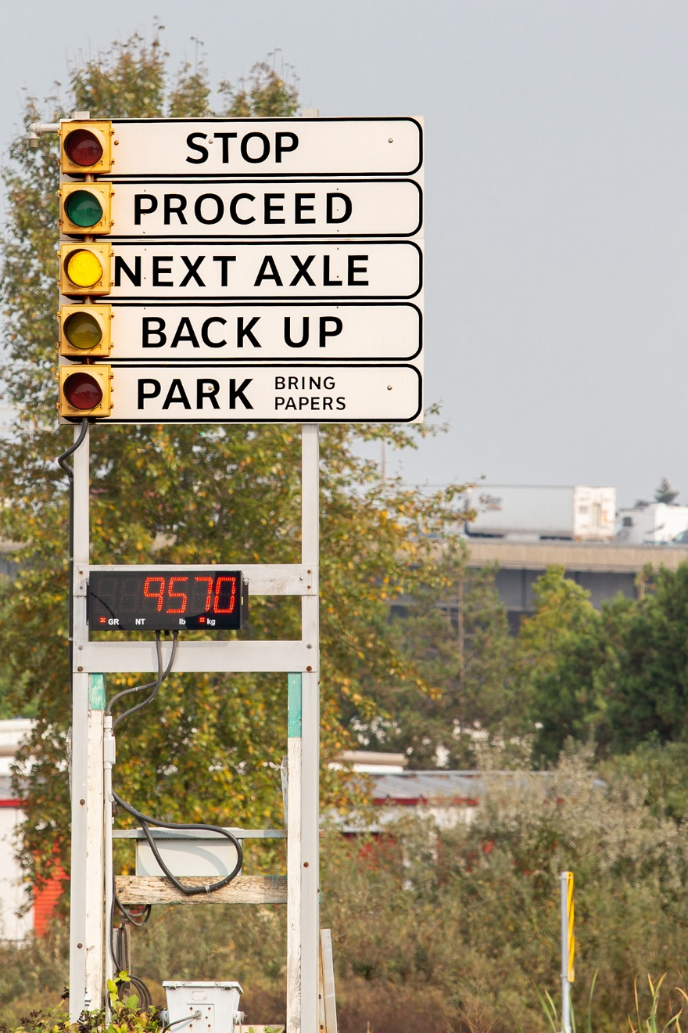
Vehicle inspection stations
All commercial vehicles or combinations over 5,500 kg are required to report to inspection stations when instructed by signs or lights.
Notes:
Instructor notes:
If your vehicle is loaded, drive slowly across the scale lane.
If empty, drive slowly in the lane beside the scale lane. Whether loaded or empty watch the light board for instructions.
If the “STOP” light is activated, stop the vehicle and wait for further instructions.
If the “BACK UP” light is activated, slowly and safely back the vehicle up keeping in mind there may be other vehicles behind you.
If the “PARK” light is activated, park the vehicle in the lot and bring all of the vehicle and driver documents to the scale building.

Slide 11
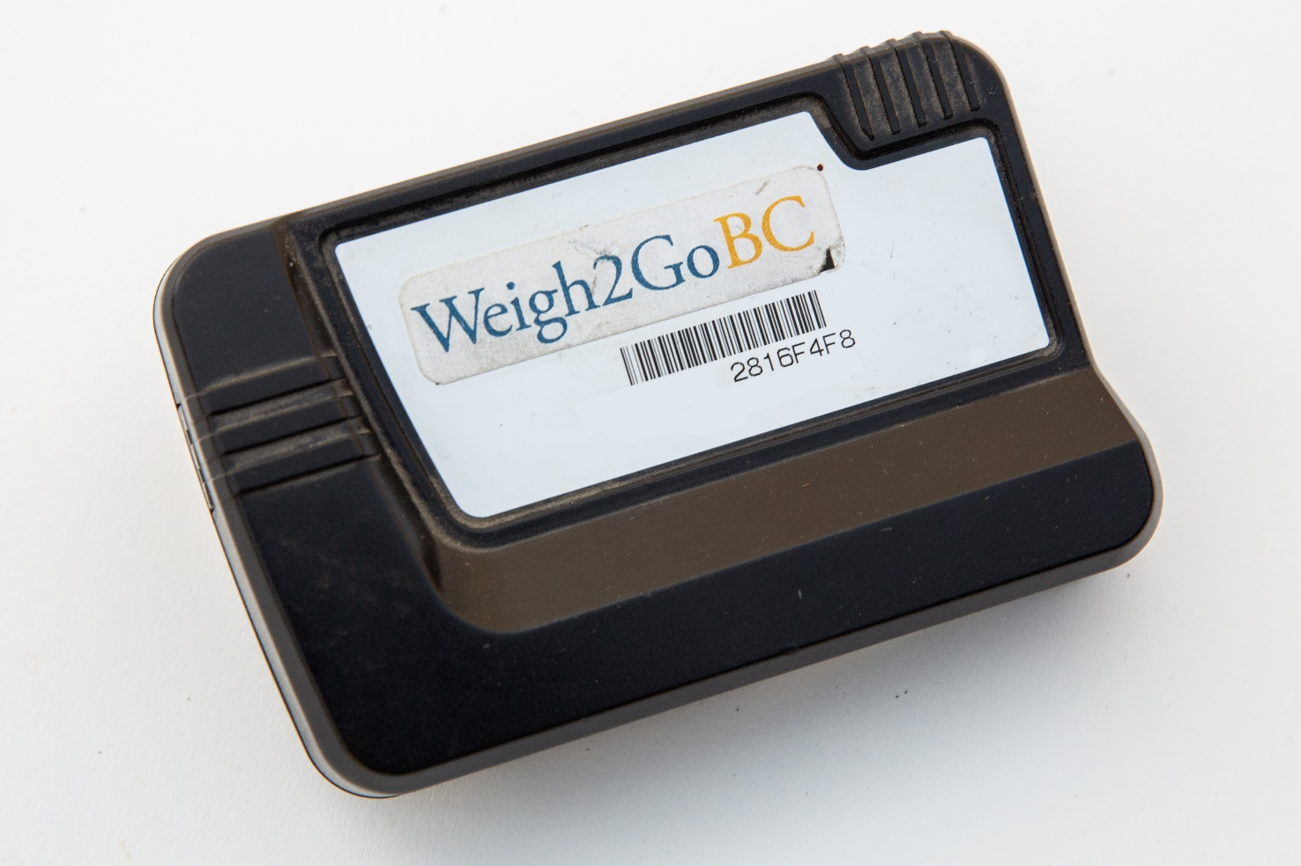
Vehicle inspection stations continued
Weigh2GoBC inspection stations
Notes:
Instructor notes:
Explain the Weigh2GoBC program:
Now, Weigh2GoBC technology allows commercial carriers to bypass Weigh2GoBC inspection stations.
A vehicle with a registered transponder communicates with a weigh-in-motion equipped station upon approach, and the vehicle is identified and checked for height, weight and safety credentials while travelling at highway speed.
Based on National Safety Code standards, data is collected on all commercial vehicles and determines a carrier’s rating, taking into account history such as violation tickets, out-of-service records, and at-fault crashes.

Slide 12
Vehicle defects
Recording defects
Reporting defects
Driving with defects
Notes:
Instructor notes:
Recording - must record a defect on the report immediately after the initial inspection or upon discovery of a defect while travelling or when discovered at the end of a trip or day.
Reporting - For reporting defects to the carrier, the carrier may designate an employee to receive reports of defects.
Minor and major defects, which are listed in the NSC 13 Schedule 1, must be reported immediately by the driver or inspection person to the carrier upon discovery of the defect.
Depending on the driver’s situation, reporting defects to the carrier may be done in person, by phone, via written report or by electronic means.
Driving with defects: A driver may continue to drive with a minor defect that is listed on an inspection schedule if the driver has immediately entered the defect on the daily inspection report and reported the defect to the carrier.
No driving when a major defect that is listed on an inspection schedule is present on the vehicle
Review the defects chart in the student guide.

Slide 13
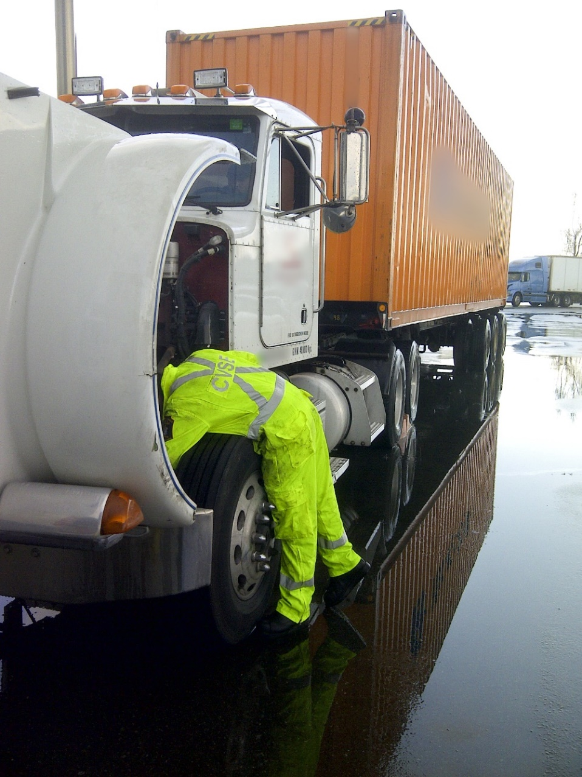
Inspection procedures
Notes:
Cover slide to introduce inspections.

Slide 14
Inspection procedure – video
Class 1 Pre-trip inspection
Notes:
Show a video that goes over a pre-trip inspection.

Slide 15
Enroute inspection checks
All lights are clean and working.
No air leaks.
All wheels are secure, and tires are properly inflated and are not hot.
No broken or loose items on the vehicle.
Load/cargo is secure.
Coupling devices are secure.
Dangerous goods placards are clean and secure (if applicable).
Trailer locking mechanisms are secure and in good condition.
Brakes are properly adjusted.
No fluid leaks under the vehicle.
Mirrors and windshield are clean.
Notes:
Instructor notes:
Before performing the enroute inspection, keep the following in mind:
Make sure the vehicle is completely off the road.
You should be able to enter and exit a rest or check stop so that you do not have to back up.
Do not make a stop at the bottom of a hill or on an uphill slope.
The stop area should have an adequate acceleration lane to allow you to merge back onto the highway at the appropriate speed.

Slide 16

Pre-hill inspection checks
Compressor maintains full reservoir pressure.
No audible air leaks.
Glad hands and air lines are secure.
Brake drums and hubs are not overheated.
Pushrod travel is within limits.
No fluid leaks.

Slide 17
Post-trip inspection checks
Fuel the truck if required.
Return to the yard and park your vehicle.
Park your vehicle and allow the engine to cool down on low idle.
Shut down engine, secure the rig and turn all lights and switches off.
Complete a circle check of the truck exterior.
Interior check.
Notes:
Instructor notes:
Completed at the end of the shift. This will enable you to obtain service or repairs if required before the next trip.
The report should include any problems discovered during the trip.
Postponing inspections can result in problems that are frustrating, time consuming and costly.
Circle check of the truck exterior:
body condition (no new damage)
lights that have been left on, check that all exterior lights are functioning properly
suspension
mud flap (secure)
fuel cap (secure)
new leaks
check condition of wheels and tires and tire pressure.
Interior check:
floor (clean, nothing left behind)
seats (no new damage)
close windows
set seatbelts back in order
complete logbook.
Note: In cold weather, ensure trailer brakes cool before activating the park brakes to prevent snow from melting to water and re-freezing between the brake shoe and drum.

