Slide 1
Welcome to the
Air Brakes Course
Notes:
Instructor:
Welcome students to the air brake course.
The course covers information needed to write the air brakes knowledge test at ICBC.
If applicable, explain that there are students in the course who are in different training streams.
For those not upgrading their licence to Class 1, 2, or 3, practical training and the pre-trip assessment is included (explain when this will occur).
(Note: If your course is not an air brakes certification course, explain that students will go to ICBC for the practical pre-trip test.)
Class 1 MELT students will receive additional theory for trailers and plenty of practical training as part of their MELT course. The air brakes pre-trip test (part of vehicle inspection) will be conducted by ICBC as part of your road test.

Slide 2
About the facilities
Washrooms
Coffee and lunch facilities
Breaks
Emergency exits/ muster area
Cell phones
Public health requirements, if applicable
Notes:
Review housekeeping items.
If required, discuss Covid 19 distancing and safety rules.

Slide 3
Course overview
Understand the importance of air brake inspections
Basics of how air brakes systems work
Components of a single unit air system
Air brake pre-trip and enroute inspections
How to identify major and minor defects in the air system
How to check and adjust air brake pushrod travel
Notes:
Provide brief overview of what will be covered in the single-unit portion of the course.

Slide 4
Licensing
Who needs an air endorsement?
Notes:
Briefly explain the requirements for an air brakes endorsement (Code 15).
To operate vehicles equipped with air brakes on a highway (other than a vehicle defined as a construction vehicle), you must have a B.C. driver’s licence with an air brakes endorsement.
An air brakes endorsement is also required to operate most vehicles equipped with air-over-hydraulic brakes.

Slide 5
How to apply for an air brake endorsement
Book your knowledge test online at icbc.com
Study the air brake sections in the Driving Commercial Vehicles (DCV) guide to prepare
Present your course card when you attend for your test
Provide primary and secondary ID and pay the test fee ($15)
  Acceptable ID is listed on inside back cover of the DCV guide or on icbc.com
Notes:
Instructor:

Slide 6
Air brake knowledge test
Multiple choice test
Available in English only – no translators
20 out of 25 correct answers required to pass
If unsuccessful, must wait seven days to try again
Three attempts are allowed – after that you must take the course again
Notes:
Explain they can skip questions if they are unsure of the answer, but it will come up again to be answered to finish the test.
Test results are valid for one year. If you haven’t had the air brake endorsement placed on your driver’s licence, by passing the practical test, within one year of passing the air brake knowledge test, you’ll need to do the knowledge test again.
Advise students if your school charges to retake the course.
NOTE: If you have Class 4, 5, or 7 non-certification students in the class, explain about that they must make an appointment to take the air brake pre-trip inspection test at ICBC and provide an air brakes-equipped vehicle.

Slide 7
Introduction to air brakes
Air brakes are used as an alternative to hydraulic brakes which are used on lighter vehicles such as automobiles.
Hydraulic brakes use a liquid (hydraulic fluid) to transfer pressure from the brake pedal to the brakes to stop the vehicle.
Air brakes are used in heavy commercial vehicles due to their reliability.

Slide 8
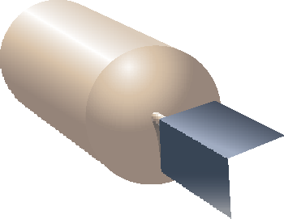





Why do we have air brakes?
Air brake systems:
Use a much greater force to apply the brakes than hydraulic braking systems do, which is needed to cope with the heavy loads.
Are more tolerant to small leaks, which in a hydraulic system could result in brake failure.
An air brake system includes a compressor to generate more compressed air as needed.
Are capable of stopping heavy vehicles safely.
Notes:
Ask: What is the advantage of being able to generate more air with a compressor?
(If you have a loss of fluid in a hydraulic system, you have lost your braking power).

Slide 9
What is compressed air?
Air can be compressed (squeezed) into a much smaller space than it would normally occupy.
For example, tires are filled with compressed air to support the weight of a vehicle. Squeezing air into a smaller space increases the air’s resistance.
This resistance creates pressure, which can be converted into mechanical force to apply the brakes.
Air brakes are able to generate more braking force than hydraulic brakes.

Slide 10
Heavy vehicle braking
Heat
Motion
Traction
Friction
Notes:
Heat is a form of energy.
In an internal combustion engine, the heat energy produced by engine combustion is converted to the energy of motion through the moving parts of the engine and drive train, turning the wheels.
Even though the energy of motion turns the vehicle’s wheels, the vehicle won’t go anywhere unless there’s traction between the tires and the road surface.
When stopping a vehicle, the energy of motion is converted to the energy of heat through friction between the lining/pad and drum/rotor surfaces of the vehicle’s brakes.
The final factor that determines stopping distance is traction.

Slide 11
Heavy vehicle braking cont.
The energy goes full circle.
The basics behind braking systems is that friction converts the energy of motion to heat energy.
Heat Energy - Energy of Motion - Heat Energy.
From the engine
Through the drivetrain
Through the brakes
Notes:
Explain that the heat generated from the braking is absorbed by the drum or disc and released to the atmosphere.

Slide 12
Stopping distance and stopping time
Total stopping distance is the distance your vehicle will travel from the moment you:
see — a hazard
think — decide to stop
do — place your foot on the brake pedal until you stop.
It takes about 3/4 of a second of perception time to see the problem (see-think) and another 3/4 of a second to react (do).
Only then will your vehicle begin to slow down.
Notes:
Stopping distance is the time the vehicle travels from the time the hazard is seen until the vehicle is stopped.
Total stopping distance or time depends on the ability of the brakes linings or pads to produce friction, the brake drums to dissipate heat and the tires to grip the road.
Ask: what else can affect your stopping distance? (i.e. brake shoe or pads worn, drums or rotors worn, tires worn, road conditions.)
Reaction time is the time it takes from when you see the hazard to the time the brakes are applied.
Brake lag is the time it takes the air pressure to apply the brakes. See next slide.

Slide 13
Brake lag and braking distance
A car’s brakes begin to work almost instantly when you press on the brake pedal, but this is not the case when operating a vehicle with air brakes.
Brake lag time | Braking distance
There’s a brake lag time of approximately 4/10 of a second from when you apply the brake pedal (foot valve) to when the air reaches the wheel and applies the brake | Add to this the braking distance, which is the distance the vehicle travels after the brakes are applied until it stops
Notes:
Ask: What happens to the total stopping distance if you’re coming down a hill? (It will be longer).

Slide 14
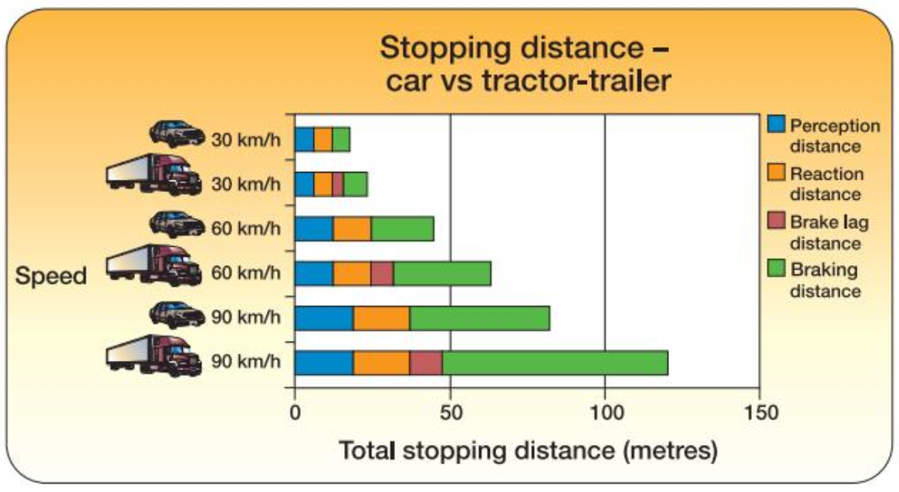
Importance of following distance
Notes:
Review stopping distances for cars vs tractor-trailer, for different speeds
Cars and light truck drivers follow the two-three second rule.
Large heavy vehicles – minimum of five seconds behind the vehicle ahead at highway speeds or one second for every ten feet of total vehicle length. This could be up to seven seconds with a fully loaded trailer. Stay even further back when conditions are less than ideal
Ask: how do you count following distance? Demonstrate if no one knows.

Slide 15
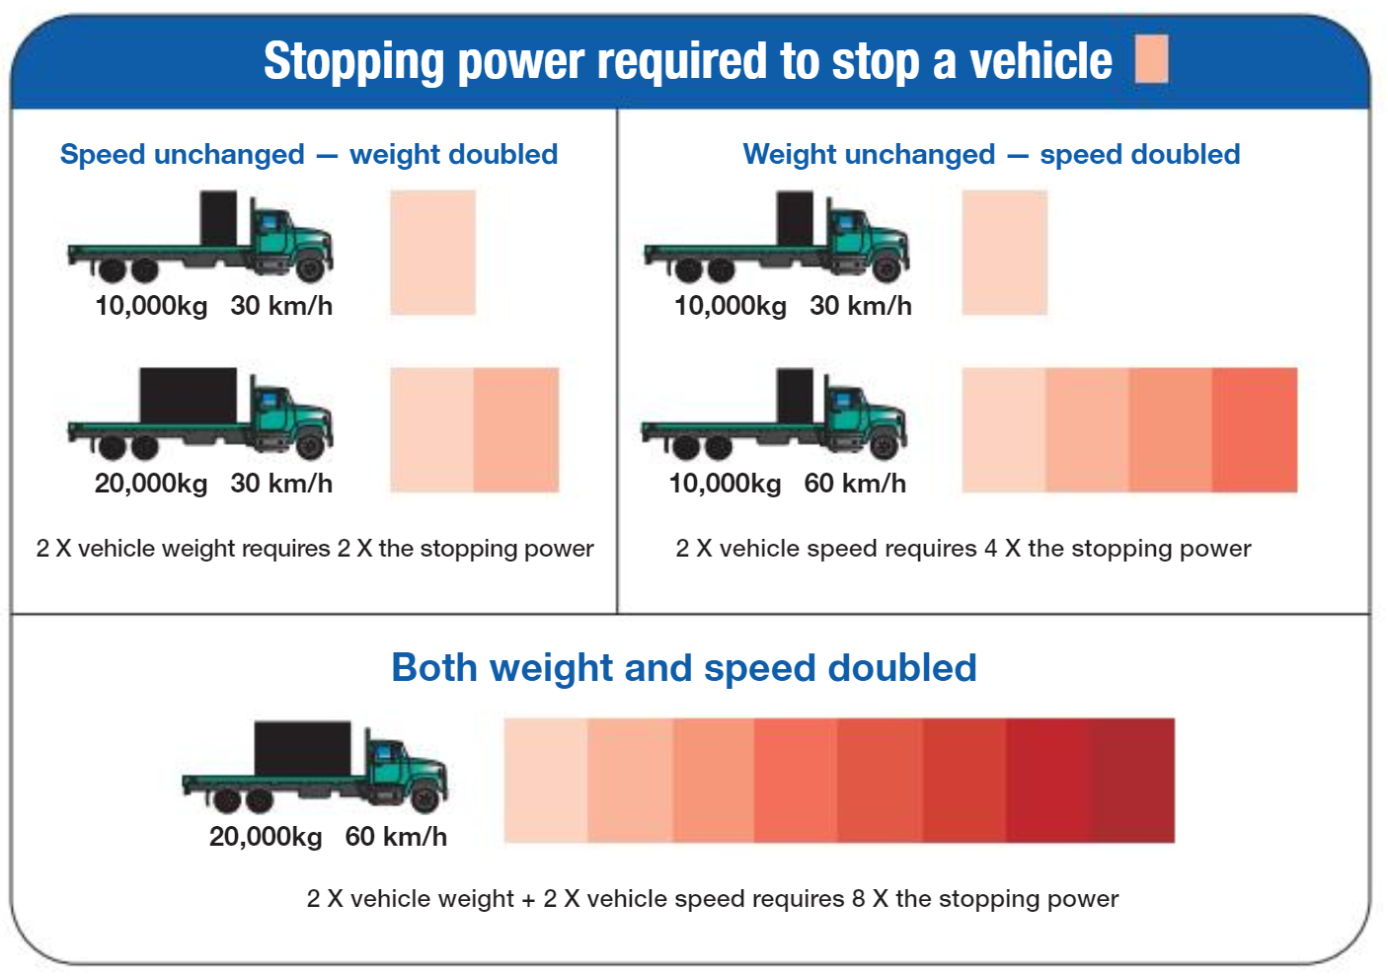
Stopping power
Notes:
Review the information in the slide.
Speed and weight affect the stopping power required to stop any vehicle, and how far it will travel before it stops.
You need more stopping power when the speed you’re travelling, and/or the weight of your vehicle, increases:
2 ✕ vehicle speed requires 4 ✕ the stopping power
2 ✕ vehicle weight requires 2 ✕ the stopping power
2 ✕ vehicle speed and 2 ✕ vehicle weight requires 8 ✕ the stopping power.

Slide 16
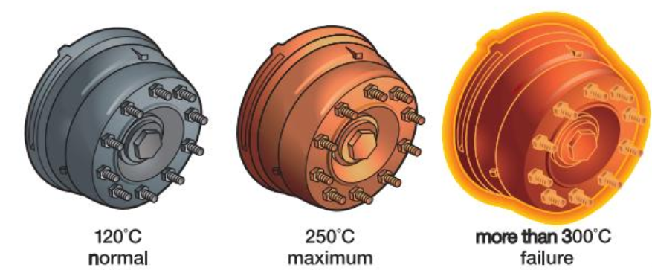
How much heat can brakes handle?
Notes:
Explain the brake drums and linings absorb the heat created by the friction of the brake shoes rubbing against the drum to stop the vehicle – this heat is dissipated into the atmosphere
Normal operating temperature of the brake drums is between 120 and 250 degrees Celsius
If the temperature of the drum exceeds 300 degrees Celsius brake failure may occur
Ask: as the drums heat up what is happening with the drum? (It is expanding away from the brake shoes)
Next slide to discuss brake fade.

Slide 17
Brake fade
Brake fade occurs when your brakes stop working properly because they’re overheated.
Your vehicle takes longer to stop or may not stop at all if you haven’t properly controlled the speed.
You’ll need to apply more pressure to maintain the same braking force as brake fade increases
Brake drums can expand and move away from the shoes. The brakes won’t work – you’re having a runaway!
Brakes may catch fire.
Notes:
Discuss that disc brakes are better at reducing brake fade then drum brakes as most discs have cooling vents
Brake fade will still occur with disc brakes however it is not cause by the expanding away from the pads but rather a term called “gassing”
Gassing is when a layer of gases caused by heat buildup between the pads and the disc reducing the ability of the pad to grab the disc.
Ask students what else might affect brake fade, i.e. if the drums are worn they will heat up quicker and will be less effective in dissipating the heat.

Slide 18
Engine retarders
Engine retarders provide an additional (or auxiliary) way of slowing of the vehicle
They, along with the appropriate gear, are the best way to control your speed on long downgrades
Engine retarders (also known as engine brakes) help save the main braking system for emergency stopping
Four main types of retarders:
    engine retarders
    exhaust retarders
    hydraulic driveline retarders
    electric driveline retarders
Notes:
Many retarders can absorb as much, or more horsepower, than the engine can.
Explain that we find exhaust brakes even on the heavy duty pick ups today to assist in braking.

Slide 19
Using retarders
More efficient at a higher engine rpm and a lower vehicle speed - it’s important to select the right gear
Select gear before start down the hill - more likely to miss a shift if you wait until you’re on the downgrade
Be cautious if you’re using retarders/engine brakes on slippery roads – this can cause lock up, engine stall, loss of control or a jackknife if towing a trailer
A modern truck with an engine retarder and properly maintained muffler system shouldn’t be noisy
Many municipalities post signs restricting drivers from using engine retarders/engine brakes.
Notes:
Explain that engine retarders are not a replacement for a well maintain braking system but a tool to aid with the braking
Discuss they work best at a higher RPM
Discuss that exhaust brakes are usually use on light to medium weight vehicles
The other types are usually used on heavier types of vehicles
Explain that the brake pedal on the air system will feel different then their car
Ask: What will be some of the determining factors if use of the retarder is necessary?
Review stopping on icy roads and if the retarder should be used and what may happen. Does this apply to wet roads?
When should we not use the retarder?

Slide 20
En route pre-hill brake checks
Notes:
These signs, showing special instructions for commercial vehicles, may be placed before a downhill grade. The one in the top left corner shows the speed suggested for descending the grade. The other signs direct you to check your brakes. Note that commercial vehicle signs have a dashed border.

Slide 21
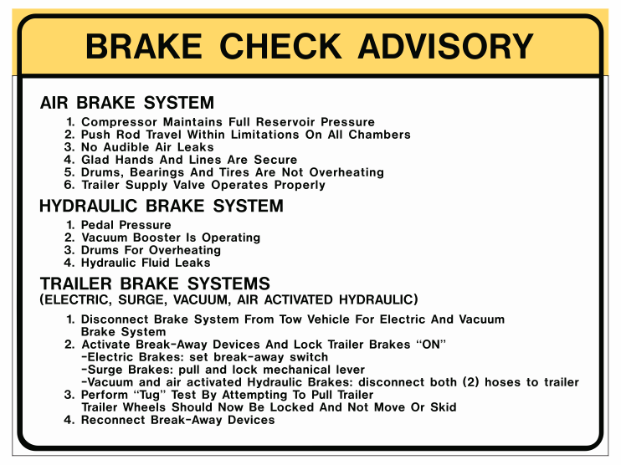
Notes:
Review mandatory en route brake checks that are appropriate for the vehicles your students will be driving.

Slide 22
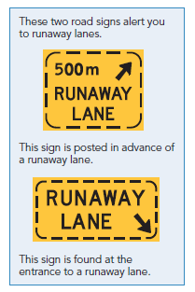
Runaway lanes
The most common cause of downhill runaways is travelling a speed that requires you to use your service brakes
Runaway lanes are located beside the road on some downhill grades
These lanes are there to help slow and stop vehicles if their brakes fail
These lanes are there for safety. Don’t use them for any other purpose.
Notes:
Briefly discuss what to do in the event of a total loss of brakes.

Slide 23
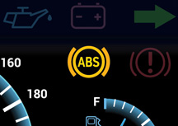
Anti-lock braking systems (ABS)
Additional to a normal air brake system
Doesn’t allow you to drive faster or stop sooner
Stopping distance may be longer on some surfaces such as gravel
Can prevent wheel lock-up on slippery surfaces
You can brake hard and maintain steering control. Do not pump the brakes
Only as good as the driver - learn the correct technique and practice so you’re ready in an emergency. Read your vehicle manual.
Notes:
Ask: has anyone ever had their ABS activate? What was it like?
Explain that on some vehicles that they may feel a vibration this is normal and they need to keep a steady pressure on the pedal. If they release the foot valve, their stopping distance will be lengthened.
Stress that in a single unit vehicle, if their ABS has activated, they have likely done something wrong and lost traction – i.e. driving too fast for conditions, late braking, braking too hard or suddenly. Drivers should aim for smooth, well planned driving that doesn’t risk loss of traction.

Slide 24


















Basic air brake components
Air compressor
Governor
Air lines
Air reservoirs
Foot valve (brake pedal)
Foundation brakes
Notes:
Review basic air system.
Review the six components required to operate a basic system.

Slide 25



















Brake chamber components
Includes:
The diaphragm - converts compressed air into a mechanical force - size of the diaphragm directly effects the amount of force.
The slack adjuster - acts as a lever to increase pressure which converts the pushing motion to a twisting motion.
Notes:
Ask students if they have every used a tool, instrument or device that multiplies force such as a long bar or a 2 X 4 to move something. This is referred to as a force multiplier.
A slack adjustor acts as a lever to increase force.
Explain the purpose of the components in the diagram.
Explain that the size of the diaphragm and the amount of air pressure pushed against it will determine the force produced.
An example would be if 100 psi is applied against a 30-inch diaphragm it would produce 3000 psi of force.
The push rod is attached to a slack adjuster which converts the pushing motion to a twisting motion.
The slack adjustor has other jobs, as the name implies, it removes the slack between the brake shoes and the drum. It also serves as a lever to increase force in applying the brakes
The S-cam is a shaft with splines on one end which fits into the slack adjustor and has an S shape on the other which is used to force the brake shoes against the drum.

Slide 26
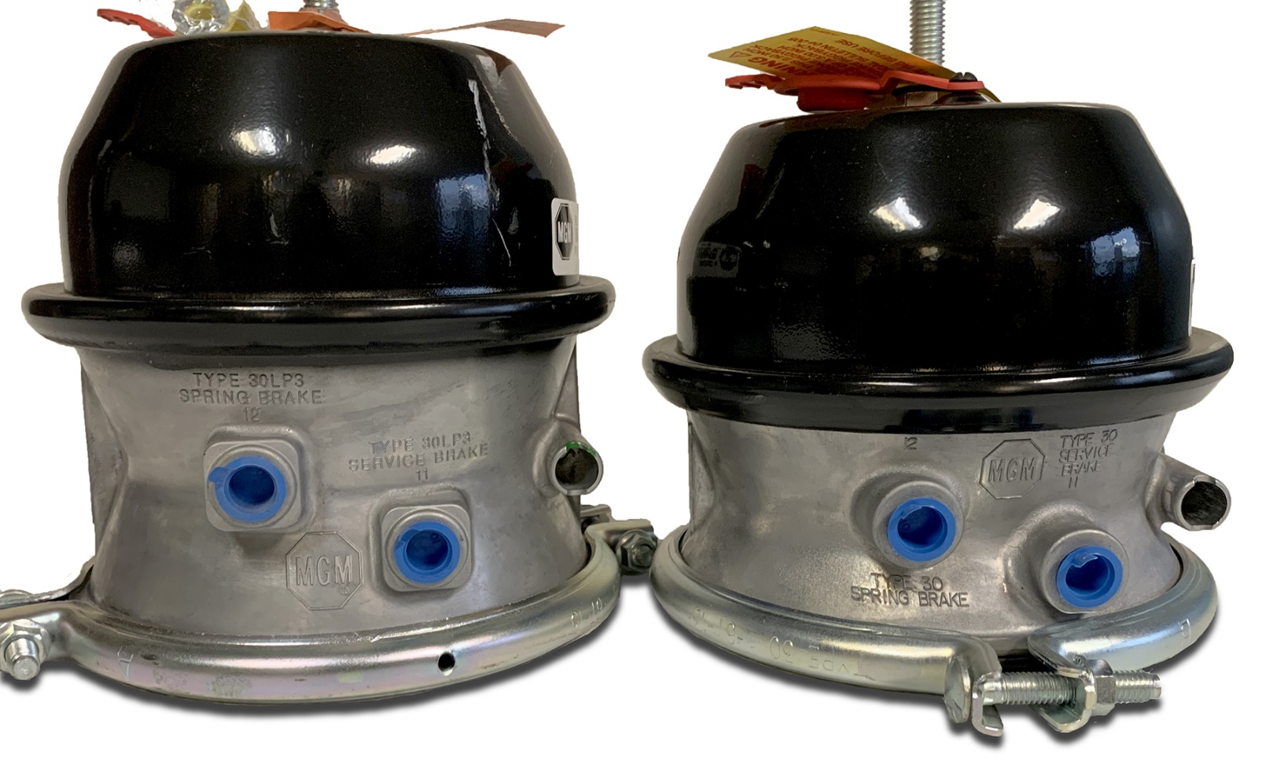
Long stroke and regular stroke brake chambers
Notes:
Many new air brake systems have long stroke brake chambers, this has a longer pushrod stroke than the pushrod of a standard brake chamber.
They are identified by their square-shaped inlet ports and/or trapezoid-shaped name tag on a clamp bolt.
Explain that the advantage of the long stroke is you have ½ inch extra in stroke on the push rod.
Discuss different sizes with the most common being a type 30. Explain what that means.

Slide 27
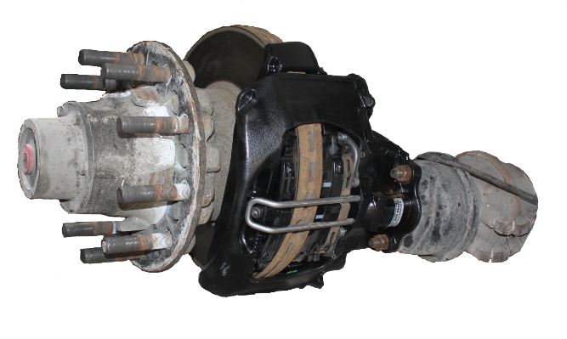
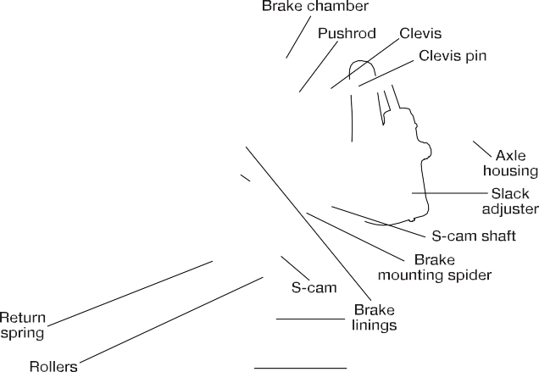
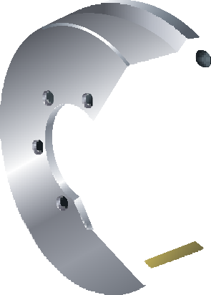

































Foundation brakes
The brake assembly at each wheel is commonly called the foundation brake.
S-cam type
Air disc brakes
Notes:
Explain the brake parts around the wheel that are operated by the air brake system, including the brake chamber.
The most popular type of foundation brake is the S-cam drum brake, the other braking system used are disc brakes.
Describe disc brakes:
Disc brakes use a floating caliper.
Like drum brakes, they are available with and without spring brake chambers.
The disc brake works on the same principles as the drum converting air pressure to braking force.
Pressure from the foot valve operates the brake chamber in the same way.
The pushrod exerts pressure onto the lever.
The connected actuating overcomes the return springs.
The force then passes through two rods and tappets to the brake pads, clamping onto the disc.
Review images and ask what are some differences between the S-cam type and the disc type, i.e. no push rod visible, no slack adjuster.

Slide 28

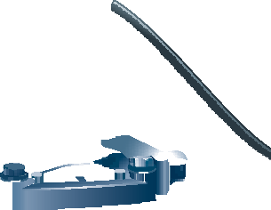
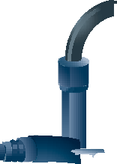


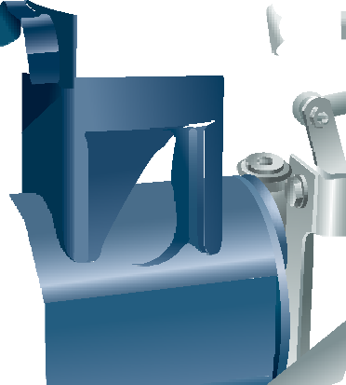











Compressor
An air brake system requires a way to compress air and store it in reservoirs (tanks) so that it’s available for instant use.
The compressor takes air from the atmosphere and compresses (pressurizes) it and pumps it through an air line to a supply reservoir.
As long as the engine is running, the compressor is producing air
The air that leaves the compressor is hot (over 204° C or 400° F) and will form condensation when it reaches the cold reservoirs.
Notes:
Checking the security (attachment) and operation of the compressor is part of an air pre-trip.
As part of the pre-trip you’ll check that the compressor is able to build air pressure from 50-90 psi in three minutes or less at a fast idle. If it doesn’t have it checked by a mechanic.
Ask: What are two different measurements used for pressure? (Pounds per square inch - psi or kilopascals - kPa)

Slide 29
Compressor needs a clean air supply
The compressor needs a supply of clean air to work properly.
The air from the atmosphere supplies both the truck engine and the compressor.
A piston-type compressor operates on a similar principle to that of the intake and compression strokes of a typical car engine.

Slide 30
How are compressors cooled?
To prevent the compressor from overheating, two types of cooling systems are used:
The most common method on heavy trucks is to circulate engine coolant through the compressor.
Oil lubricates the moving parts of the compressor, similar to oil lubricating the moving parts of a car’s engine.
Oil helps to cool the compressor and is usually supplied by the same oil as the engine.
It’s important to ensure there is sufficient oil supply.

Slide 31
Governor
Once the desired air pressure has been reached, there needs to be a way to stop compressing air. This is the job of the governor.
When enough pressure has been built up, the governor causes the compressor to go into the “unloading” stage.
If the air pressure in the tanks drops below a certain level (such as after a series of brake applications), there needs to be a way to start compressing air again.
Notes:
Explain the function of the governor, it puts the compressor in the loading stage (adding air to the reservoirs) and the unloading stage (allowing the air produced by the compressor to return to the atmosphere without being stored in the reservoirs).
Ask why we would want the compressor to be able to return the air to the atmosphere and not be stored.
The compressor is always producing air if the engine is running.

Slide 32
Governor cont.
Governors are usually set to unload the compressor (stop the compressor from pumping air to the reservoirs) when the air pressure reaches between 105 and 135 psi (724 and 931 kPa).
The range between minimum and maximum pressure should be approximately 20 psi (138 kPa).
The governor must restart the compressor anytime the air pressure drops below 80 to 85 psi (552 to 586 kPa).
For example, if the maximum air pressure was 125 psi, the governor would restart the compressor if air pressure in the reservoirs dropped to 105 psi. Applying the brakes several times would likely cause the air pressure to drop to this level.
Notes:
The compressor never stops producing air as long as the engine is running.
The governor controls where the air is directed, either into the reservoirs - the “loading stage” or the “unloading stage” where the air is returned to the atmosphere and not sent to the reservoirs.
Checking the governor
As part of the pre-trip, you’ll lower the air pressure by applying and releasing the brakes several times and check that the governor puts the compressor into the loading stage by 80 psi.
Then, once pressure builds to maximum in the air tanks, you’ll check that the governor “unloads” any additional air pressure produced by the compressor. You can hear the air release and see on the gauges that pressure is no longer building.

Slide 33



Air reservoirs
Reservoirs are steel or aluminum tanks used to store the compressed air produced by the compressor.
A safety valve on the first reservoir protects the reservoirs from being over-pressurized and bursting if the governor fails to unload the compressor.
Safety valves are normally set to vent the excess pressure at approximately 150 psi (1,034 kPa).

Slide 34
Air reservoirs cont.
Sludge will make its way to the reservoirs. It is a combination of water and oil from the compressor caused when hot air meets the cold tanks.
To prevent sludge from contaminating the air valves in the system, drain valves (drain cocks) are installed in all reservoirs.
The wet (or supply) tank should be drained first.
Most manufacturers recommend that you drain reservoirs daily.
When draining reservoirs, allow time for the air to completely drain.
Notes:
Checking the air reservoirs
If the truck has a wet tank, it should be drained daily, as well as the primary and secondary.
Not all vehicles have wet tanks, many have an air dryer integrated system - ADIS.
You can tell it is an ADIS system if the governor is mounted to a small pancake like air tank with the air dryer.

Slide 35






Foot valve
Pressing on the brake pedal (called the foot valve or treadle) applies the air brakes, just like stepping on the brake pedal applies the brakes in a car.
Releasing the foot valve allows the application air to be exhausted through the assembly’s exhaust ports to the atmosphere.
Simply put, it is a foot-controlled pressure regulator. It’s the device that allows you to select any pressure needed to make a gentle, or a very rapid stop.
Notes:
Compare the foot valve to a tap, the more you open a tap the more pressure you will have. The same thing is true with the foot valve. The harder you push on the pedal the more air will pass through.
The maximum pressure the foot valve can deliver is the reservoir pressure.

Slide 36


















Foot valve cont.
A unique feature of a foot control valve is the ability to maintain the application pressure that you’ve chosen, even if there is a small leak downstream from the foot valve.
Notes:
Explain that the pressure from the foot valve is just a signal telling how much air to send from the reservoirs to the brake chambers. This is why the foot valve has the ability to maintain the pressure at the brake chambers.
Introduce the leak test. For a single unit, the system must not lose more then 3 pounds in one minute with the engine shut off.
Ask: Why would we want the engine off?

Slide 37
Foot valve cont.
The driver is applying the brakes, this can be seen by the light shading in the air lines connecting the foot valve to the air chambers. The arrows show the direction of air flow. The air chambers are pressurized and the brake linings have contacted the brake drums, slowing the vehicle.
Notes:
Advise that service brakes are what we call the brakes that stop the vehicle when we push on the foot valve.
Point out in the diagram that when the foot valve is depressed, the air from the reservoirs travels to the brake chambers.
In a properly maintain air system it will take 4/10 of a second from the time the pedal is pressed to the time the brakes begin to apply.

Slide 38















Foot valve cont.
In this simplified diagram, the driver’s foot is off the brake pedal, allowing the brakes to release.
When the driver releases the foot valve, air pressure in the brake chambers exhausts into the atmosphere.
Notes:
Point out when the foot valve is released the air exhausts and there is no air on the service side.

Slide 39






















Dual air brake systems
Dual foot valve - two control valves operated by a single pedal.
Allows the brake system to be divided into two independent sections.
Each section has its own supply, delivery, and exhaust ports.
Notes:
A dual air brake system will prevent total brake failure if there is a problem with one of the systems.
Most dual systems use three reservoirs to hold air with air gauges on the primary and secondary reservoirs.
Explain that the primary in most systems controls the rear brakes on the vehicle and the secondary control the front brakes.

Slide 40
Dual air brake systems cont.
The two sections of the dual foot valve are the primary and secondary.
When brakes are applied, both sections are activated.
Air from primary tank is applied to the rear drive axle brakes, air from secondary tank is applied to the front steering axle brakes.
Notes:
Explain that the primary and the secondary tanks are filled though one way check valves. If one side of the systems fails, the driver will not have full braking power but they will still be able to have a controlled stop.
Note the change in terminology for the reservoirs. The first reservoir (wet tank) is called the supply reservoir. The two service reservoirs are called the primary reservoir and secondary reservoir, indicating the section of the dual foot valve that they supply.
The supply tank feeds the primary and secondary tanks.
Explain that a one-way check valve protects from air loss if the discharge line from the compressor was to break.

Slide 41


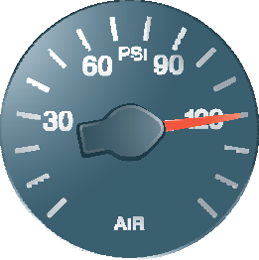




Reservoir pressure gauges
All air brake-equipped vehicles have at least one air pressure gauge on the instrument panel to indicate the air pressure in the service reservoir system.
Rather than having two separate reservoir gauges, one for primary and one for the secondary, some vehicles have a single gauge with two needles, indicating the pressure in the primary and secondary reservoirs as shown below on the right.
Notes:
Discuss operating pressures.
The governor should maintain the pressure in the reservoirs between 105 and 135 psi.
The governor should return to the reload stage 20 psi below maximum and must start to reload by 80 psi.
If the governor does not start to reload by 80 psi the vehicle is out of service and should not be operated.
Discuss the compressor test of 50 psi to 90 psi in under three minutes, the time starts when the first needle goes through 50 and the timer stops when the last needle goes through 90 psi.

Slide 42











Low-air warning device
The low-air warning device (with a light and buzzer) must come on when air pressure drops below 60 psi (414 kPa).
All vehicles equipped with air brakes must have a warning device to indicate if the air pressure in the system drops to a dangerous level.
This could occur if there’s an air leak, or if you apply the brakes repeatedly and have used up the air supply more rapidly than the compressor can replenish it.
Notes:
Checking the low air warning device:
Ask: How could we test the low air warning device during a pre-trip?
Answer – by intentionally lowering the air in the system. This is done by pressing and releasing the foot valve (fanning down) until the low air light and alarm (if equipped) comes on. It must activate by 60 psi or above.
This is done with the parking brakes released.
If the warning device fails to operate correctly, the vehicle cannot be driven until it is repaired.
The warning device must have a light. Ask: Why do you think a light is needed? (A hearing impaired person may operator an air brake equipped vehicle.)

Slide 43






Low-air warning device cont.
Some older vehicles have a low-air warning device near the top of the windshield that drops into the driver’s view when air pressure drops below approximately 60 psi.
Known as a wig-wag.
If it activates – stop and find the cause of the air loss.
Air pressure remaining in the system (about 60 psi) will be enough to stop the vehicle if you act promptly.

Slide 44

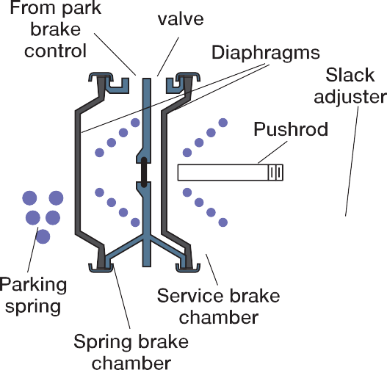



Parking brakes – spring parking brake
While air pressure does an excellent job to help stop a vehicle by applying the foundation brakes, it’s unreliable (and illegal) for use for parking.
If you park a vehicle using only the air, any leaks in the system, or any failure in a hose, diaphragm, or air valve would result in loss of air pressure and a possible rollaway collision.
Regulations for parking brakes require that the parking force must be maintained by mechanical means and be unaffected by loss of air pressure.

Slide 45
Parking brakes – spring parking brake cont.
Most spring parking brakes consist of an additional chamber attached to the rear of a service brake chamber. The added chamber contains a powerful coil spring arranged so that the spring force can be applied to the brakes through the normal service chamber pushrod.
Notes:
Ask: Why are spring brakes not placed on the steering axle?
Answer – In an emergency, the spring brakes may apply and they would lock up the wheels on the steering axle and possibility cause the driver to lose steering control.

Slide 46
Parking brakes – spring parking brake cont.
These brakes are applied and remain applied by mechanical spring pressure, not by air pressure. If air pressure falls beneath the amount needed to keep the spring compressed, the spring pushes against the pushrod in the service brake chamber.
This pushes the pushrod out against the slack adjuster to apply the foundation brakes.
Parking brake chambers are piggy-backed onto the service brake chambers and operate the foundation brakes through the same linkage
Notes:
Ask - If the brakes are out of adjustment how will it effect the parking brakes?
Show them on the diagram that the parking brakes use the same pushrod to apply the brakes so if the brakes are out of adjustment the parking brake will be less effective.

Slide 47
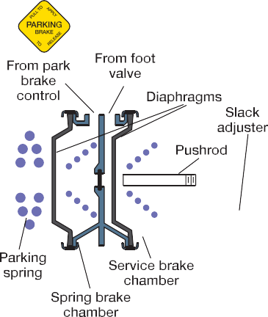



Applying and releasing spring parking brakes
Spring brakes are normally applied and released by using the parking brake control valve on the dashboard.
If the air pressure in the system falls below approximately 60 psi, the spring brakes may begin to apply or drag.
This diagram shows a spring parking brake chamber in the released position. The service brake is also in the released position. The parking brake diaphragm has inflated, compressing the main spring. The spring parking brakes are now released.
Notes:
Explain that air supplied to the parking control valve is from both primary and secondary air. This is referred to as blended air.
One other way to release the spring brakes is to manually cage or wind-off the spring brake by using a caging bolt. Important - if this is being done, block the wheels to prevent the vehicle from rolling away.
Questions to check understanding:
When driving, is there air in the spring brakes? The service brakes? Both sides? Or no air in the chamber at all?
Answer - Spring brakes are released when driving.
When driving, and you have to stop, if you apply the service brakes is there air in the service brake side? The spring brake side? Both sides? Or no air in the chamber at all?
Answer – air in both service and spring brake sides.
If you have completed driving for the day, park and apply the spring brakes for the night, is there air in the spring brake side? The service brake side? Both sides? Or no air in the chamber at all?
Answer - no air at all as the spring brakes have been applied and the spring brakes are a mechanical force that holds the brakes on.

Slide 48






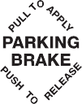






Parking brake control valve
A parking brake control valve (usually a yellow button) is mounted on the dashboard. In most cases, pushing this valve in allows air pressure to flow to the spring parking brake chambers, causing these spring parking brakes to release.
Pulling this valve out exhausts the air pressure against the spring parking brake chamber, causing these brakes to apply. Instructions are usually on the button.
While the push-pull parking brake control is the most common, some systems may use a switch instead. Usually flipping it in one direction applies the spring parking brakes and flipping it in the other direction releases them.
Notes:
Mention that some older systems may use a switch.

Slide 49
Driver alert – compounding of brakes
When spring parking brakes are applied, there’s up to 2,000 lbs. of force applied to all of the brake components.
If a heavy service brake application is made, the force of the air application is added to the spring force. This could add a further 3,000 lbs. for a total of 5,000 lbs. This is known as compounding and can damage slack adjusters, S-cams, brake chamber mounting bolts, brake shoe rollers, shoes and brake drums.
Note: lighter brake applications of less than 30 to 40 psi (207 to 276 kPa), to prevent a vehicle from rolling while the spring parking brakes are being released or applied, aren’t harmful.
Always be sure that you have released the spring parking brakes before making heavy service brake applications, such as during a pre-trip inspection.
Notes:
Confirm the students understand compounding is the adding of two forces spring brakes and service brakes at the same time.

Slide 50

















Spring parking brakes in dual air systems
The two-way check valve uses both primary and secondary reservoirs to supply the parking brake dash control with air.
The air that is delivered from the two-way check valve is frequently called blended air.

Slide 51
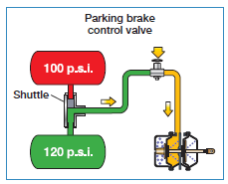
Two-way check valve
Two-way check valves have two inlet ports and one delivery port.
A free-floating shuttle within the valve moves away from the inlet with the higher pressure, and the higher pressure will be supplied to the parking brake control.
This ensures that spring parking brakes will not automatically apply if there’s total loss of air in one of the reservoirs.

Slide 52
Spring brakes
– when air is lost from the primary circuit
Spring parking brakes don’t apply automatically in a dual air system when air is lost from one circuit.
The low-air warning system alerts you to the air loss, allowing you to make a controlled stop using the front axle brakes.
Some vehicles with dual air systems have an optional device called a spring brake modulator.
The spring brake modulator senses a loss of pressure in the primary system, and when the service brakes are applied, causes air to be exhausted from the spring parking brakes in direct proportion to the brake application.
When applying the foot valve normally, you can control the amount of spring force used to assist the front brakes to bring the vehicle to a controlled stop.
Notes:
Explain that the air used to hold off the spring brakes is released in direct proportion to the foot valve application.
Note that you will not have many applications before the spring brakes apply and you will not be able to move the vehicle.

Slide 53
Other types of foundation brakes
Wedge brakes
Air Disc Brakes
Air-over-hydraulic brakes
Notes:
Discuss where you may find the different types of brakes.
For example wedge brakes are found on equipment that, due to limited space, you may not be able to use standard type 30 chambers, like a bus.
Air disc brakes may be found in any application. Air over hydraulic will be more commonly found on lighter units.

Slide 54
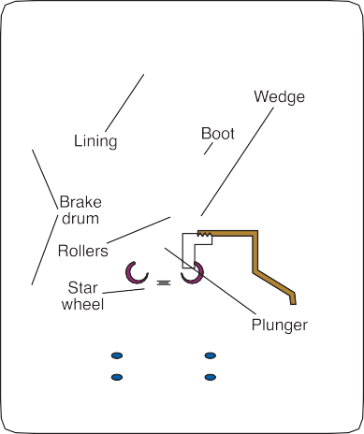







Wedge brakes
Notes:
Discuss that unlike conventional S-cam braking systems, you can’t easily check the wedge brake adjustment of a wedge brake.
Adjustment and repairs to wedge brakes should only be done by a qualified mechanic.

Slide 55
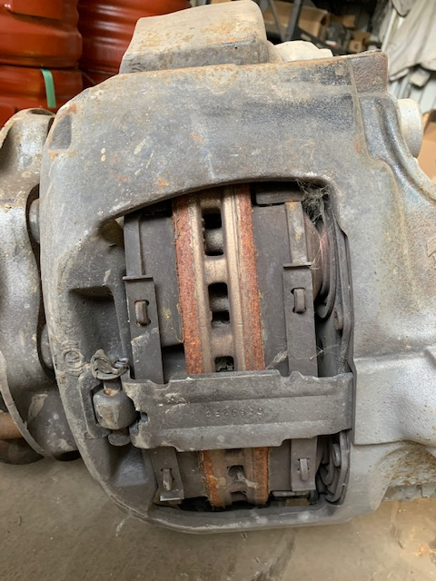
Air disc brakes
Notes:
Explain that, unlike conventional S-cam braking systems, you can’t easily check the adjustment of an air disc brake.
Make sure adjustment and repairs to air disc brakes are only done by a qualified mechanic.

Slide 56





















Air over hydraulic brakes
Notes:
Discuss similar parts shared as a standard car, and remind the students the fluid needs to be checked.
An air brake-endorsed driver’s license is required to operate most vehicles equipped with air-over-hydraulic brakes. The only exception is if the brake system doesn’t use an air treadle. In this case, an air brake-endorsed driver’s license isn’t required.

Slide 57
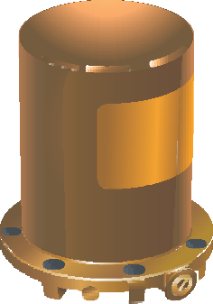
Air dryers
Air dryers are optional devices installed in the compressor discharge line between the compressor and the first reservoir.
Designed to remove any water vapour, oil mist and carbon particles from the air before it’s delivered to the first reservoir.
Even if the air brake system includes an air dryer, air reservoirs should still be drained daily to check for contaminants.

Slide 58
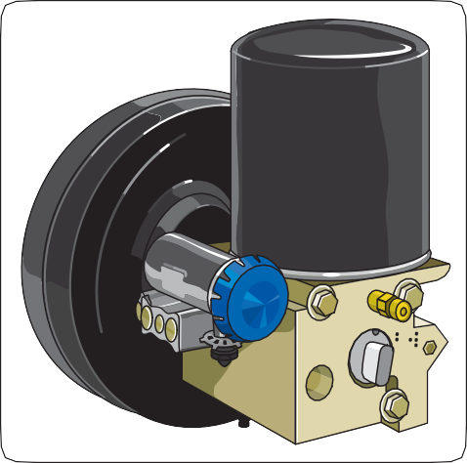
Air dryer integrated system (ADIS)
Integrated air dryer systems are common with most modern vehicle manufacturers.
One way to determine if you have an integrated air dryer system is the air dryer will be mounted to a small air tank.
Notes:
Review the following so the students understand the system builds air differently.
A unique feature is that air pressure builds in one service reservoir first and when pressure reaches approximately 100 psi the other reservoir will begin to fill.
Pressure in both service reservoirs and the air accessories circuit will then build to full pressure.

Slide 59









Alcohol evaporators and injectors
Alcohol evaporators and alcohol injectors are optional devices that introduce a small amount of alcohol vapour into the air system.
The alcohol vapour combines with any moisture that may be present. In effect, the alcohol acts as an anti-freeze, lowering the freezing point of any moisture that’s collected in the air system
Notes:
These systems are designed to use pure methyl hydrate to provide the alcohol. Be sure to use only methyl hydrate specifically formulated for use in alcohol evaporators or alcohol injectors.

Slide 60
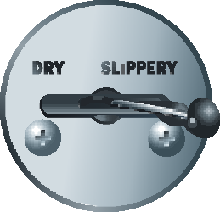
Front wheel limiting systems
Found on older trucks – pre year 2000.
Automatic front wheel limiting systems and manual front wheel limiting systems.
Notes:
Discuss the two types.
The automatic front wheel limiting valve has no driver input and the manual valve allows the driver to engage on slippery roads reducing air pressure to the front wheels.
Both have been replaced on vehicles manufactured after April 2000 by ABS.

Slide 61
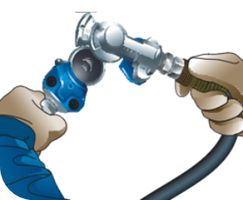
Gladhands
Gladhands are used to deliver air to the trailer.
In your single you may find these on the rear of the unit.
Make sure the gladhands are stowed on the holders or coupled together.
Notes:
Ask the students why it is important to couple them together or stow them on the holders? (To keep dirt out of them. If they have dirt in them they will deliver this to the valves in the system.)

Slide 62












Bobtailing
Driving a tractor without a trailer attached is called bobtailing.
Because a bobtail tractor has very little weight over the rear drive axles, it’s very easy to lock up the rear brakes, even with a light brake application.
To help prevent this unwanted lockup and to increase control, some tractors are equipped with a bobtail proportioning system.
Notes:
Instructor notes:
When the tractor is being driven with a trailer attached, the tractor brakes operate normally. But when bobtailing, the braking pressure to the drive axle brakes is reduced by as much as 75 %, preventing the rear brakes from locking.
The steering axle brakes receive full application pressure.
A tractor with a bobtail proportioning system will stop in a shorter distance and control will be increased, especially on wet or slippery road surfaces.
Because the steering axle brakes are doing most of the braking, a higher than normal pedal pressure is required.

Slide 63
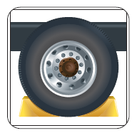
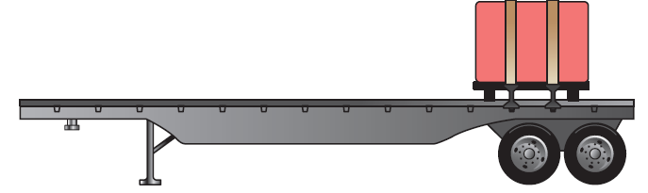
Empty trailers
When leaving a trailer, make sure you leave it with the wheels chocked.
Notes:
Why would you want to make sure the wheels are chocked? Answer - to make sure it doesn’t roll away.

Slide 64







Air brake adjustment
Federal and Provincial law require you check manual and automatic slack adjuster daily during the pre-trip inspection.
Slack adjustment = adjusting the brakes to keep the air chamber pushrod travel within tolerance.
Pushrod travel = the distance the pushrod extends from the brake chamber when the brakes are applied.
Slack Adjustment
Pushrod travel
Brake chambers
Notes:
Explain that during a pre-trip drivers have to check the travel either by the pry bar method or application method. Give the students the measurements for both the pry bar method and the applied stroke.
Advise one of the common brake chambers is a type 30 with 2.5 inches of stroke. There is also a long stroke brake chamber identified by the square inlet port which has 3 inches of travel.
Explain if one brake is out of adjustment the others will have to work harder and may overheat.

Slide 65









Importance of brake adjustment
Importance of properly adjusted brakes:
Overheating – improperly adjusted brakes or worn parts in brakes.
Brake fade - brake drum expands away from the brake shoes, you have to push harder on the brake pedal to maintain the same braking force.
If the drum continues to expand away from the shoes, the pushrod plate inside the brake chamber hits the bottom of the brake chamber and you have no more stroke available to apply the brakes. This will now be a runaway situation.
Notes:
Expand on slide details…
If you do not have properly adjusted brakes or you have worn parts in your brakes you have the risk of your brakes overheating.
If your brakes are not properly adjusted, as the brake drum heats from the friction of the brakes, the brake drum will expand away from the brake shoes.
If the brake shoes are worn, or the brake drum is worn, this may happen quicker then a well maintained braking system.
If the drum continues to expand away from the shoes you may experience what is know as “bottoming out” which means the pushrod plate inside the brake chamber hits the bottom of the brake chamber and you have no more stroke available to apply the brakes.

Slide 66
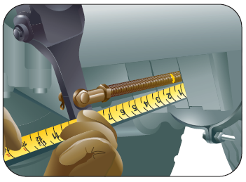
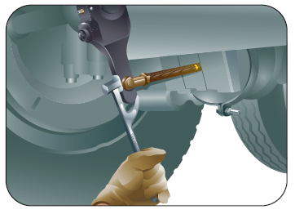
Checking brake adjustment
Notes:
Confirm the air is over 100 psi the wheels are chocked, and the brakes released.
If using the pry bar method, you will need a bar and you’ll use the bar to extend the pushrod.
The travel should not exceed ½ to ¾ of an inch. The travel should be the same of each side of the axle.
Adjust as required.
If using the applied stoke method, you’ll need two people or a way to hold a full brake application.
Make and hold a brake application
Check pushrod travel it should be 1 ½ to 1 ¾ on each wheel.
Confirm the travel is the same at both wheels on the axle.
Adjust as required.
It should be noted that automatic slack adjuster may extended to 2 inches.
Some air brake chambers will have a red band on the pushrod. If this red band is visible the brake is out of adjustment.

Slide 67
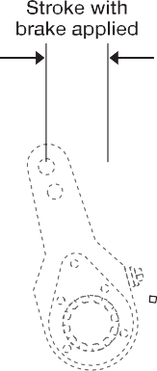
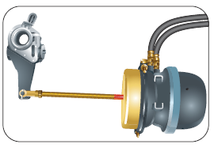



Adjusting a manual slack adjuster
Notes:
To adjust brakes with a manual slack adjuster check the travel with one of the methods – pry bar or applied stroke.
Note the direction the end of the S-cam rotated when the brakes where being applied.
If the brake need adjustment, push in the locking collar and turn the nut so the end of the S-cam rotates in the same direction it did to apply.
Tighten the nut until there is resistance.
Check to make sure there is no travel on the push rod
Back the nut off 1/3 of a turn and recheck the travel to confirm there is between ½ and ¾ inch of travel.
Confirm that the locking collar has come back out to cover the nut.

Slide 68
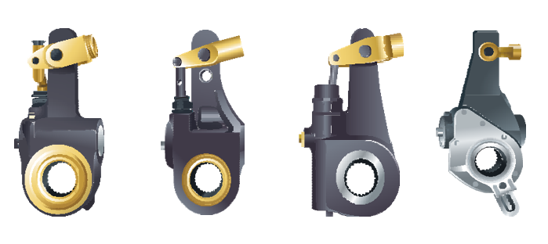
Automatic slack adjusters
Crewson Brunner
Gunite
Rockwell
Haldex
Notes:
Go over the different types of automatic slack adjustors.
If an automatic slack adjustor requires adjustment, refer to adjuster manual – these can be downloaded from the manufacturers website.
If an auto slack needs adjustment, have it checked at a shop as soon as possible. It needs replacing.
Optional - if the instructor knows how to adjust the different types, go over how to adjust them, time permitting.

Slide 69



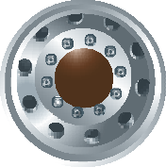


Air brake pre-trip – getting started
Before getting started:
make sure you are safe and seen
block the wheels
place transmission in low gear.

Slide 70
Air brake pre-trip - reservoirs
Check to see if you have some air on the air gauges.
Drain the supply tank(wet tank) if equipped.
Recheck the gauges to see if the air in the reservoirs remained the same this confirms the one way check valve is working.

Slide 71
Air brake pre-trip – foundation brakes
Open the hood and check the travel of the slack adjustor.
Check the air line coming out to the brake chamber for cracks or damage.
Check the brake chamber to ensure it is in good condition and secure (firmly mounted).
Repeat this on both sides.
Notes:
Ask: What was the travel allowed on a pry bar method? (1/2 - 3/4)
Explain that they should check the complete foundation brakes.
Ask: What were the foundation brake components?

Slide 72
Air brake pre-trip - compressor
Check the compressor to ensure it is secure and the discharge line (the main line of the compressor) is in good condition.
Check that all other air lines under the hood are secure and in good condition.
Check that there are no coolant or oil leaks.
Notes:
If the vehicle is equipped with a belt driven compressor, check the condition and tension of the belt.

Slide 73
Air brake pre-trip – in cab
Get into the vehicle, confirm the vehicle is in neutral, and start the vehicle.
Release the brakes by pushing in the yellow parking brake control valve.

Slide 74
Air brake pre-trip – governor
Press and release the brake pedal – called fanning down - to lower the air no lower then 80 PSI. Allow the compressor to build to maximum air pressure between 105-135.
Next, lower the air 20 PSI to confirm the governor puts the compressor into the reload stage, this will be determined when the needles begin to climb. Continue to fan down to check that the low air warning comes on by 60 PSI.
Continue to lower the air pressure until both needles are below 50.
Then, check the compressor. When the first needle hits 50 PSI start timing. The compressor must build from 50 to 90 PSI in under 3 minutes at 1000-1200 RPM. Stop the timing when the last needle goes through 90 PSI.
Confirm the parking brakes remained released, and continue to build to maximum air to confirm that the governor puts the compressor into the unload stage between 105 and 135.

Slide 75
Air brake pre-trip – leak test
With the brakes released, the engine off and the window open to hear any audible air leaks, make a firm brake application.
To perform a leak test, hold a firm brake application for 1 minute, you cannot lose any more then 3 PSI during that time.
Listen for any audible air leaks.
Once completed, confirm there is a minimum of 100 psi in the reservoirs, confirm the brakes remained released, put the vehicle in low gear, take the keys, and exit the vehicle.
Notes:
Ask: Why do we have to have the engine turned off?
Ask: Why would you want to take the keys with you?

Slide 76
Air brake pre-trip – under vehicle
Go under the rear of the vehicle to check the air tanks to confirm they are secure, the air lines are tied up and secure
Then, move back to the rear wheels to perform the same checks as at the front wheels

Slide 77
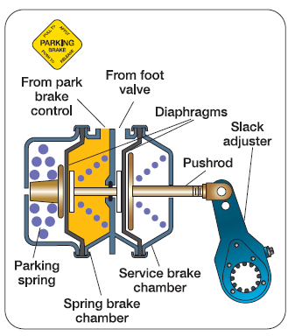
Air brake pre-trip – rear wheels
Check at each wheel that the air lines going into the brake chambers are in good condition, the brake chambers are in good condition, and that you have the correct travel.
Use either the pry bar method or the applied stoke method.

Slide 78
Air brake pre-trip – apply the brakes
Exit from under the vehicle and apply the brakes by pulling the yellow button.

Slide 79
Air brake pre-trip – remove blocks
Once the brakes are applied remove the wheel blocks.

Slide 80
Air brake pre-trip – brake response
Two-way brake response test
Enter the vehicle and confirm the transmission is in neutral.
  Start the vehicle, place in low gear with the parking brakes applied.
  Try to move the vehicle to confirm the parking brakes are holding.
If the brakes hold, release the parking brakes and allow the vehicle to roll ahead.
  Using the foot valve make a brake application to confirm the vehicle will stop.
Notes:
When pulling against the parking brakes to confirm they are holding, stress that this is a gentle pull.
If the student is not licenced to drive the vehicle you are using, the brake response test must be done verbally.
It is always the drivers responsibility to ensure the systems is function properly and is safe to operate.

Slide 81
Recap critical checks
  You must not drive if:
  Pushrod stroke of any brake exceeds the adjustment limit
  Air loss rate exceeds prescribed limit
  Low air warning system fails or system is activated
  Inoperative service or parking brake
  You may be able to drive but get these checked by a mechanic:
  Audible air leak
  Slow air pressure build-up rate
Notes:
Ensure students understand what defects are a must-not-drive problem.

Slide 82
Air brake “Jeopardy” game
The following slides are for the game. Use slide presentation mode.
Notes:
The game must be run in slide presentation mode. Explain how the game works.
List student names on the board and have them take turns selecting a question.
Click on dollar amount under the selected category to go to the question.
After they guess, click on the slide to see the correct answer.
The house icon at the bottom right corner will take you back to the selection slide.

Slide 83
Jeopardy
P.S.I.
Numbers
Valves
On the Road
Take a Brake
$100
$100
$100
$100
$100
$200
$200
$200
$200
$200
$300
$300
$300
$300
$300
$400
$400
$400
$400
$400
$500
$500
$500
$500
$500
Final Jeopardy

Slide 84
1 - $100
The low air alarm activate by this p.s.i.
60 p.s.i.

Slide 85
1 - $200
The safety valve should activate at this p.s.i.
150 p.s.i.

Slide 86
1 - $300
The governor must return the compressor to the loading stage between these p.s.i.
80 to 85 p.s.i.

Slide 87
1 - $400
This is the acceptable p.s.i. loss in an air leak test on a single unit.
3 p.s.i.

Slide 88
1 - $500
An automatic front wheel limiting valve will deliver 100% application pressure to the front wheels at this p.s.i.
60 p.s.i.

Slide 89
2 - $100
Using the pry bar method, air brakes in proper adjustment should be within these measurements.
½ to ¾ of an inch

Slide 90
2 - $200
This is the force delivered to the push rod when a 100 p.s.i. application is made with a Type 30 brake chamber diaphragm.
3000 p.s.i.

Slide 91
2 - $300
This is the percentage the braking performance of the front brakes is reduced by when a manual front wheel limiting valve is activated.
50%

Slide 92
2 - $400
This is the maximum time for a compressor to build from 50-90 p.s.i.
3 minutes

Slide 93
2 - $500
This is the maximum push rod travel on a long stroke type 30 brake chamber.
3 inches

Slide 94
3 - $100
This valve can maintain the same delivery pressure even if there is a small leak.
Foot valve

Slide 95
3 - $200
Air loss is protected by this valve if the discharge line is damaged.
One-way check valve

Slide 96
3 - $300
This allows operation of the rear brakes if there is a primary system failure.
Spring brake modulator valve

Slide 97
3 - $400
This speeds up service brake application to the rear wheels.
Relay valve

Slide 98
3 - $500
This is required whenever two sources of air are used to deliver blended air to a single device or system.
Two-way check valve

Slide 99
4 - $100
This is the number one reason for an air brake system failure.
Brakes out of proper adjustment

Slide 100
4 - $200
This will occur when the brake drums exceed the safe operating temperature.
Brake fade

Slide 101
4 - $300
This is the final factor that will determine if a vehicle will move.
Traction

Slide 102
4 - $400
This is how often an operator is required to inspect a belt for cracks and adjustments on a belt driven compressor.
Daily

Slide 103
4 - $500
This is usually 4/10th of a second long in a properly maintained air brake system.
Brake lag

Slide 104
5 - $100
This performs as a parking brake.
Spring brakes

Slide 105
5 - $200
If the speed of the vehicle is double, you will require this much force to stop in the same distance.
4 times

Slide 106
5 - $300
The advantage of this type of circuit system is to avoid total brake failure.
Dual circuit system

Slide 107
5 - $400
A bobtail proportioning valve reduces the air pressure to the rear wheels by this percentage.
75%

Slide 108
5 - $500
To keep dirt out of the lines that deliver air to the trailer, make sure that these are attached to the holder or coupled together.
The gladhands

Slide 109
Final Jeopardy
The governor should signal the compressor to resume building air pressure at this point.
20 p.s.i. below maximum

