Slide 1
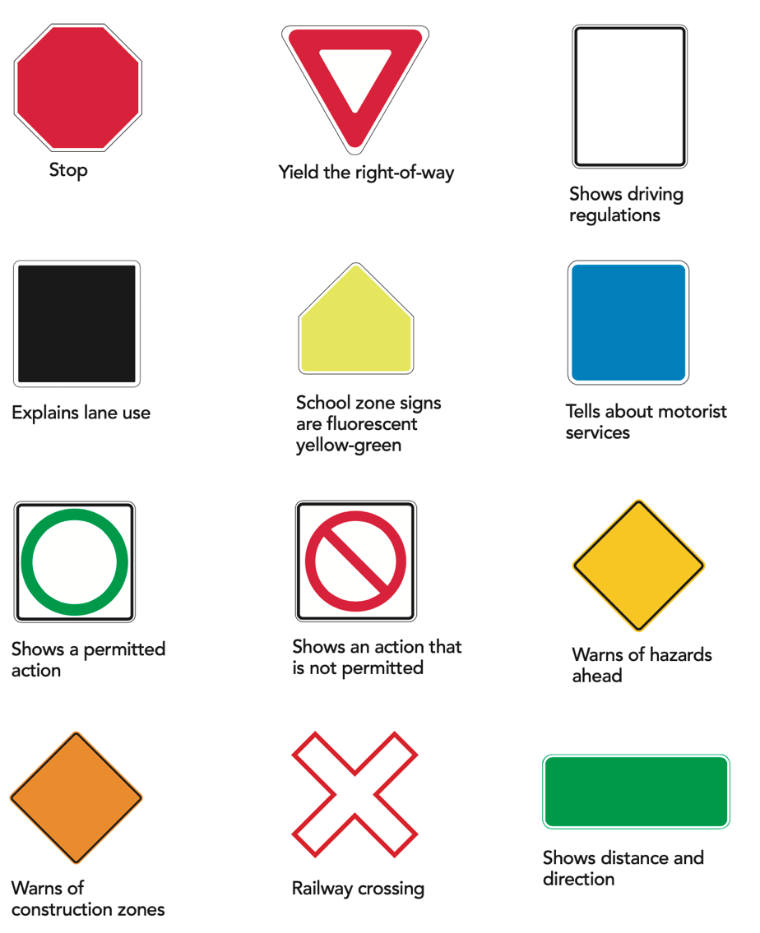
Signs, Signals & Road Markings
Notes:
Instructor notes:

Slide 2
Unit overview
Clarify traffic rules
Identify signs that are especially important to commercial vehicles
Appreciate the importance of knowing and following regulations attached to signs, signals and road markings
Notes:
Instructor notes:
Provide an overview of the unit
Ask: why do we have traffic control devices?

Slide 3
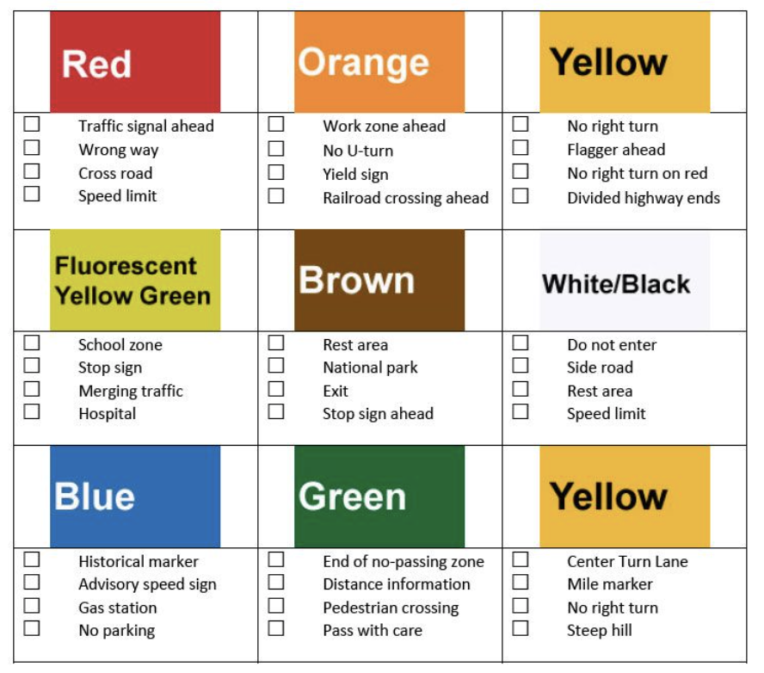
Traffic sign colours
Notes:
Instructor notes:
Red generally means stop or no. The use of red on signs is limited to stop, yield, and prohibition signs.
A white background indicates a regulatory sign.
Yellow conveys a general caution message.
Green shows permitted traffic movements or directional guidance.
Fluorescent yellow/green indicates pedestrian crossings and school zones.
Orange is used for warning and guidance in roadways work zones.
Coral is used for incident management signs.
Blue indicates road user services, tourist information, and evacuation routes.
Brown is used to show guidance to sites of public recreation or cultural interest

Slide 4
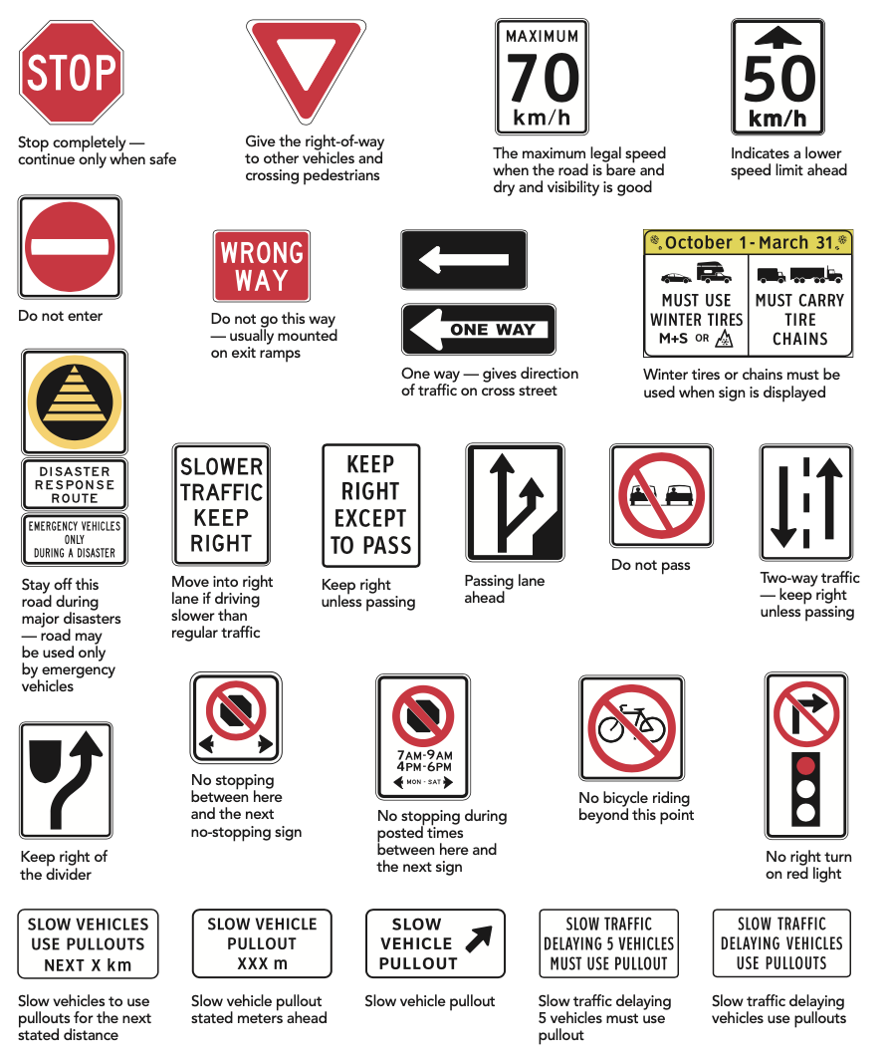
Regulatory signs
Notes:
Instructor notes:
These signs tell you about driving laws and regulations.
Drivers who do not follow the instructions on these signs may receive penalties.

Slide 5
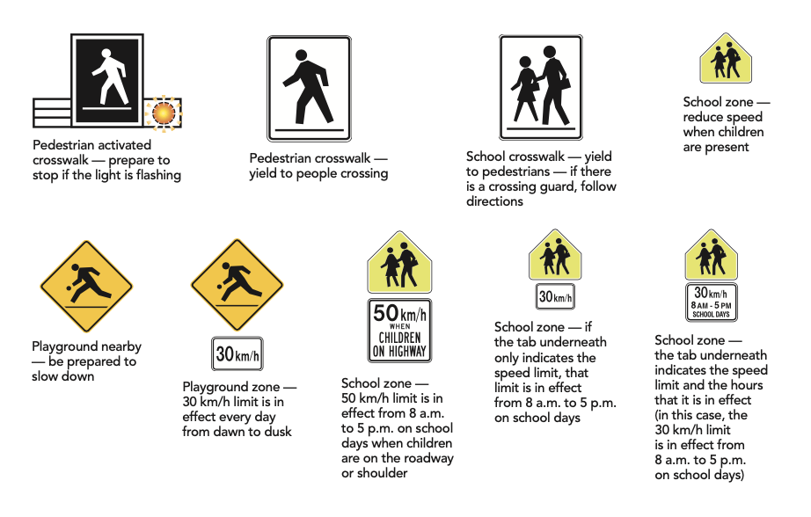
School, playground and crosswalk signs
Notes:
Instructor notes:
These signs tell you the rules to follow in areas where you need to be extra cautious.

Slide 6
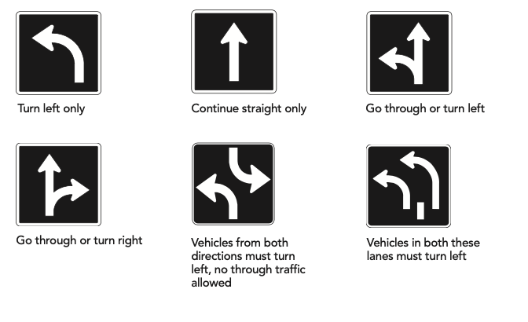
Lane use signs
Notes:
Instructor notes:
Signs showing which lanes may be used to turn or go straight are mounted above the lane or at the side of the lane before the intersection.
If you are in a designated lane, you must follow the direction indicated by the arrows.
You may not move into or out of a designated lane while you are in an intersection.

Slide 7
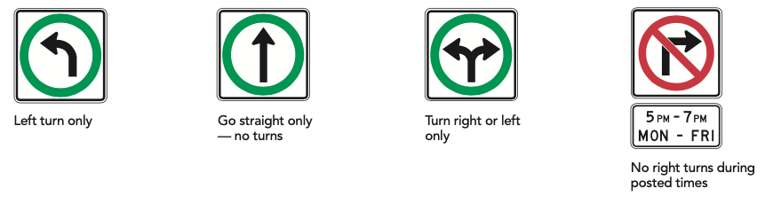
Turn control signs
Notes:
Instructor notes:
Turn control signs are mounted directly above the intersection.
You must follow the direction of the arrow.

Slide 8
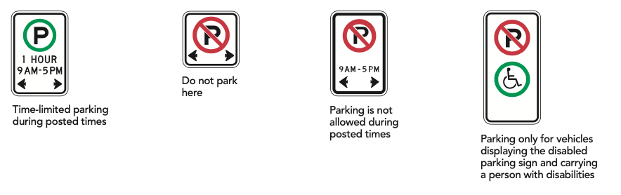
Parking signs
Notes:
Instructor notes:
Parking signs let you know where and when you are allowed to park.
You may receive fines or your vehicle may be towed (or both) if you park illegally.

Slide 9
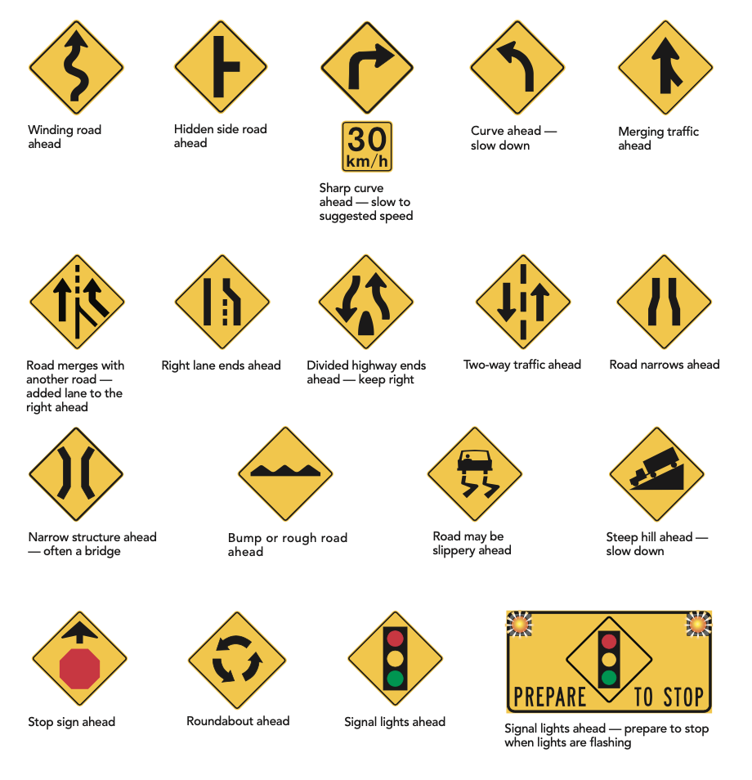
Warning signs
Notes:
Instructor notes:
Most warning signs are yellow and diamond-shaped. They warn of possible hazards ahead.

Slide 10
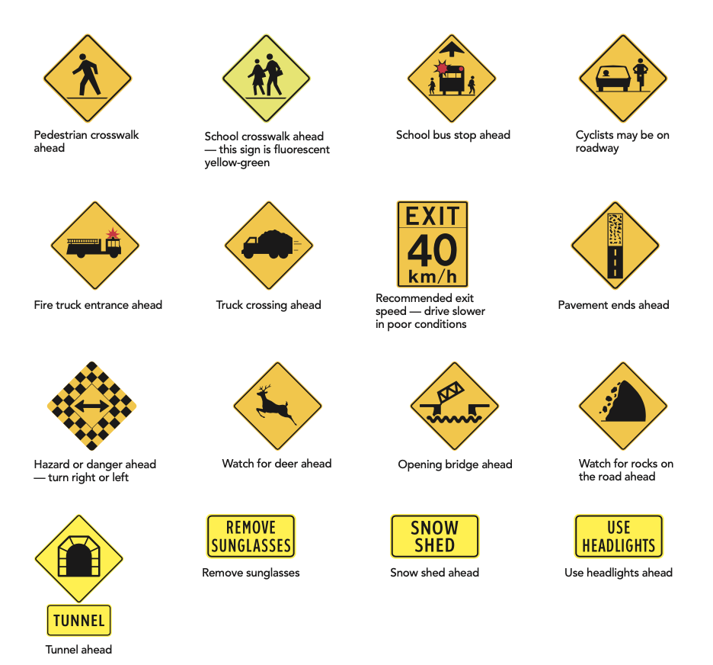
Warning signs continued
Notes:
Instructor notes:
Most warning signs are yellow and diamond-shaped. They warn of possible hazards ahead.

Slide 11
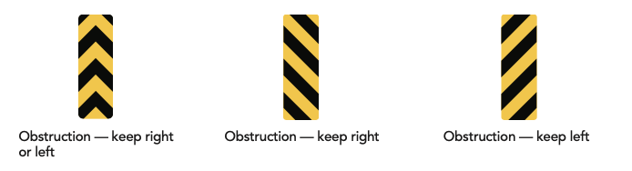
Object markers
Notes:
Instructor notes:
Pay special attention to object markers — they are mounted on obstructions.

Slide 12
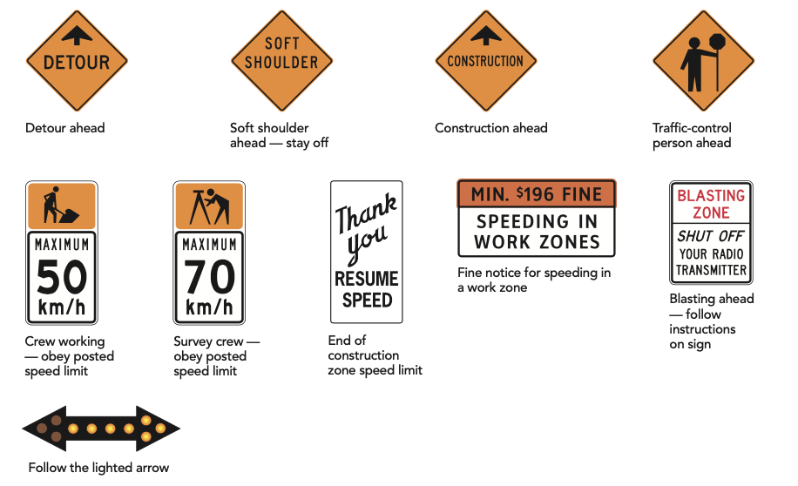
Construction signs
Notes:
Instructor notes:
These signs warn of construction and maintenance work – pay attention!
Obey traffic-control persons, travel within the posted speed, stay well back from all equipment and pass only when it is safe.

Slide 13
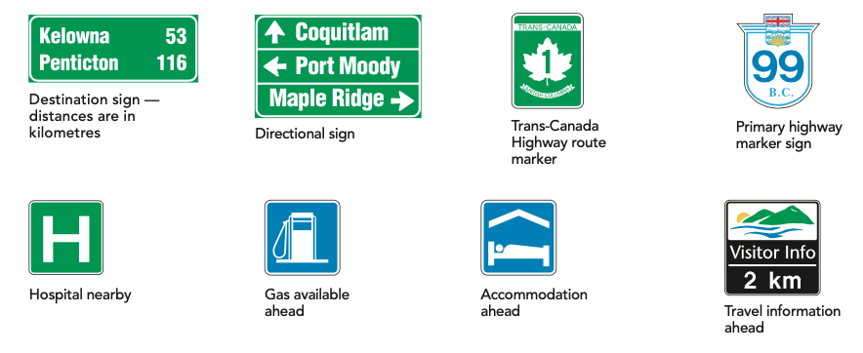
Information and destination signs
Notes:
Instructor notes:
These signs give information about destinations, route numbers and facilities.

Slide 14
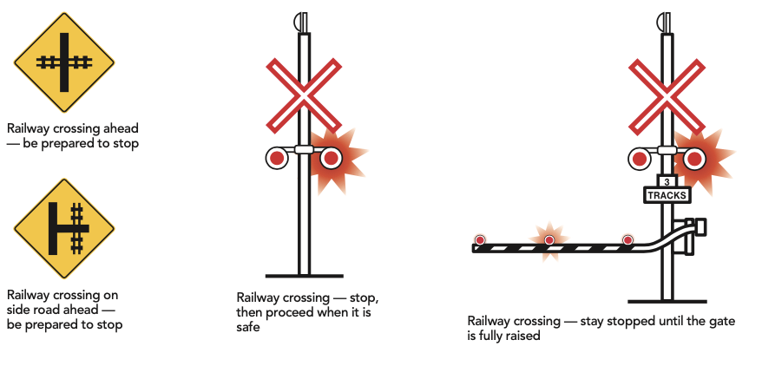
Railway signs
Notes:
Instructor notes:
Public railway and highway crossings are indicated with signs or pavement markings and may also have mechanical or electrical warning devices for your protection.

Slide 15
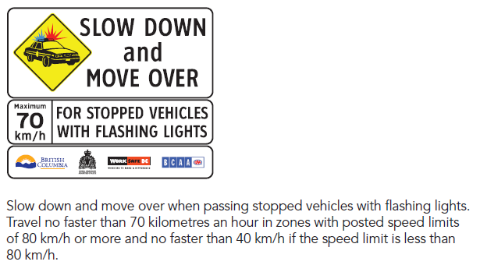
Stopped vehicles with flashing lights

Slide 16
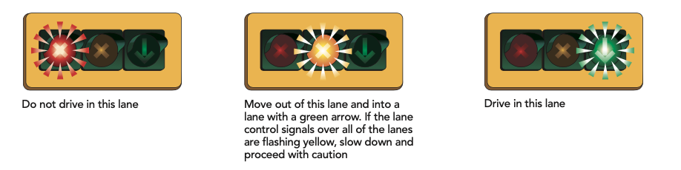
Signals
Notes:
Instructor notes:
Lane control signals are placed over lanes to indicate which ones are open for driving.

Slide 17

Lane control signals
Notes:
Instructor notes:
Lane-use control signals are special overhead signals placed over a certain lane or lanes. They permit or prohibit drivers to use the lane beneath the signal.
You can distinguish lane-use control signals from other signs and signals by their placement over a certain lane or lanes and by their distinctive shapes and symbols.

Slide 18
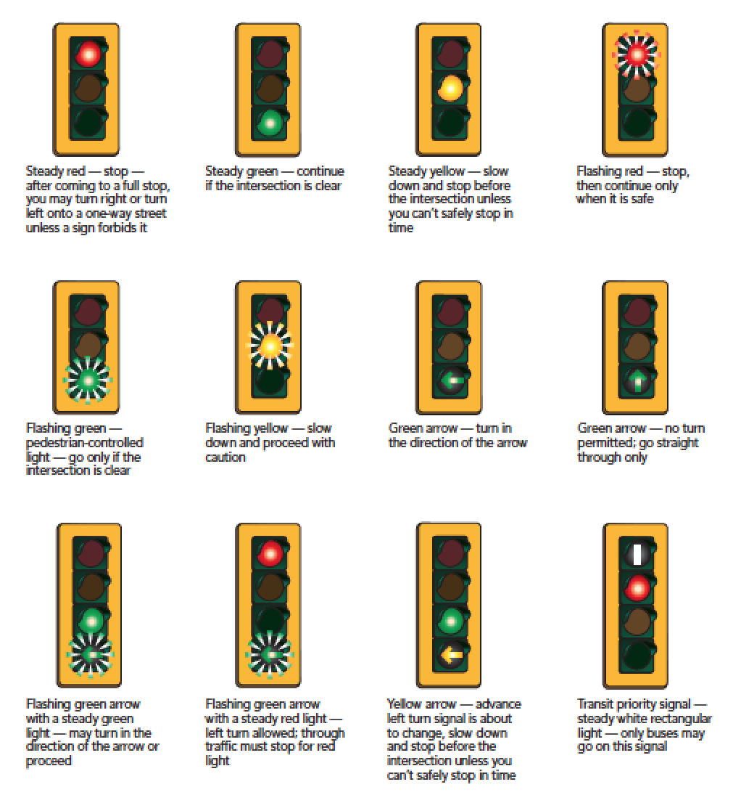
Traffic lights
Notes:
Instructor notes:
The colour of the light determines which stream of traffic has the right of way.
Generally, a red light means “stop,” a yellow light means “caution” and a green light means “go.”
These signals can have slightly different meanings if they are flashing or if they are shaped as arrows rather than circles. In some places green arrows may flash; in others they may not.
The traffic control signal may be vertical or horizontal.

Slide 19
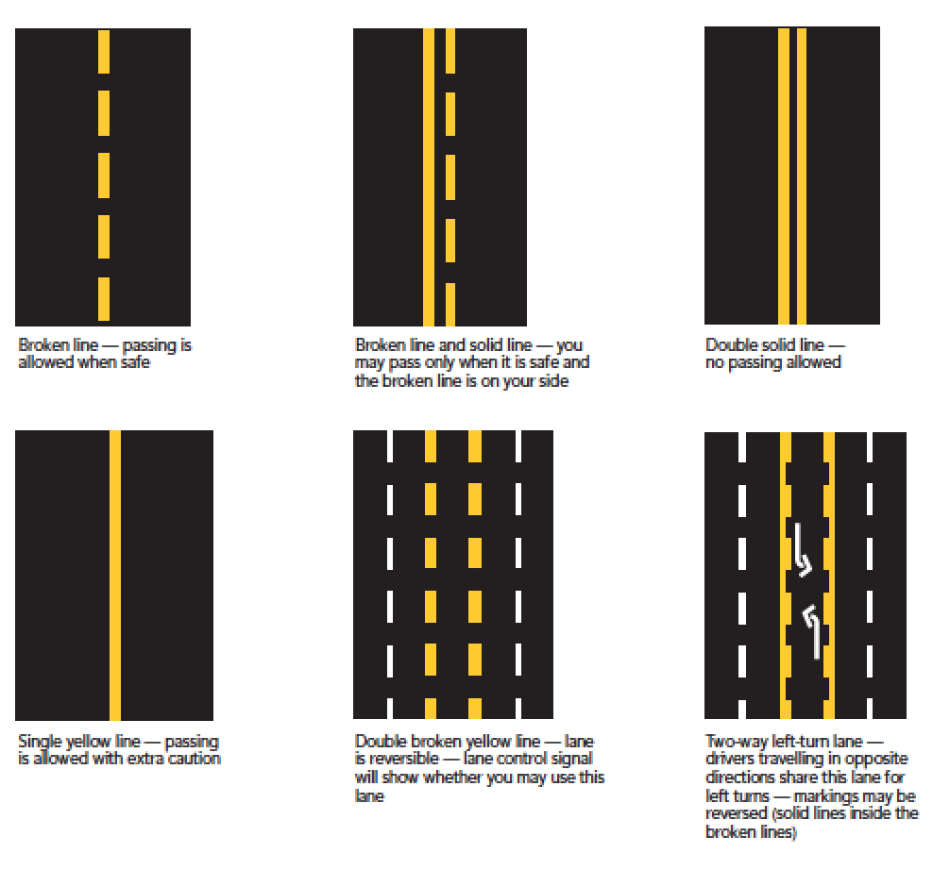
Road markings – yellow lines
Notes:
Instructor notes:
Road markings give you warnings or direction. It is illegal to drive over freshly painted, wet pavement markings.
Yellow lines
Yellow lines divide traffic moving in opposite directions. If there is a yellow line to your left, there will be traffic coming towards you on the other side of that yellow line.

Slide 20
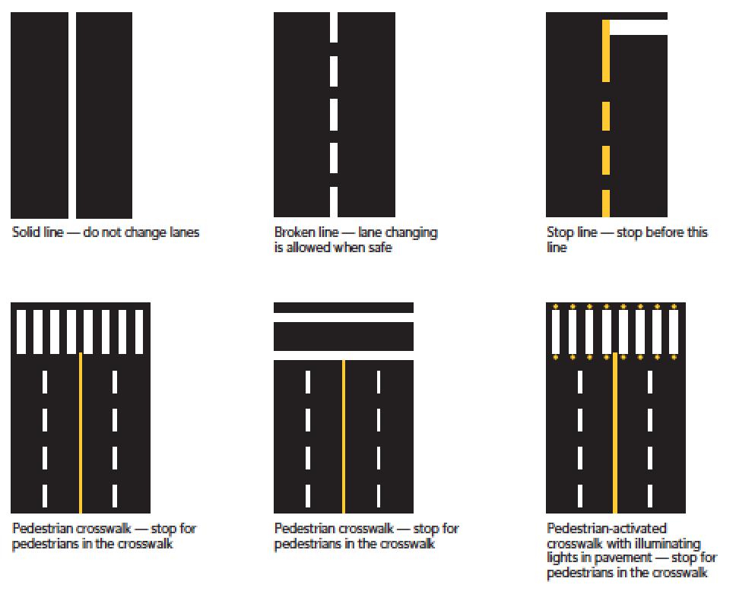
Road markings – white lines
Notes:
Instructor notes:
White lines
White lines are used to separate lanes of traffic moving in the same direction.
White lines also mark crosswalks, stopping positions and the right shoulders of highways.

Slide 21
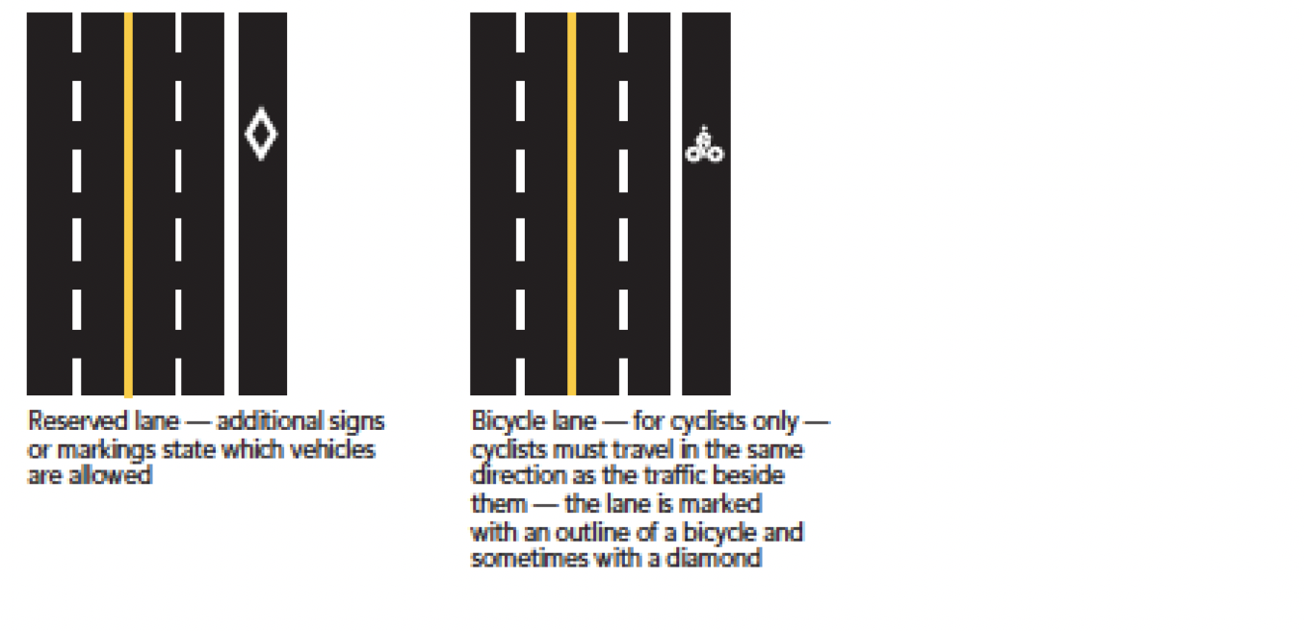
Reserved lane markings
Notes:
Instructor notes:
These markings set off lanes for HOVs, buses and bicycles. HOV lanes are marked with thick solid or broken lines and white diamond symbols.

Slide 22
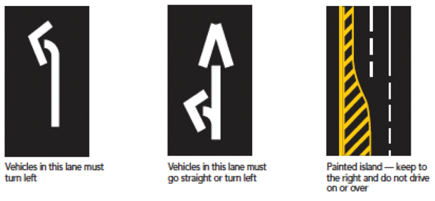
Other markings

Slide 23
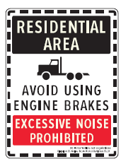
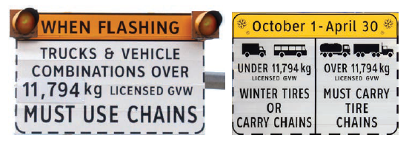
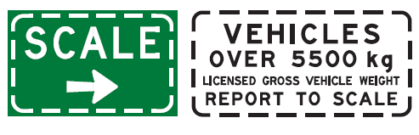
Commercial vehicle signs

Slide 24
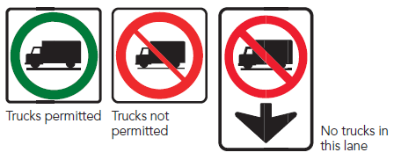
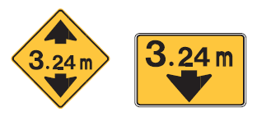
Commercial vehicle signs – lanes and space

Slide 25
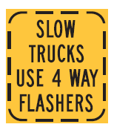
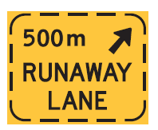
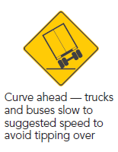
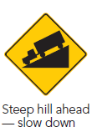
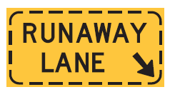
Commercial vehicle signs - hills and curves

Slide 26
Commercial vehicle signs - hills

