Slide 1
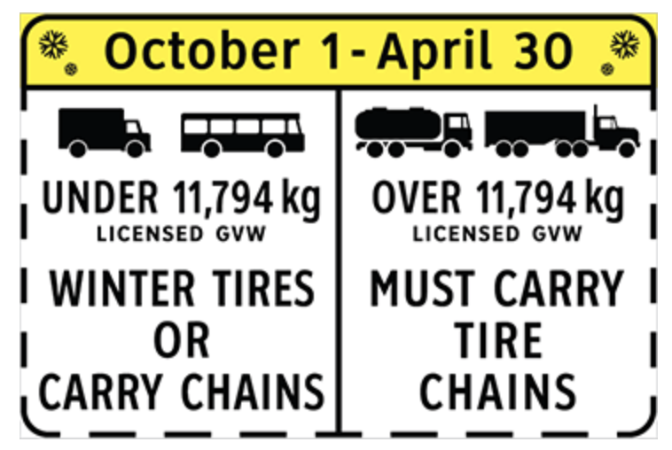
MELT Class 1 Driver Training
Tire Chains
Notes:
In some cases tire chains are required for your vehicle to operate. In fact, you can be fined for not having them. The B.C. Ministry of Transportation will have signs posted. Any vehicle over 11,794 kg found crossing that point without proper tires is subject to a fine.
From the MoTI website: Drivers must obey winter tire and chain signs throughout the province from October 1 to April 30. For select highways not located through mountain passes and/or high snowfall areas, tire and chain requirements end March 31.

Slide 2
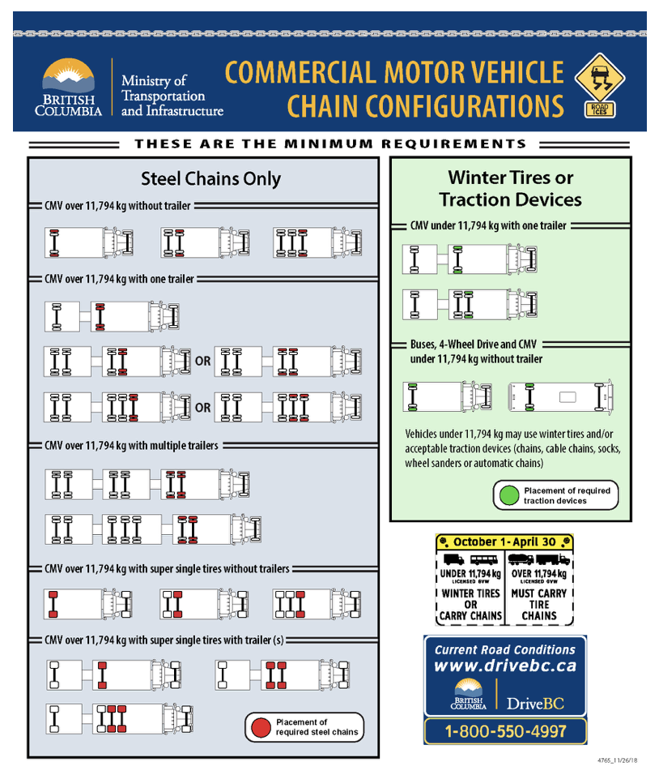
Chain configurations
Notes:
Instructor notes:
Depending on the LGVW, vehicle type, and configuration of commercial vehicle, the requirements vary for type, number, and placement of chains or acceptable traction devices.
Have students refer to this chart in the student guide.

Slide 3
Preparing to chain up
Choose safe location, away from traffic
Park vehicle on stable and level ground
Set parking brakes
Wear high visibility clothing
Gather needed equipment:
  Pliers & gloves
Notes:
Instructor notes:

Slide 4
Applying chains
Drape chains over tire according to type
Move vehicle to roll the chains onto the tire
Triple chains:
  attach centre
  inside and outside clips
Adjust and tighten using adjustment wrench
Attach bungees correctly (if required)
Notes:
Instructor notes:

Slide 5
Removing chains
Park vehicle on stable and level ground (if possible)
Set parking brakes
Wear high visibility clothing
Remove bungees (if applicable)
Triple chains:
  release clips
Lay chains flat
Drive off of chains
Check condition of chains
Properly store chains
Notes:
Instructor notes:

Slide 6
How to install tire chains
Video - B.C. Ministry of Transportation
How to Install Tire Chains on a Commercial Vehicle (7:59)
https://www.youtube.com/watch?v=SKcibc-Qc78
Notes:
Instructor notes:

