Slide 1
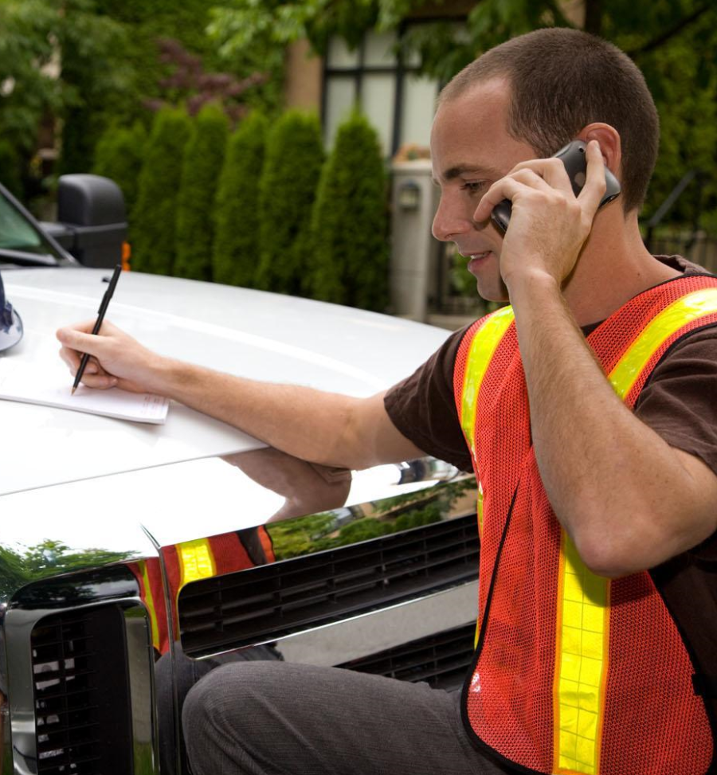
MELT Class 1 Driver Training
Workplace Communication

Slide 2
Unit overview
Communicating appropriately – words, tone, gestures and body language
Being sensitive to cultural, ethnic and gender diversity
Communication devices
Notes:
In this unit you will learn about the basic skills needed for workplace communication. To become a successful professional, a driver has to be able to communicate clearly and correctly to co-workers, the public and clients.
Effective communication begins with recognizing the barriers to good communication and using strategies to overcoming them.
Recognizing your own communication style can help you adapt to others.
Drivers use a variety of electronic tools to communicate and this unit provides a brief introduction to them.

Slide 3
Communication styles
Notes:
Ask the students what they already know about effective communication.
Do they know someone who is a good communicator? What makes them a good communicator? (For example, someone who asks questions and is a good listener).
Do they know someone who is not a good communicator? What do they do that isn’t effective? (For example, they interrupt, express their own thoughts or offer advice without listening fully.)
What questions could you ask someone to fully understand what they are attempting to communicate?

Slide 4
What is your primary communication style?
Let’s take the quiz and find out...
Notes:
Refer students to the quiz in their workbook

Slide 5
Communication style scoring guide
Mostly A’s: passive
Mostly B’s: passive-aggressive
Mostly C’s: aggressive
Mostly D’s: assertive
Note: If you have two scores that are high and very close in number, this means you probably use both styles as needed, usually choosing the communication score with the highest score first.
Notes:
Instructor notes:
Briefly discuss what the students noticed about each of the four styles.
Which style would provide the clearest and most respectful communication?
(Hopefully students will agree that assertive is the way to go!)

Slide 6
How to become an assertive communicator
Take ownership (use “I” statements)
Maintain eye contact
Learn to say “no”
Ask questions
Listen
Voice your needs and desires confidently
Notes:
Instructor notes:
Understanding how others communicate can be key to getting your message across to them. In order to develop a more assertive communication style, here are a few tips to keep in mind.

Slide 7
Barriers to communication
External barriers
Vocabulary/language use barriers
Situational barriers
Age
Physical appearance
Cultural attitudes
Body language
Gender language
Notes:
Discuss factors that may create barriers to communication.
Explain that we have an activity about gendered language – next slide.

Slide 8
Gender inclusive language activity
Gendered noun | Gender neutral noun
Actress
Anchorwoman, anchorman
Man-mad
Flag man
Businesswoman, businessman
Chairwoman, chairman
Fireman
Mailman
Policeman
Saleswoman, salesman
Stewardess, steward
Waitress
Man
Mankind
Handyman
Housewife
Notes:
Explain:
You’ll be interacting with people of varying ages, social circles, identities, ethnicities and experiences.
Gender inclusive language means speaking and writing in a way that doesn’t discriminate against a specific sex or gender identity and that does not perpetuate gender stereotypes.
Making your daily language gender inclusive and free of bias will ensure that you won’t offend the people you communicate with.
Changing your language or expecting the change from others can take time. A lot of the language we use day to day is deeply rooted in habits that have been formed over time.
Creating gender neutral conversation can be challenging but noticing the habits within your conversation and how they prolong stereotypes can be an eye opening experience.
Have students to the workbook activity in pairs or triads.

Slide 9
Gender inclusive language ideas
Gendered noun | Gender neutral noun
Actress | Actor
Anchorwoman, anchorman | Anchor
Man-made | Machine-made, synthetic, artificial
Flag man | Flagger
Business woman, business man | Business person
Chairwoman, chairman | Chair, head, chairperson
Fireman | Firefighter
Mailman | Mail carrier, postal worker
Policeman | Police officer
Saleswoman, salesman | Salesperson, sales attendant
Stewardess, steward | Flight attendant
Waitress | Waiter, server
Man | Person, individual
Mankind | People, human beings, humanity
Handyman | Fixer, maintenance person
Housewife | Homemaker
Notes:
Explain that the use of “they” instead of “he” or “she” is now considered acceptable and, in fact, sometimes preferable when referring to a person.
Ask: Has anyone discovered you’ve been using gendered language? Would you be willing to share?

Slide 10
Listening well
What can you do to make sure you listen well?
Notes:
Have student brainstorm ideas then compare to the ideas on the next slide. This is very subjective so all ideas are good.

Slide 11
What can you do to make sure you listen well?
Stop talking
Eliminate distractions - move to a quiet place
Recognize and tune out personal bias
Focus on the speaker's problems rather than your own
Use tone of voice and body language to show that you are listening
Focus on the content of the message rather than on the speaker or their communication style
If the speaker has an accent different from yours, it can be helpful to look at their mouth when they are talking.

Slide 12
Body language activity
How can one’s body language affect your communication with another person?
Notes:
Instructor notes:
Discuss briefly then do the role play activity.

Slide 13
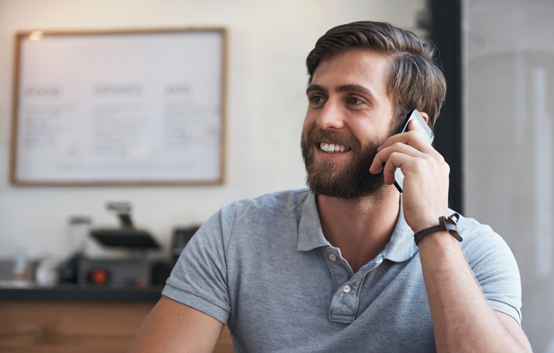
Using communication technology

Slide 14
Communication technology continued
What are three do’s of courteous cell phone use?

Slide 15
Communication technology continued
Do’s of cell phone use:
Use only hands free when driving
When possible, pull over to make your calls.
Maintain a three metre zone around yourself while talking on a cell phone.
Keep calls brief and to the point.
Tell the person at the other end where you are or what you’re doing, so they can anticipate distractions or problems talking to you.
If your on speaker and you’re not alone, inform the caller that others are present.

Slide 16
Communication technology continued
What are the three don'ts of cell phone use?

Slide 17
Communication technology continued
Don’ts of cell phone use:
Don’t subject other people around you in a confined space (small room, elevator, etc.) to your conversation. Wait until you can be in a quiet, private location
Don’t set your cell phone ringer and tone to a loud, annoying tune.
Don’t dial while driving. Use voice activated dialing or pull over to make that call.
Don’t take a personal call when you're discussing something with a customer.
Don’t have emotional conversations in public.

Slide 18
Communication technology continued
What are three tips for leaving an effective voice mail message?

Slide 19
Communication technology continued
Tips for voicemail:
identity yourself
leave your number
be clear and concise
speak slowly
say when you need a response by
indicate when you can be reached

Slide 20
Communication technology continued
What points are considered good e-mail etiquette?

Slide 21
Communication technology continued
Email etiquette:
be concise and to the point
check spelling and grammar
answer as quickly as you can
don't attached big unnecessary files
don't over use flagging options
don't use all capitals
read messages before sending
use meaningful subject lines
don't send jokes without getting permission first

