Slide 1
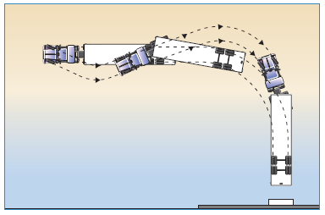
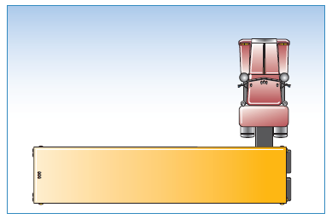
MELT Class 1 Driver Training
Backing Basics
Notes:
Instructor notes:

Slide 2
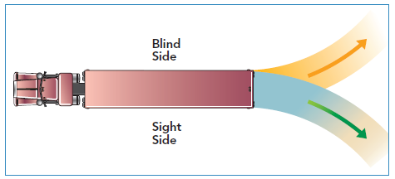
Blind side – Sight side
Notes:
Instructor notes:

Slide 3
General tips for backing
Start in the best position
Adjust your mirrors
Turn on 4-way flashers
Get out and look (GOAL)
Silence your audio and roll down the window
Sound horn
Use mirrors on both sides
Back slowly
Don’t be in a hurry
Back and turn toward the driver's side
Back out of traffic
Notes:
Instructor’s notes:

Slide 4
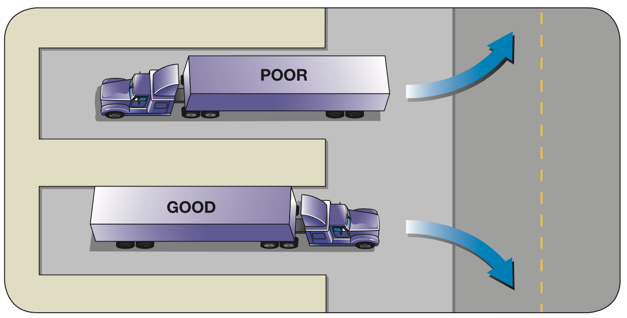
Back out of traffic
Notes:
Instructor’s notes:
It’s easier to back out of traffic than into traffic. In the picture the driver in the vehicle at the top drove straight into the loading dock and will now have the difficult task of backing into traffic to get back onto the road. The driver in the vehicle at the bottom backed out of traffic into the loading dock and can now easily drive forward to get back onto the road.

Slide 5
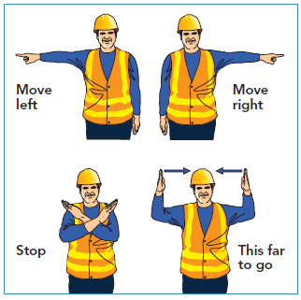
Use a guide
Notes:
Instructor notes:
Use a reliable guide whenever one is available. The guide should stand near the back of your vehicle where you can see them in the driver’s side mirror. If you cannot see your guide, stop! The image below shows hand signals used for backing.
Demonstrate hand signals and have the trainees state what the hand signal means.
Have the trainees divide into groups of two. Have them establish hand signals between them.
Emphasize that both the driver and the guide should have an understanding of what signals will be used when backing up.
As long as both the driver and the guide understand which signal is used for each movement there is no wrong way to communicate.

Slide 6
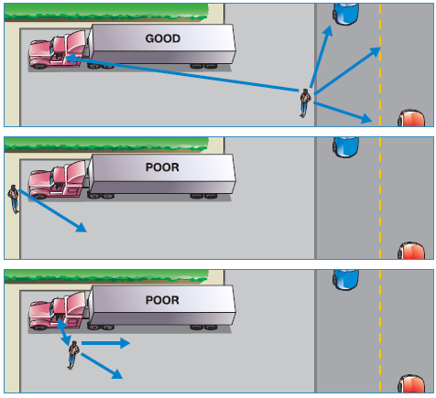
Guide placement
Notes:
Instructor notes:

Slide 7
Straight line backing
The earlier a drift is detected, the less steering input will be needed to correct.
It’s easier to start over than to reposition the vehicle while backing.
Use reference points.
Check mirrors on both sides to help stay in a straight line.
Honk twice when you start your backing and then again for every vehicle length as you proceed backwards.
If you’re backing to a loading dock, remember to open the trailer doors before you reach the building.
Notes:
Instructor notes:

Slide 8
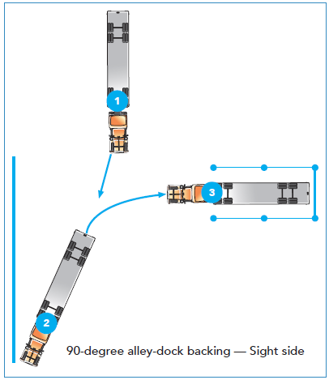
Alley-Dock backing
Notes:
Instructor notes:
90 Degree Reversing, Driver Side (Left Side)
Reversing to the left provides a clear view in the left mirror of the space you are reversing into. Drive the tracker-trailer forward out of the starting position and align it with the target space while driving forward into the pull up area.
Secure the vehicle and start reversing and turn the steering wheel to the right to move the trailer to the left. Once the trailer is curving towards the space, turn the steering wheel to the left and let the tractor follow the trailer into the space.
When the trailer is in line with the parking space, turn the steering wheel even more to the left to straighten the tractor in relation to the trailer. Slowly finish reversing into the loading dock or parking space. Stop the vehicle when the desired position is reached.
90 Degree Reversing, Blind Side (Right Side)
Reversing from the blind side uses the same steps as Driver side reversing. However, it is harder to see where you are going. Once the reversing has started, you will mostly be using the right side mirror, including the convex mirror.
You should stop often and get out of the tractor to check your position.

Slide 9
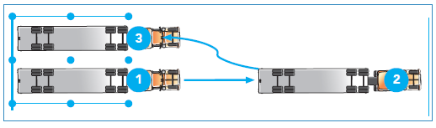
Offset backing
Offset backing (right and left) (5:14)
https://www.youtube.com/watch?v=0u25cTDYEoQ
Notes:
Instructor notes:
To offset back a tractor-trailer to a left spot;
Drive the tractor-trailer forward until the front of the tractor is 1.5 times the total unit length past the front of the parking lane.
Prior to reversing, walk around the vehicle in a counter clock-clockwise direction and check for obstacles, possible hazards and clearance. After re-boarding, check mirrors and put the gear in reverse. Always select the lowest reverse gear available. Release park brake, start reversing, turning the steering wheel to the right to move the trailer to the left.
Begin to turn the steering wheel to the left direction at the appropriate time, aligning the trailer with the adjacent lane.
Straighten the truck and trailer, and continue to reverse into the final parking position.
To offset back a tractor-trailer to a right spot;
Drive the tractor-trailer forward until the front of the tractor is 1.5 times the total unit length past the front of the parking lane.
Prior to reversing, walk around the vehicle in a counter clockwise direction and check for obstacles, possible hazards and clearance. After re-boarding, check mirrors and put the gear in reverse. Always select the lowest reverse gear available. Release park brake, start reversing, turning the steering wheel to the left to move the trailer to the right.
Begin to turn the steering wheel to the right direction at the appropriate time, aligning the trailer with the adjacent lane.
Straighten the truck and trailer, and continue to reverse into the final parking position.

Slide 10
Parallel parking
YouTube Video
Parallel parking (1:53)
https://www.youtube.com/watch?v=EHjK7ZWkDOI
Notes:
Instructor notes:
Parallel parking involves backing into a space along a curb or dock.

