Slide 1
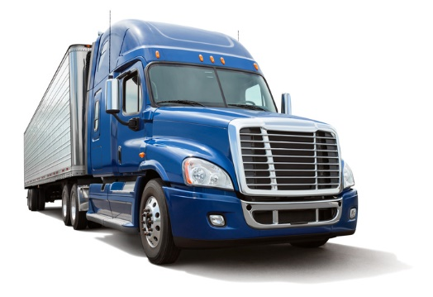
MELT Class 1 Driver Training
Defensive and cooperative driving
Notes:
Instructor notes:

Slide 2
Lesson overview
Use defensive and cooperative driving strategies
Identify hazards and conflicts
Communicate effectively with other road users
Understand how driving conditions affect safety
Appreciate how the size and weight of a tractor-trailer affects other road users
Recognize common situations that lead to crashs and explain strategies to avoid them
Understand that personal attitudes and good driving habits are key to preventing crashs
Understand the challenges of driving in adverse conditions.
Notes:
Instructor notes:
The purpose of this unit is to explain the importance of professionalism, defensive driving and to teach students how to drive in a safe manner, regardless of the actions of others.

Slide 3
Defensive and cooperative driving
What do these mean to you?
Cooperative driving
Pro-active driving
Defensive driving
Notes:
Ask: what do these terms mean to you?
There is no one correct answer. This initial discussion is to get students to think about how they think about driving, allow them to share their experiences and introduce them to the concepts of defensive and cooperative driving. Use questions to get the students to expand on their ideas.
Defensive driving
Using driving strategies that minimize risk and help avoid collisions.
Involves being proactive and anticipating potential conflicts and hazardous situations and taking action early to eliminate the conflict.
Cooperative driving
Analyzing how you are affecting others rather than just how others are affecting you
Driving in a way that assists the safe flow of traffic and use of the roadway. This fosters a pro-social mindset and the understanding other road users perspectives in a not-so-perfect driving environment.
Never using your vehicle to intimate or bully other vehicles on the road.

Slide 4
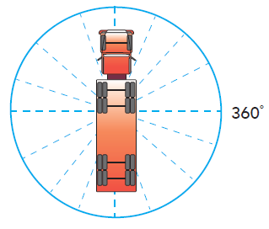
Zones of awareness
Notes:
Instructor notes:
Many drivers are content to limit their awareness to the things they can observe through the windshield, with an occasional glance in their mirrors. A defensive driver, however, realizes a hazard can come from any angle and that their zone of awareness must include a full 360˚ area around the vehicle as well as above and below the vehicle.

Slide 5
Hazard detection system
See
Scan and identify any real or potential hazards or conflicts
Predict and decide
Execute your decision
Do
Think
Notes:
Instructor notes:
See-think-do is a hazard detection system
Use your eyes to see and your mind to analyze what you see for potential dangers. A system that works well is see, think, do

Slide 6
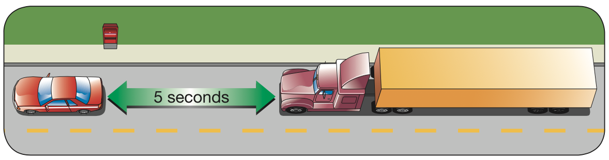
Defensive driving and space management
YouTube video (2:52)
https://www.youtube.com/watch?v=7u4n2vTHzoo
(Image source: ICBC Drive Commercial Vehicle Manual)
Notes:
Instructor notes:
A driver needs to be aware of space – space occupied by their vehicle. You are the largest vehicle on the road and any other vehicle is small and fragile.
Remember there are 6 sides to every truck (front, back, left, right, above, below). You must be mindful of all the possible obstacles and know how to effectively control your space.
Space in front is most important. Making sure you have enough time to stop is the only way to avoid hitting the vehicle in front.
Emphasize the importance of staying within the speed limit. Otherwise, drivers will be constantly overtaking other drivers and having to pass. Drivers can never have the desired space in front if they speed.
Discuss how much space to leave in front and how that space increases as the length and the speed of the rig increases. 1 second driving time for every 10 feet of truck length. An extra second should be added if you are going over
Stress the professional driver’s responsibility to maintain an adequate space cushion.
Stress the rule of adding more space because of bad weather, poor visibility, or bad road conditions. When conditions are less than ideal, increase the number of seconds and adjust your following distance.

Slide 7
Stopping distance and stopping time
Total stopping distance is the distance your vehicle will travel from the moment you:
  See — a hazard
  Think — decide to stop
  Do — place your foot on the brake pedal until you stop
It takes about 3/4 of a second of perception time to see the problem (see-think) and another 3/4 of a second to react (do).
Only then will your vehicle begin to slow down.
Notes:
Instructor notes: This slide and the next three are a review of information covered in the air brakes unit.
Stopping distance is the time the vehicle travels from the time the hazard is seen until the vehicle is stopped.
Total stopping distance or time depends on the ability of the brakes linings or pads to produce friction, the brake drums to dissipate heat and the tires to grip the road.
Ask: what else can affect your stopping distance? (i.e. brake shoe or pads worn, drums or rotors worn, tires worn, road conditions.)
Reaction time is the time it takes from when you see the hazard to the time the brakes are applied.
Brake lag is the time it takes the air pressure to apply the brakes. See next slide.

Slide 8
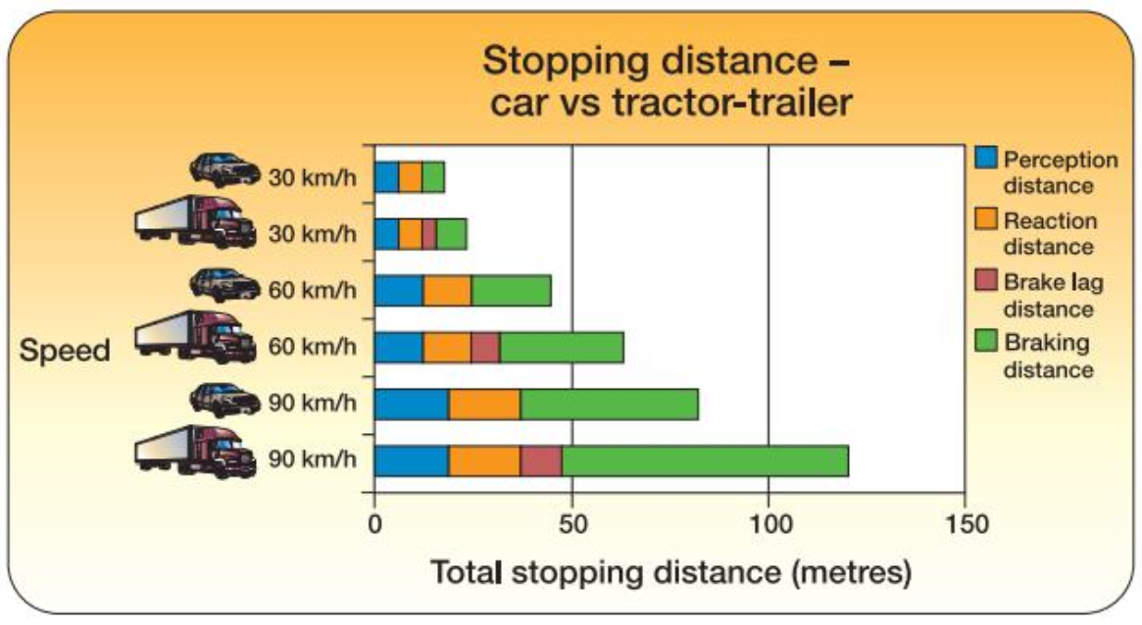
Following distance
Notes:
Instructor notes:
Review stopping distances.
Cars and light truck drivers follow the two-three second rule.
Large heavy vehicles – minimum of five seconds behind the vehicle ahead at highway speeds or one second for every ten feet of total vehicle length. This could be up to seven seconds with a fully loaded trailer. Stay even further back when conditions are less than ideal
Ask: how do you count following distance? Demonstrate if no one knows.

Slide 9
Speed and weight effects on stopping
Speed and weight affect the stopping power required to stop any vehicle, and how far it will travel before it stops.
You need more stopping power when the speed you’re travelling, and/or the weight of your vehicle, increases:
2 ✕ vehicle speed requires 4 ✕ the stopping power,
2 ✕ vehicle weight requires 2 ✕ the stopping power, and
2 ✕ vehicle speed and 2 ✕ vehicle weight requires 8 ✕ the stopping power.
Notes:
Instructor notes:

Slide 10
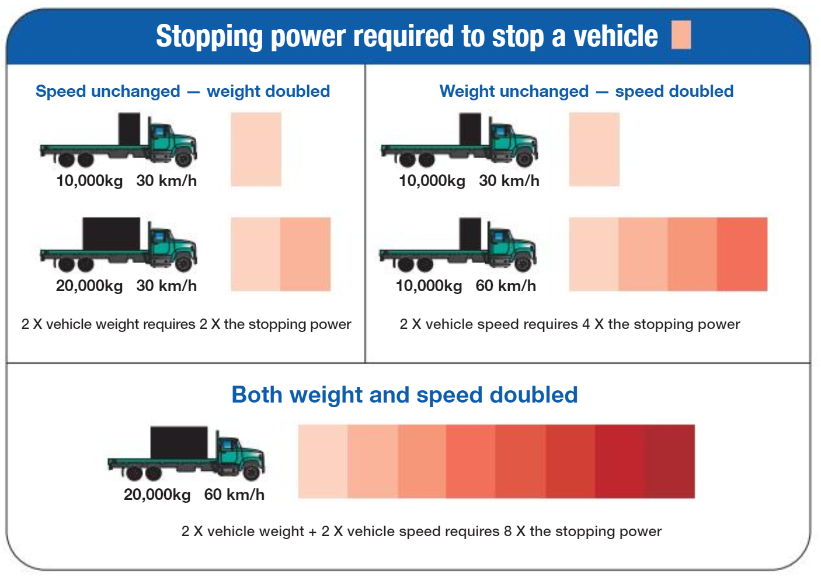
Stopping power
Notes:
Using questions, review stopping power required to stop large vehicles. This information is

Slide 11
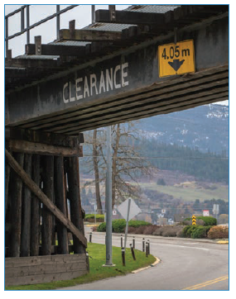
Space all around
In front
To the sides
To the rear
Above
Below

Slide 12
Developing good visual habits
Keep your eyes moving
YouTube video (41 seconds )
https://www.youtube.com/watch?v=2INaqewU518
Notes:
Watch and discuss video
Continuously scanning our surroundings on and off the road leads to good visual habits. As well as looking ahead, you should be scanning to the sides and behind your vehicle. Watch road signs and check your vehicle’s instruments. Your eyes should be continually moving from far to near.
To do this well, you must avoid distractions while driving. Using the phone or radio, eating or other activities, and visual distractions outside of the vehicle, such as a cargo issue or traffic incident, can all cause you to miss key information.
Discuss how to use your eyes
Discuss good visual habits tips
Discuss blind spots
Discuss eye health

Slide 13
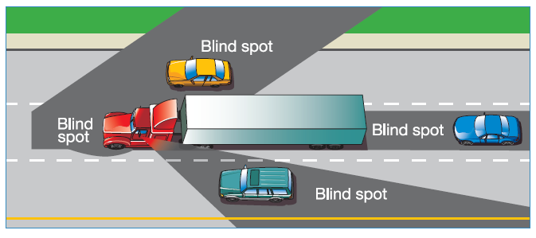
Blind spots

Slide 14
What can these other senses tell you?
Hearing
Feeling
Smelling
Spider senses
What would you pay attention to?
Have you had an experience with this in your own vehicle?
Discuss in your groups.
Notes:
Hear
The sound of car horns, train whistles, children playing and the sound of other vehicles are all examples of messages we receive through hearing and are indicators of potential hazards.
Listening to the sound of your own vehicle can help you identify maintenance problems that can lead to a crash if left unattended.
To gain the greatest advantage of your hearing, avoid playing the stereo or radio excessively loud and keep other in-vehicle noises at a low level.
Feel
As we drive, our bodies are in contact with various parts of the vehicle, our hands on the steering wheel, our bodies in the seat and our feet on the pedals.
The vibrations caused as the wheels roll over the road surface are transmitted through the vehicle to our bodies.
These vibrations can tell us much about the road surface and how our vehicle is ‘holding’ the road.
For example, if the steering feels “light”, the road is slippery.
Smell
Can your nose really warn you of a potential driving hazard? Yes! The signals tend to be subtler and you must learn to interpret them with experience.
Smell may give the driver early indication of a possible problem with their vehicle such as the smell of hot oil, rubber, or anti-freeze. Early detection of a vehicle problem allows the driver more time to find a safe location to park and have the problem dealt with.
“Spider” senses
When you just know something isn’t right, pull over and inspect your vehicle.

Slide 15

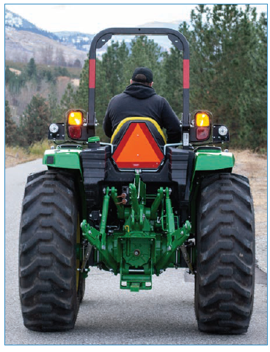
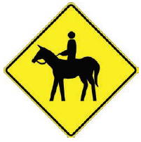
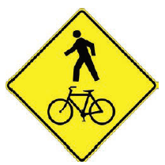
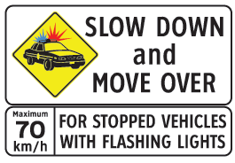

Sharing the road
Pedestrians
Cyclists
Motorcycles and smaller vehicles
Work zones
Slow moving vehicles
Emergency vehicles
Horses
Notes:
Key points
One of the most important aspects of proactive and defensive driving is recognizing potential hazards before they become a real hazard.
Early recognition allows the time you need to avoid trouble. It is vitally important that you recognize and become immediately aware of what you see while driving.
It is important to understand how others perceive your vehicle. For example, they may not know how long it takes you to stop or that the trailer will track to the inside of the corner.
Discuss those we share the road with from a commercial driver’s perspective.

Slide 16
Driving conditions – watch for surprises!
Frozen snow from truck smashes car window
YouTube video(1:08)
https://www.youtube.com/watch?v=jGNDPHqUslg
Notes:
Show this video as a way to introduce the topic of driving conditions.
Discuss a driver’s responsibility to clear snow and ice from their vehicle.

Slide 17
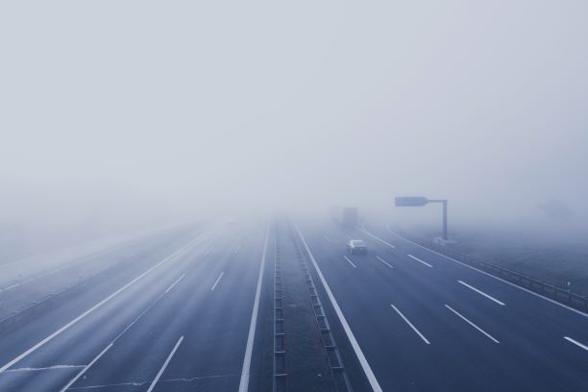
Six conditions of driving
Light
Weather
Road
Traffic
Vehicle
Driver
Notes:
Instructor notes:
See information in the student guide.
There are six basic conditions in any driving situation; your ability to adjust to these conditions will increase your chances of avoiding a crash. It is the driver’s responsibility to adjust to these changing conditions.

Slide 18
Crash avoidance
Vehicle ahead – travelling in same direction
Another vehicle passing you
Ground clearance such as railway crossing
Vehicle behind – travelling in same direction
Vehicle approaching intersection or at an angle
You passing another vehicle
Someone driving beside you
Oncoming vehicle
Overhead objects
What risks or situations could happen when driving under these situations?
How could you reduce your risk or the risk to others?
Notes:
Instructor notes:
Conduct small discuss groups to answer the questions and report back to the whole class.
Each of three groups get a different coloured set of topics.
See supporting information in the student guide.

