Slide 1
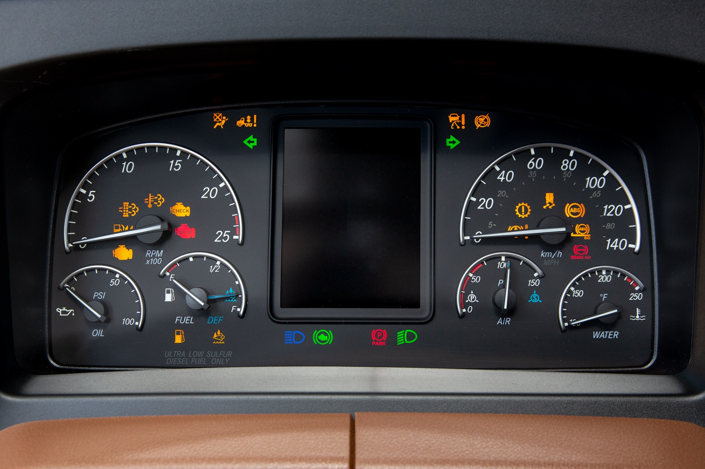
MELT Class 1 Driver Training
Gauges, switches, warning lights and indicator symbols
Notes:
Instructor notes:

Slide 2
Lesson overview
Locate and operate all typical primary and secondary controls, gauges, switches and instruments
Explain the instrument panel indicators displaying important vehicle operating information, warning and safety system status.
Notes:
Instructor notes:
The purpose of this section is to familiarize trainees with the information available on the dash of a typical tractor-trailer. It outlines the location and function of typical gauges, and the normal operating range for each. Information on how and when to operate the control switches, as well as a description of typical warning lights and symbols, and what to do when you see these light up, are also included.

Slide 3
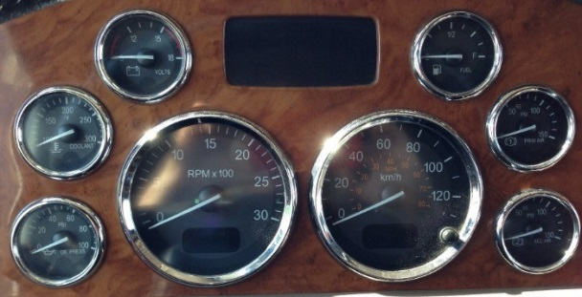
Gauges
Gauge (Instrument)
A device that displays the measurement of a monitored system by the use of a needle or pointer that moves along a calibrated scale.
It is important that you become familiar with the normal ranges as recommended by the vehicle’s operating manual and engine manual.
Notes:
Instructor notes:
Gauges and switches
It is very important to familiarize yourself with the location and types of gauges and switches in a particular vehicle before driving. Knowing where to look for information on the health of the vehicle and knowing where switches are will help you operate the vehicle safely and efficiently.
Gauges: A device that displays the measurement of a monitored system by the use of a needle or pointer that moves along a calibrated scale. The instrument panel in large trucks vary in style and the number of gauges present. For each instrument or gauge, there is a correct and incorrect operating range.
For example, a professional driver should know just by looking at their oil pressure, oil temperature, and water. Temperature gauges that they are in the correct operating range or not. It is important that you become familiar with the normal ranges as recommended by the vehicle’s operating manual and engine manual. You will need to continuously monitor the gauges for any deviations from the safe operating ranges.

Slide 4
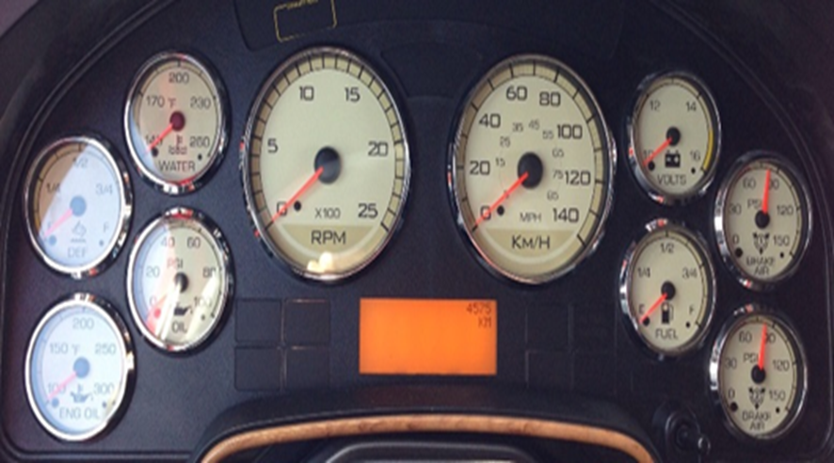
Gauges continued
Speedometer & Message Centre
The speedometer indicates vehicle speed.
The message centre usually contains the following information:
  Odometer
  Trip odometer
  Hour meter
  Warning & diagnostic messages
Notes:
Instructor notes:
Speedometer & Message Centre:
Speedometer indicates vehicle speed. The Message Centre is usually an electronic display at the bottom of the speedometer or somewhere on the instrument panel in front of the driver. It contains the following information:
Odometer
Trip odometer
Hour meter
Warning & diagnostic messages
If your malfunction indicator lamp (MIL), check engine light or stop engine light come on the message centre should display a warning or diagnostic message, pull over to determine the cause when safe to do so. Refer to the owner’s manual or contact a repair shop that specializes in the vehicle you are driving.

Slide 5
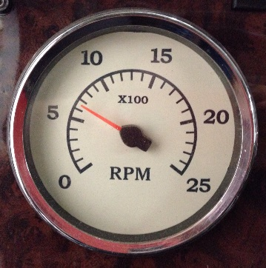
Gauges continued
Tachometer
Displays engine speed in revolutions per minute (RPM).
Notes:
Instructor notes:
Tachometer: Measures engine speed in revolutions per minute (RPM). Provides you with information to allow you to make efficient driving decisions.

Slide 6
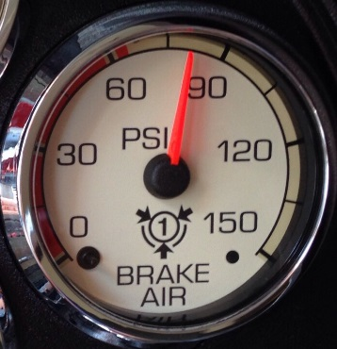
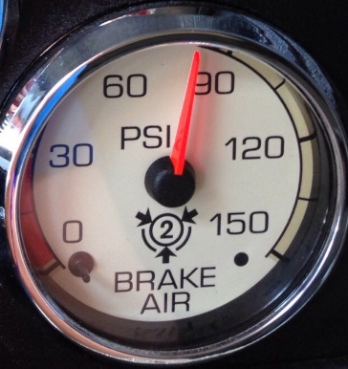
Gauges continued
Air Brake Gauge
Measures the amount of available air pressure in the reservoirs.
The Primary Circuit (top image) usually provides air pressure to the rear tractor brakes.
The Secondary Circuit (bottom image) usually provides air pressure to the front tractor brakes.
Notes:
Instructor notes:
Air Brake Gauges:
Measures the amount of air pressure in the reservoirs.
Indicates the amount of air pressure available for braking
The Primary Circuit (top image) usually provides air pressure to the rear tractor brakes.
The Secondary Circuit (bottom image) usually provides air pressure to the front tractor brakes.
Ensure the air pressure registers more than 100 psi on both gauges before moving the vehicle

Slide 7
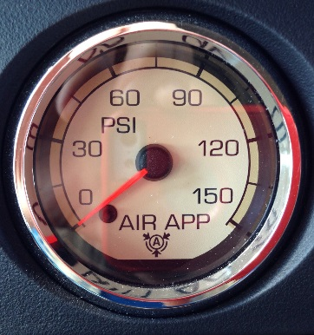
Gauges continued
Air Application Gauge
It measures the amount of air pressure being applied to the service brakes from either the foot valve or hand valve.
Notes:
Instructor notes:
Air Application Gauge:
it measures the amount of air pressure being applied to the service brakes from either the foot valve or hand valve.

Slide 8
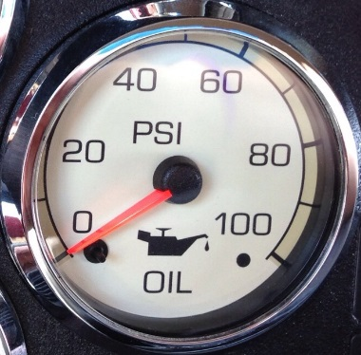
Gauges continued
Engine Oil Pressure Gauge
Measures the force (pressure) of the oil being pumped through the engine in psi.
This gauge should be monitored regularly because inadequate oil pressure can cause engine damage.
Notes:
Instructor notes:
Engine Oil Pressure Gauge:
Measures the force (pressure) of the oil being pumped through the engine in psi
This gauge should be monitored regularly because inadequate oil pressure can cause engine damage
Normally rises and falls between 20-50 psi with engine speed (refer to engine manual for correct oil pressure ranges for your engine)
If oil pressure fails to rise within 10 seconds after the engine starts, stop the engine and determine the cause
If oil pressure suddenly drops while driving, bring the vehicle to a safe stop as soon as possible and turn off the engine. Notify the vehicle owner.

Slide 9
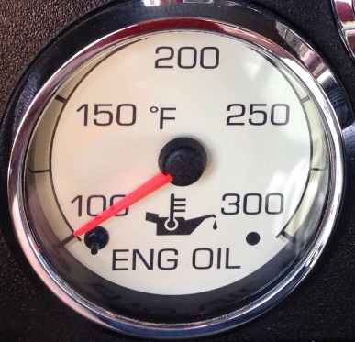
Gauges continued
Engine Oil Temperature Gauge
Measures the temperature of the engine oil.
Viscosity (thickness) of oil is much higher at lower temperatures, and oil subjected to too high of heat can lose its lubrication properties, which results in loss of lubrication of the engine components.
Notes:
Instructor notes:
Engine Oil Temperature Gauge:
Measures the temperature of the engine oil
Viscosity (thickness) of oil is much higher at lower temperatures, and oil subjected to too high of heat can lose its lubrication properties, which results in loss of lubrication of the engine components
In cold temperatures it’s important to slowly accelerate after each shift and not overwork the engine until the temperature reaches its normal operating range.
If oil temperature rises above the normal operating temperature, you should reduce the load being placed on the engine to help reduce the temperature.

Slide 10
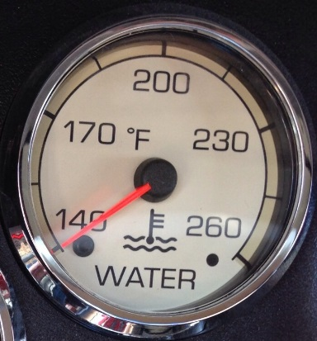
Gauges continued
Water Temperature Gauge
Measures the temperature of the engine coolant.
Should be monitored regularly to avoid engine damage.
Notes:
Instructor notes:
Water Temperature Gauge:
If the engine overheats and the Engine Coolant Temperature warning light illuminates:
Overheating can happen when there are low coolant levels, a sudden loss of coolant, and severe operating conditions such as climbing a steep grade.
If the engine overheats and the Engine Coolant Temperature warning light illuminates:
Down shift to a lower gear to lessen the load on the engine and monitor the gauge.
If the problem persists stop the vehicle but leave the engine running unless a low water warning device indicates a loss of coolant.
With the transmission in neutral, check to ensure that the oil pressure gauge reads normal. Increase the engine speed to about 1100 to 1200 RPM maximum. Return the idle speed to normal after 2 to 3 minutes. If the warning light does not go off or the temperature gauge does not begin to drop, turn the engine off.
If the overheating came from severe operating conditions, the temperature should have cooled by this time. If it has not cooled, stop the engine and let it cool before checking to see if the coolant is low.

Slide 11
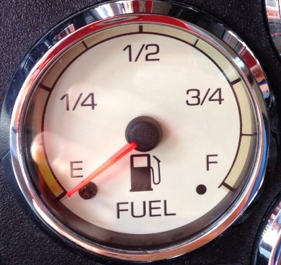
Gauges continued
Fuel Gauge
Measures the approximate level/amount of fuel in your fuel tank(s).
Should be monitored to ensure there is plenty of fuel to reach your destination.
Fuel tanks should be kept at least half full to reduce condensation and a buildup of moisture in the tanks.
Notes:
Instructor notes:
Fuel Gauge:
If you notice that the needle is stuck in one position for too long, this can indicate an issue with the gauge, the sensor in the tank(s), or the fuel is not leveling out between the two tanks. You should stop the vehicle, remove the cap(s), and ensure you still have plenty of fuel to reach your destination.
If it is a leveling problem, one tank may still be full while the tank where fuel is being drawn from is almost empty.

Slide 12
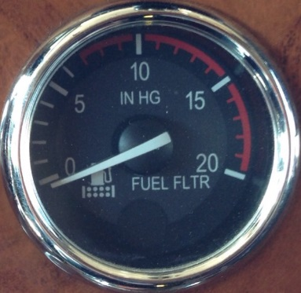
Gauges continued
Fuel Filter Gauge
Indicates the condition of the fuel filter.
Monitors for a dirty fuel filter or one that might be gelling up on a cold day.
If the needle stays in the red zone it can indicate a clog in the fuel filter.
A clogged fuel filter should be changed to maximize engine performance.
Notes:
Instructor notes:
Fuel Filter Gauge:
Usually consists of two sections – white zone and red zone.
Maximum fuel restriction is 8-10 inches of mercury (in HG).

Slide 13
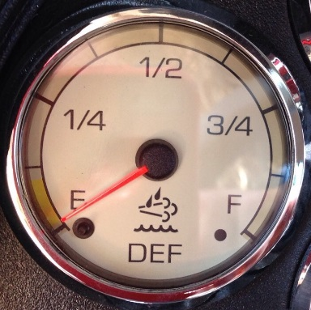
Gauges continued
Diesel Exhaust Fluid (DEF) Gauge
Measures the level of DEF in tank.
If the vehicle is allowed to run completely out of DEF, one of two things will happen:
Engine power will be reduced and speed will be limited, or
Vehicle will not start until there is DEF in the tank.
Notes:
Instructor notes:
Diesel Exhaust Fluid (DEF) Gauge:
A DEF low level warning lamp will illuminate when the DEF is low.
In a vehicle that is not used often, the DEF in the tank may crystallize around the float on the DEF level-sending unit tube and require cleaning.

Slide 14
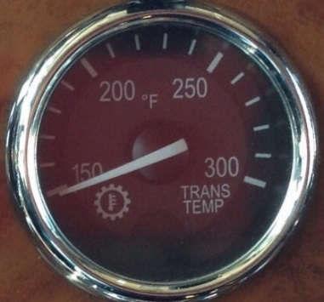
Gauges continued
Transmission Temperature Gauge
Indicates the temperature of the oil in the transmission.
This gauge should be monitored to ensure the transmission does not overheat.
If the transmission overheats, have it checked by a mechanic.
Notes:
Instructor notes:
Transmission Temperature Gauge
The normal operating range for most transmissions is 180°F to 240°F (refer to transmission owner’s manual for normal operating range)
Maximum transmission temperature is around 250°F, but it may vary depending on the type of transmission and the type of lubricant used (refer to transmission owner’s manual for maximum temperature allowed).

Slide 15
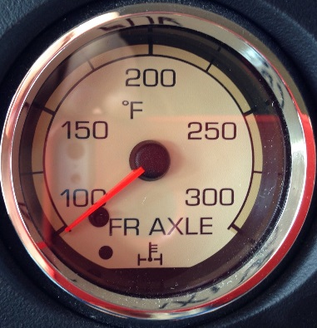
Gauges continued
Front & Rear Drive Axle Temperature Gauges
Measures the temperature of the lubricant in the front and rear drive axles.
Temperatures vary with the type of load, driving conditions, and type of lubricant.
High temperature readings indicate you should have the axle lubrication checked.
Driving with very hot temperatures in your rear drive axles can cause serious damage to axle bearings and seals.
Notes:
Instructor notes:
Front & Rear Drive Axle Temperature Gauges
Normal operating temperatures can range between 80°F-220°F depending on the type of manufacturer (refer to owner’s manual for normal temperatures for your vehicle).
Maximum axle temperature may vary depending on the axle and type of lubricant. It is normal for the front axle to read higher than the rear axle.
When the truck is under a load such as climbing steep grades, it is not unusual for the temperatures to exceed the normal operating range as long as the temperature returns to normal when the load decreases.

Slide 16
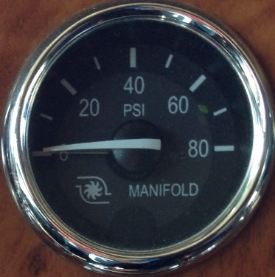
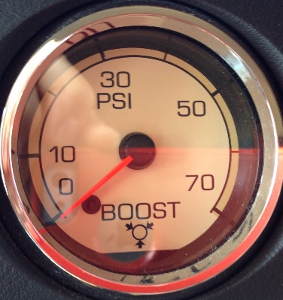
Gauges continued
Manifold Pressure/Turbo Boost Gauge
Indicates the power the engine is putting out by showing the amount of turbo boost in psi.
The amount of psi indicated on the gauge will vary depending on the load placed on the engine.
Notes:
Instructor notes:
Manifold Pressure/Turbo Boost Gauge:
The name and look of this gauge may vary from truck to truck, but they perform the same function.
A driver can drastically improve fuel efficiency by monitoring and attempting to keep the pressure low when accelerating.
If the pressure goes down when the engine is under a load, there may be something wrong with the engine, and it should be checked by a mechanic.

Slide 17
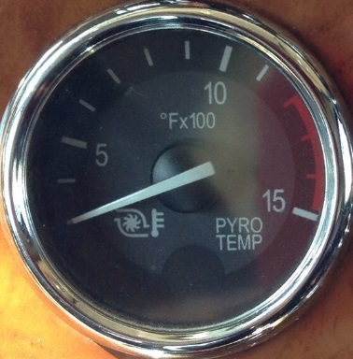
Gauges continued
Pyrometer
Indicates engine exhaust temperature.
Monitoring engine exhaust temperature is a more effective and efficient way to recognize early signs of engine problems over any other method.
Mostly present on older trucks with mechanical engines.
Notes:
Instructor notes:
Pyrometer:
Refer to owner’s manual for normal operating temperatures.
Sustained high temperature can lead to engine failure.
Higher exhaust temperatures can be a result of these basic causes:
Excessive fueling (heavy acceleration or faulty fuel system
High intake ambient air temperature
Restricted air flow
Lugging the engine (improper acceleration or shifting)

Slide 18
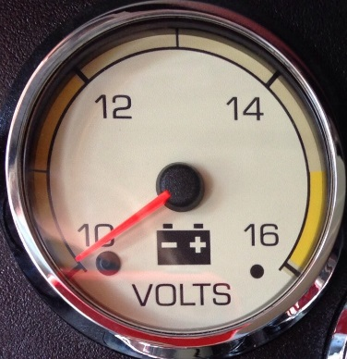
Gauges continued
Voltmeter
Displays the voltage at which the batteries are being charged while the engine is operating.
Displays the stored voltage in the batteries when the ignition is turned on.
Monitoring this gauge can help drivers to anticipate charging issues before they become major problems.
Notes:
Instructor notes:
Voltmeter:
A fully charged battery will typically read between 12-14 volts, and it should stay within this range unless there is a heavy pull on the electrical system.
If the gauge stays below 12 volts (undercharged) or goes above 15 volts (overcharged), you should have the system checked.

Slide 19
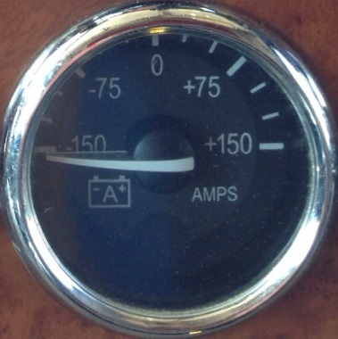
Gauges continued
Ammeter (Amp Gauge)
Measures the current electrical draw on the batteries.
Indicates how many amps are being delivered by the alternator to your electrical system.
Normal operating range should be slightly above zero.
Notes:
Instructor notes:
Ammeter (Amp Gauge):
A constant high reading may indicate a battery is drawing current from the alternator for the wrong reasons.
A constant negative draw is a good indication that the alternator is not working properly.

Slide 20
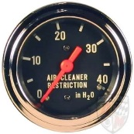
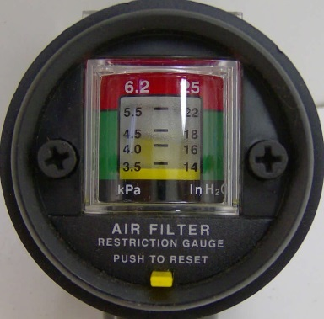
Gauges continued
Air Filter Restriction Indicator or Gauge
Indicates the condition of the engine air cleaner.
Measured by inches of water (inH20) or kilopascals (kPa).
Notes:
Instructor notes:
Air Filter Restriction Indicator or Gauge:
The type of gauge may vary from truck to truck, but they perform the same function.
A clean filter should register at approximately 7 inH₂0 (1.7 kPa) (this may vary based on system design)
A filter whose life is over will register approximately 25 inH₂0 (6.2 kPa) and may cause damage to the engine. The filter should be inspected and replaced if necessary.
Holes in the paper element render an air cleaner useless and may cause the gauge to display a false reading even if the paper element is clogged.
Replace the paper element if it is damaged.

Slide 21
Gauges tour
YouTube video (9:16)
2004 Peterbilt379 Gauges Tour
Dave reviews each gauge on the dashboard of his 2004 Peterbilt 379
https://youtu.be/b2c564JGgcI
Notes:
Instructor notes:

Slide 22
Switches
A device for making and breaking the connection in an electrical circuit.
Switches are either off or on, engaged or not engaged.
Switches control important functions, so it is essential to know:
where they are,
when to use them, and
if they are in the correct operating position.
Notes:
Instructor notes:
Switches:
Different manufacturers of trucks will have different types, styles, and configurations of switches. The switches will be identified by either names or symbols.
They could be rocker, toggle, button, or some other style. For these reasons, it is important that you become familiar with all of the controls of the vehicle you are driving, and refer to the owner’s manual if necessary.

Slide 23
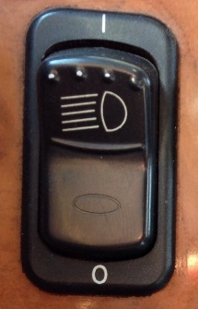
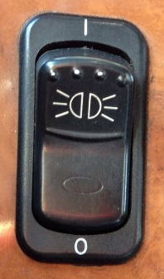
Switches continued
Headlights
When the headlights are ON, the dash lights, front park lights, side marker lights, and tail lights are also illuminated.
ID & Clearance Lights
These are the amber lights on the top of the cab, top of the trailer in the front and on the sides, and the red lights at the top of the rear of the truck and trailer.
Notes:
Instructor notes:
Headlights
Turning on the headlights will turn the daytime running lights off.
Push switch UP to turn lights ON.
Push switch DOWN to turn lights OFF.
ID & Clearance Lights
To turn ID & clearance lights ON and OFF.
Push switch UP to turn lights ON.
Push switch DOWN to turn lights OFF.

Slide 24
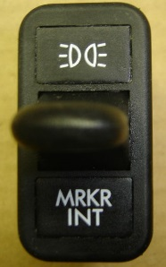
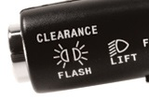
Switches continued
Marker Interrupter/ID & Clearance Lights Flash
Used to thank other drivers who display courteous behavior. Generally used at night to thank other drivers who assisted you in passing them.
Both types can be flashed multiple times to thank drivers by alternately pushing and releasing the switch or button.
Notes:
Instructor notes:
Marker Interrupter / ID & Clearance Lights Flash
It can be a switch on the dash (above image), or else a button on the end of the headlight dimmer lever located on the steering column.
Dash switch:
Push switch DOWN to momentarily turn OFF all marker and clearance lights.
RELEASE switch to turn the lights ON.
Lever button:
Push button IN towards the steering wheel to momentarily turn OFF all marker and clearance lights.
Release button to turn the lights ON.

Slide 25
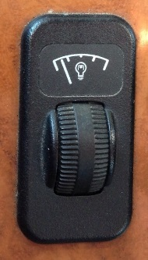
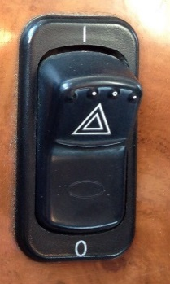
Switches continued
Panel Light Dimmer
To vary the brightness of the instrument panel lights.
Dimming the panel lights at night can help to increase visibility of the road ahead, and decrease the strain placed on your eyes.
Hazard Lights/Four-Way Emergency Flasher
To be used when the vehicle is disabled, parked under emergency conditions, or any time you have to stop off the road or on the side of the road, day or night.
Notes:
Instructor notes:
Panel Light Dimmer
When the headlight switch is on:
Rotate the thumb wheel UP to BRIGHTEN the panel lights
Rotate the thumb wheel DOWN to DIM the panel lights.
Hazard Lights / Four-Way Emergency Flasher
To warn other motorists that you are stopped so they can easily avoid you.
All turn signals on both the truck and trailer will flash simultaneously.
The flasher will work when the ignition switch is in the ON or OFF position.
Push switch UP to turn lights ON.
Push switch DOWN to turn lights OFF.
Used in conjunction with emergency flares/reflectors.

Slide 26
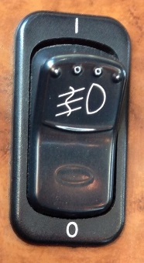
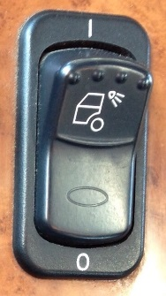
Switches continued
Fog Lights/Driving Lights
To be used in foggy or blizzard like conditions to assist with visibility.
State and Provincial requirements vary as to when high beams and fog lights can and cannot be used together.
Work Light
Most or all power units come equipped with lights mounted to the side of the cab or bunk.
Use these lights at night when backing up, coupling, and uncoupling.
Notes:
Instructor notes:
Headlights
Turning on the headlights will turn the daytime running lights off.
Push switch UP to turn lights ON.
Push switch DOWN to turn lights OFF.
ID & Clearance Lights
To turn ID & clearance lights ON and OFF.
Push switch UP to turn lights ON.
Push switch DOWN to turn lights OFF.

Slide 27
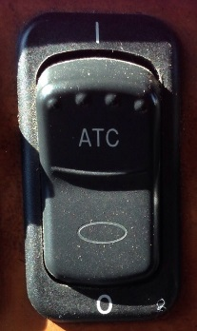
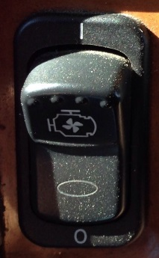
Switches continued
Automatic Traction Control (ATC)
When turned ON, a Wheel Spin Control warning light will illuminate and allows for additional wheel spin before the power will be reduced.
Engine Fan Override
Allows you to control the engine fan manually or automatically.
Notes:
Instructor notes:
Automatic Traction Control (ATC)
The Automatic Traction Control (ATC) switch is a momentary switch. Briefly push the top of the switch to activate or deactivate it.
The ATC system limits wheel spin when power is applied to the drive axles during reduced-traction situations. When the ATC is active, the ATC will apply gentle braking to the spinning wheel, to force power to the wheel(s) with better traction. If both wheels are spinning, the system will signal the electronic engine to reduce power.
Pressing the ATC switch will temporarily allow more drive wheel spin, to help burn through a thin layer of ice, or to help throw off accumulated mud or snow. When the switch is activated, an ATC or WHEEL SPIN icon located in the driver's message center will blink slowly. Pressing the switch again will cycle the system back to normal operation.
Engine Fan Override
Push switch UP to turn the fan ON.
Push switch DOWN to turn the fan OFF.
When the switch is ON, the fan will run regardless of engine temperature.
When the switch is OFF, the fan will automatically cut in when the coolant reaches cut in temperature and cut out once the temperature has dropped to the normal operating range.
Do not operate the engine fan in the manual (ON) position for extended periods of time. It was designed for intermittent operation only.

Slide 28
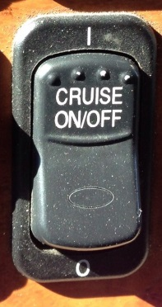
Switches continued
Cruise Control On/Off
Advantages of cruise control include:
Improving driver comfort.
Maintaining a consistent speed.
Improving fuel economy by keeping a steady speed and letting the engine do the work.
Notes:
Instructor notes:
Cruise Control On/Off
This master switch turns the cruise control ON or OFF.
Push switch UP to turn cruise control ON.
Push switch DOWN to turn cruise control OFF.
Only use cruise control when conditions are ideal.
When conditions are less than ideal, turn the cruise control OFF to maintain better control of the vehicle and increase reaction time.

Slide 29
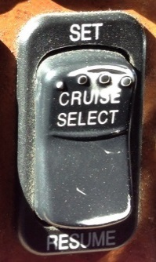
Switches continued
Cruise Control Set/Resume
When the master switch is ON, it is used to SET the desired speed, and to RESUME the desired speed when the cruise control has been interrupted.
When the master switch is ON, it is used to SET the idle speed while the truck is parked with the engine running.
Notes:
Instructor notes:
Cruise Control Set/Resume
Cruise control:
Push switch UP to SET desired speed and release.
Push switch DOWN to RESUME a previously set desired speed and release.
When the cruise is set and on:
Push the switch UP to INCREASE the desired speed.
Push the switch DOWN to DECREASE the desired speed.
Setting Idle speed:
Use accelerator to bring the idle up to desired RPM, and push switch UP to SET.
Push switch DOWN to RESUME idle speed.
Some trucks will have the idle speed preset, and then all you have to do is either push the switch UP or DOWN to set depending on the manufacturer.

Slide 30
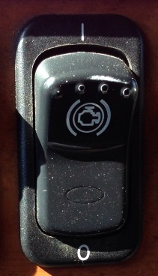
Switches continued
Engine Brake On/Off
Turns the engine brake on and off.
The engine brake is also controlled by the throttle pedal and clutch pedal.
Notes:
Instructor notes:
Engine Brake On/Off
To turn the engine brake ON or OFF.

Slide 31
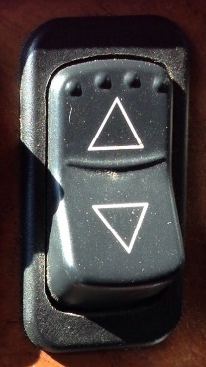
Switches continued
Engine Brake Mode Selector
Selects the progressive braking function that controls the amount of retarding/braking.
Most trucks are equipped with 3 modes to select from: LOW, MEDIUM, HIGH.
Notes:
Instructor notes:
Engine Brake Mode Selector
Most switches are designed to be used this way:
Push UP to select the HIGH mode which will give the most braking power.
Set switch to the MIDDLE for MEDIUM braking power.
Push switch DOWN for LOW braking power

Slide 32
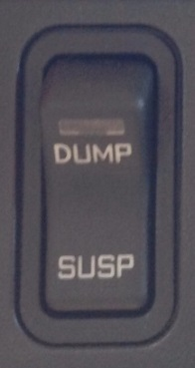
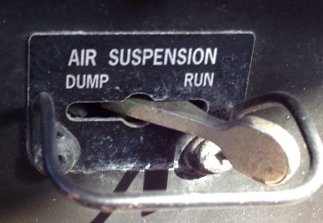
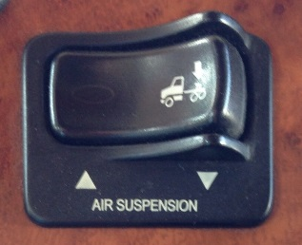
Switches continued
Air Suspension Dump Switch
Used to dump the air out of the rear suspension of the truck.
Notes:
Instructor notes:
Air Suspension Dump Switch
This will help to avoid placing added stress on components, and to avoid scraping all of the grease off of the fifth wheel plate.
The type of switch may vary from truck to truck, but they perform the same function.
The air suspension should always be in the SUSP, UP, or RUN position unless you are coupling or uncoupling a trailer.

Slide 33
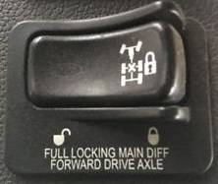
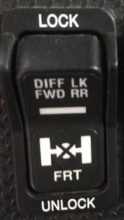
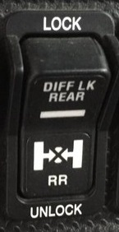
Switches continued
Differential Lock (DCDL)
Also called “main differential lock” or “wheel differential lock.”
Locks both sets of dual wheels on the same axle to ensure they both turn together at the same speed.
Used when operating on slippery or uneven surfaces.
Notes:
Instructor notes:
Differential (Diff) Lock
Not every truck will be equipped with a DCDL (Driver Controlled Differential Lock). This feature comes as an option for the forward drive axle, the rear drive axle, or both. If a truck is equipped with both, there will be a separate switch to operate each one as pictured to the above.
Move the switch to the LOCK position to lock the wheels together. You may experience under steer when DCDL’s are locked.
Move the switch to the UNLOCK position to allow each set of wheels to spin independently. It may not disengage immediately.
The differential lock should only be used at low speeds such as 40 km/h or less.
Do not switch to the LOCK position when the wheels are turning at different speeds. Should be used in conjunction with the PDL/IAD .
This type of operation is typical for most truck manufacturers, but you should always refer to the owner’s manual to ensure you are using the differential lock correctly.

Slide 34
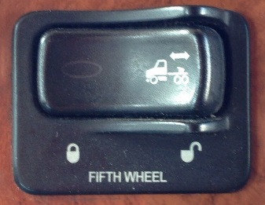
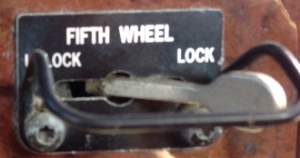
Switches continued
Fifth Wheel Slide Lock
The fifth wheel can be slid to various positions in order to adjust weight distribution between the steering axle and the drive axles.
the fifth wheel can be slid to a position to accommodate a variety of trailers.
Notes:
Instructor notes:
Fifth Wheel Slide Lock
The fifth wheel may be slid to various positions in order to adjust weight distribution between the steering axle and the drive axles.
Never operate the vehicle with the switch in the UNLOCK position.
Always ensure the switch is in the LOCK position and the pins are locked in place before driving the vehicle.
Do not move the fifth wheel while the tractor/trailer is in motion.

Slide 35

Warning lights and indicator symbols
Commercial vehicles are equipped with warning lights and symbols to inform the driver of a change to a system or component.
Notes:
Instructor notes:
Warning lights and indicator symbols
Symbols, lights, and colors may differ slightly between manufacturers. Refer to the owner’s manual before driving.

Slide 36

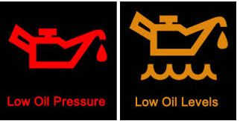
Warning lights and indicator symbols continued
Active Warnings/Exclamation Point
Illuminates when a RED warning is active.
Oil Pressure Warning Lights
May illuminate as the tractor-trailer is being started, but should go off right after the engine starts, if it does not, then the vehicle should be examined.
Notes:
Instructor notes:
Active Warnings / Exclamation Point
Oil pressure warning lights
Low pressure means there either isn't enough oil in the system or the oil pump isn't circulating enough oil to keep the critical bearing and friction surfaces lubricated.

Slide 37
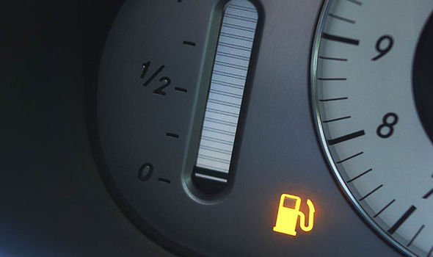

Warning lights and indicator symbols continued
Displays when the fuel level is low; light usually red, or yellow.
Active warning triangle Illuminates when a YELLOW warning is active; usually yellow.
Notes:
Instructor notes:

Slide 38
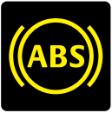
Warning lights and indicator symbols continued
Anti-Lock Brake System (ABS)
Notes:
Instructor notes:
Illuminates when the ignition switch is first turned on and will remain on until the system self-test has been completed successfully. If the light does not illuminate at all or stays on for more than 3 seconds and does not shut off, contact a repair shop as soon as possible.
Illuminates during normal operating conditions to indicate a problem with the ABS system.
Illuminates for a bulb check when the ignition switch is first turned on whether or not a trailer is connected to the vehicle. If the light does not illuminate at all, have the problem checked. If the bulb check is satisfactory, the light will do either of the following next:
With no trailer connected or a trailer not equipped with ABS is connected, the light will go off after one second.
If an ABS equipped trailer is connected properly, the light will remain illuminated for a few more seconds while the trailer ABS is tested. If no problems are detected, the light will go off. If problems are detected, the light will remain on, and the driver should have the problem corrected before the vehicle is driven with that trailer attached.
Illuminates during normal operating conditions to indicate a problem with the trailer ABS.
NOTE:
Tractors/trucks and trailers built after March 1, 2001 must be able to turn on an in-cab trailer ABS warning light.
Trailers built prior to March 1, 2001 are designed to verify ABS status via the required external yellow warning light mounted on the trailer.

Slide 39
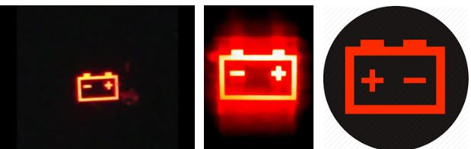
Warning lights and indicator symbols continued
The battery light indicates a battery charging problem.
Inter-Axle Differential Power Divider LOCKED; Illuminates when the Power Divider Lock / Inter-Axle Differential Lock is in the LOCKED position.
Notes:
Instructor notes:
Active Warnings / Exclamation Point
Oil pressure warning lights
Low pressure means there either isn't enough oil in the system or the oil pump isn't circulating enough oil to keep the critical bearing and friction surfaces lubricated.

Slide 40
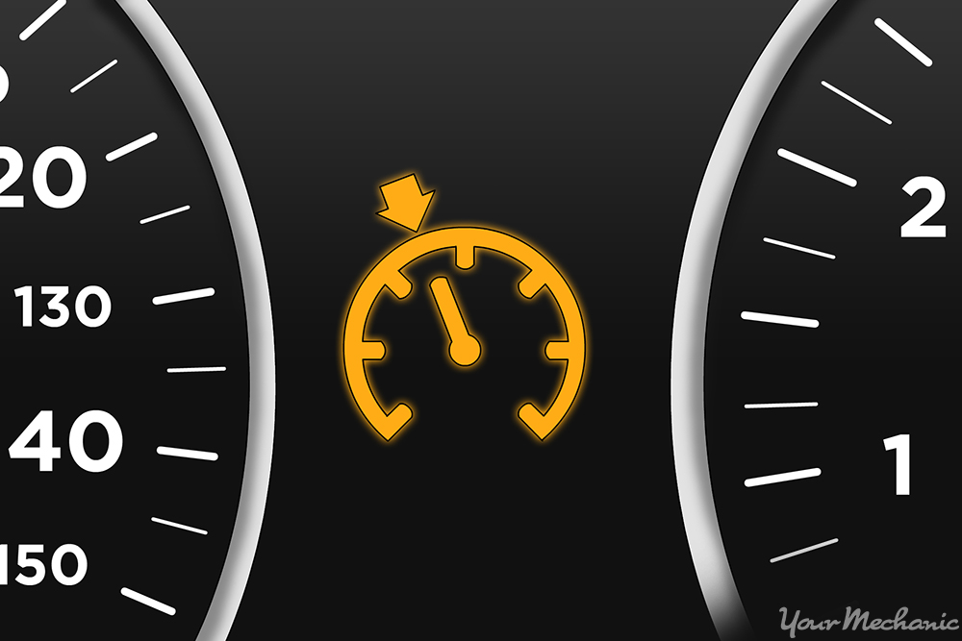

Warning lights and indicator symbols continued
Illuminates when the cruise control is active.
Illuminates when the diesel particulate filter is plugged or when the regeneration operation is active.
Notes:
Instructor notes:

Slide 41
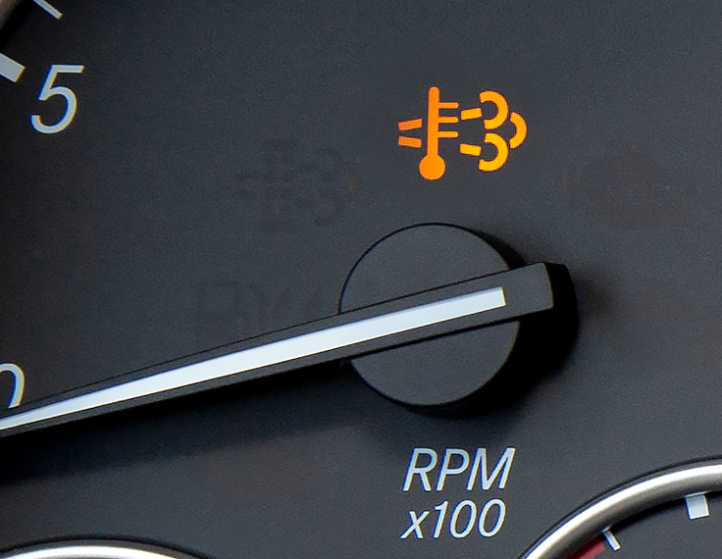

Warning lights and indicator symbols continued
High Exhaust System Temperature (HEST)
Illuminates when the exhaust gas temperature and exhaust components become extremely hot.
Malfunction Indicator Lamp (MIL)
Illuminates when a problem with the engine after treatment system exists. The vehicle can still be safely driven, but the vehicle should be serviced to correct the problem.
Notes:
Instructor notes:

Slide 42
Warning lights and indicator symbols continued
Low Coolant Level
Illuminates with an audible alarm indicating critically low coolant level.
Some trucks will shut down and will not start again until the problem has been corrected.
Notes:
Instructor notes:

Slide 43

Warning lights and indicator symbols continued
Water temperature
This light is displayed when coolant temperature becomes excessively hot.
Engine Brake/Retarder
Illuminates when the engine brake is turned on.
Notes:
Instructor notes:

Slide 44


Warning lights and indicator symbols continued
Check/Stop Engine
Check Engine Illuminates when a minor engine issue occurs.
Stop Engine Illuminates and an audible alarm tone will sound when a major engine system problem exists.
Notes:
Instructor notes:
Stop Engine
This is considered an emergency situation, and you should stop the vehicle as soon as possible and turn the engine off.
The vehicle must be serviced and the problem corrected before driving again to avoid further damage to the engine.

Slide 45
Warning lights and indicator symbols continued
Wait to Start Engine
Illuminates when the intake air heater (grid heater) needs to warm the intake air prior to starting the engine.
Fifth Wheel Slide Unlocked
Illuminates and may have an audible warning tone will sound to remind the driver that the fifth wheel slide is UNLOCKED.
Notes:
Instructor notes:

Slide 46
Warning lights and indicator symbols continued
Park Brake
Illuminates when the parking brake is applied.
Fasten Seat Belt
Illuminates to remind the driver to fasten their seat belt.
Notes:
Instructor notes:

Slide 47
Gauges tour
YouTube Video (9:16)
2004 Peterbilt379 Gauges Tour
Dave reviews each gauge on the dashboard of his 2004 Peterbilt 379
https://youtu.be/b2c564JGgcI
Notes:
Instructor notes:
The instrument panel in large trucks vary in style and the number of gauges present. For each instrument or gauge, there is a correct and incorrect operating range. For example, a professional driver should know just by looking at their oil pressure, oil temperature, and water temperature gauges that they are in the correct operating range or not. It is important that you become familiar with the normal ranges as recommended by the vehicle’s operating manual and engine manual. You will need to continuously monitor the gauges for any deviations from the safe operating ranges.

Slide 48
Kenworth
YouTube video (3:01)
T880 Kenworth Driver Academy
Switches, Cab Climate & Gauges
https://youtu.be/Pzk9Xb3EWkA
Notes:
Instructor notes:
The instrument panel in large trucks vary in style and the number of gauges present. For each instrument or gauge, there is a correct and incorrect operating range. For example, a professional driver should know just by looking at their oil pressure, oil temperature, and water temperature gauges that they are in the correct operating range or not. It is important that you become familiar with the normal ranges as recommended by the vehicle’s operating manual and engine manual. You will need to continuously monitor the gauges for any deviations from the safe operating ranges.

Slide 49
Review quiz (answer key)
ANS:
  primary control systems
  engine control systems
  secondary control systems
ANS: B
ANS: B
ANS: D
ANS: C
ANS: C
ANS: A
ANS: A
ANS: A
ANS: C
ANS: D
ANS: B
ANS: B
ANS: C
ANS: A
Notes:
Instructor notes:

